Slide 1
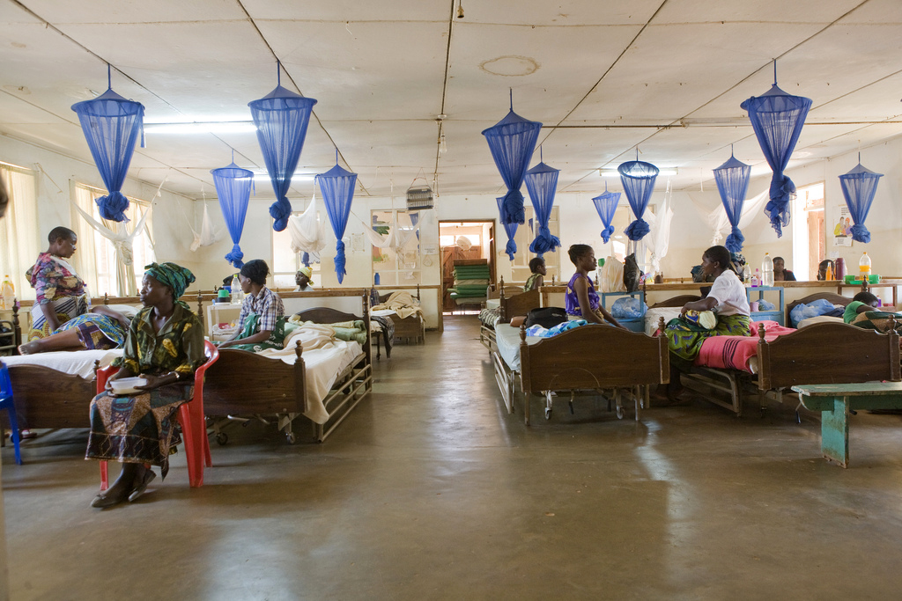

© Bill and Melinda Gates Foundation
Climate resilience and environmental sustainability
in health care facilities

Slide 2
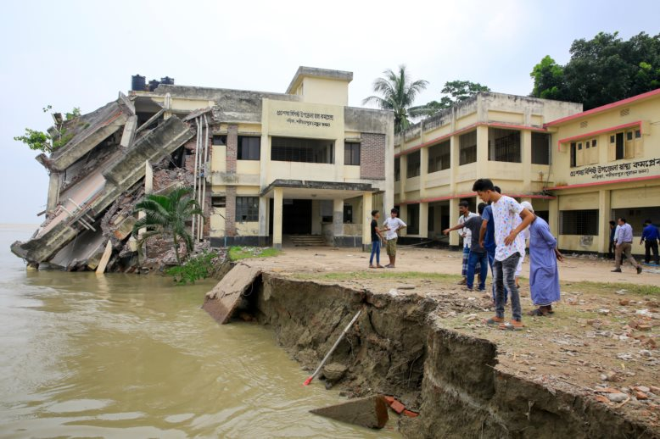
Notes:
Naria Upazila Health Complex building in Shariatpur district falls into the Padma River after severe floodings and river erosion. Shariatpur, Bangladesh
Photo Credit: M Rahman / Alamy Stock Photo (license bought)

Slide 3
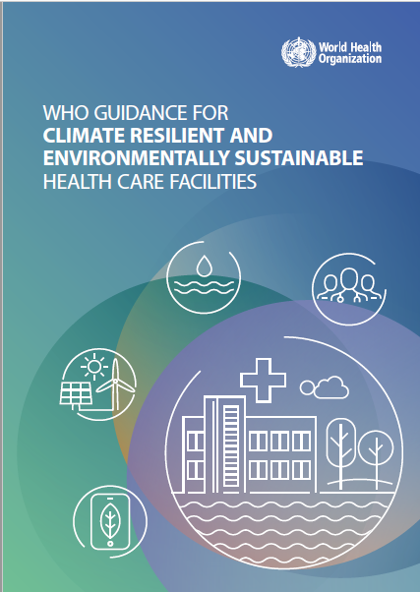
New WHO Guidance on climate-resilient and environmentally sustainable health care facilities
GOALS
To increase the climate resilience of health care facilities to protect and improve the health of their communities in an unstable and changing climate, while optimizing the use of resources and minimizing the release of wastes by becoming environmentally sustainable.
OBJECTIVES
Guide professionals working in health care settings to understand and effectively prepare for the additional health risks posed by climate change.
Monitor, anticipate, manage and adapt to the health risks associated with climate change.
Guide health care facility officials to work with health determining sectors (including water and sanitation, energy, transportation, food, urban planning, environment).
Provide tools to assist health care facility officials assess their resilience to climate change threats, and their environmental sustainability.
Promote actions to ensure that health care facilities are constantly and increasingly strengthened and continue to be efficient and responsive to improve health and contribute to reducing inequities and vulnerability within their local settings.

Slide 4
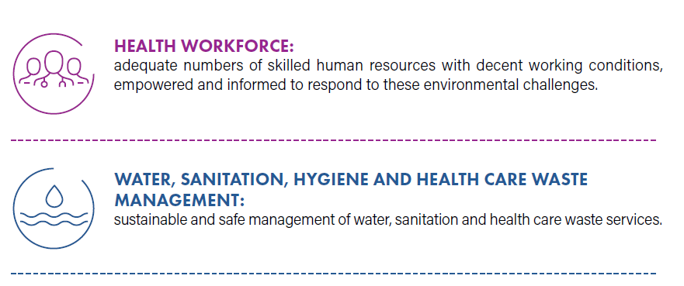
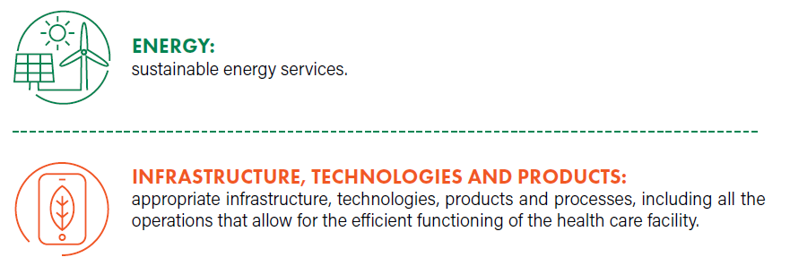
Four fundamental requirements for providing safe and quality care

Slide 5
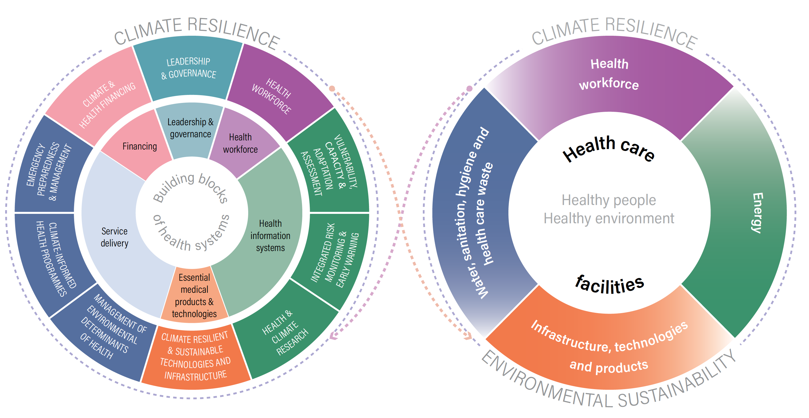
Climate resilience and environmental sustainability in health care facilities

Slide 6
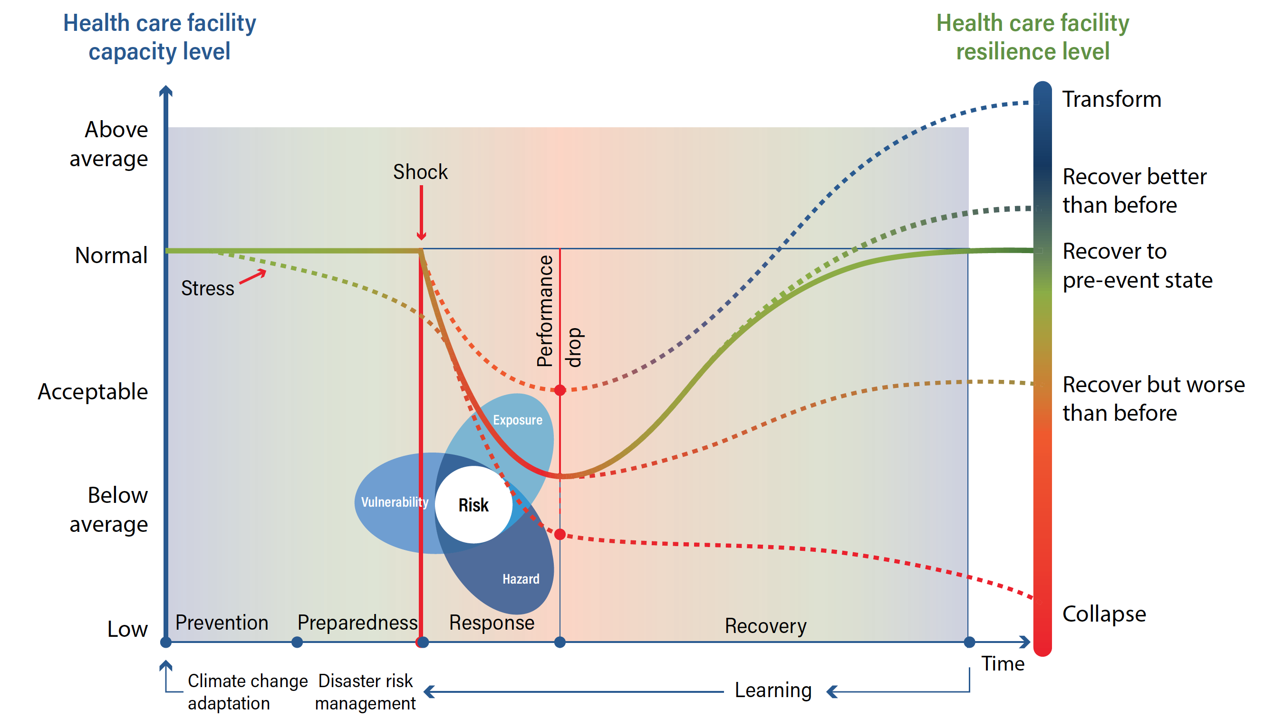
Climate resilience in health care facilities

Slide 7
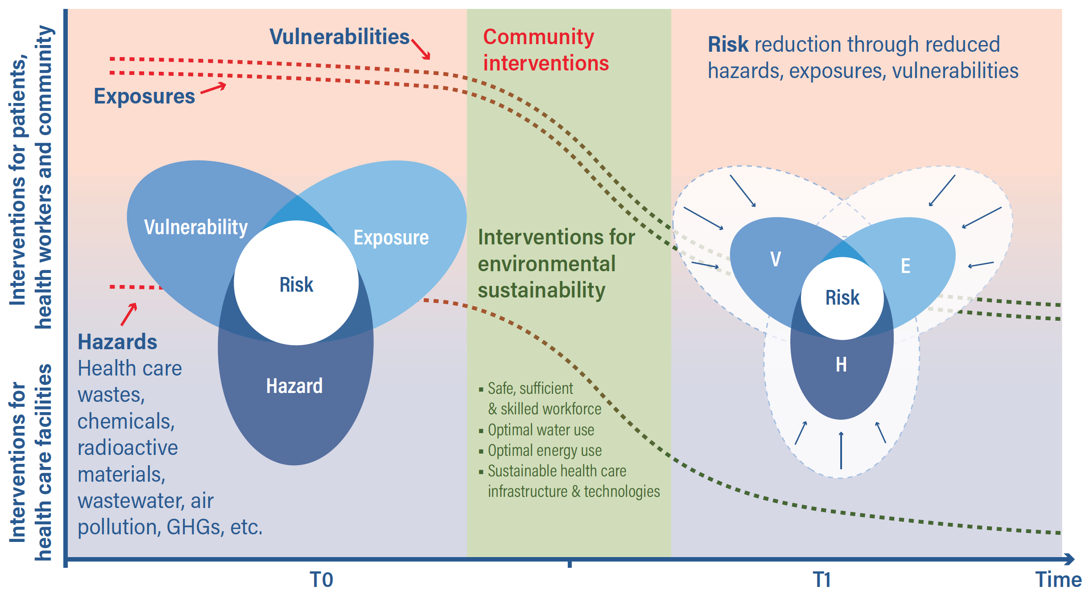
Risk Reduction in health care facilities

Slide 8
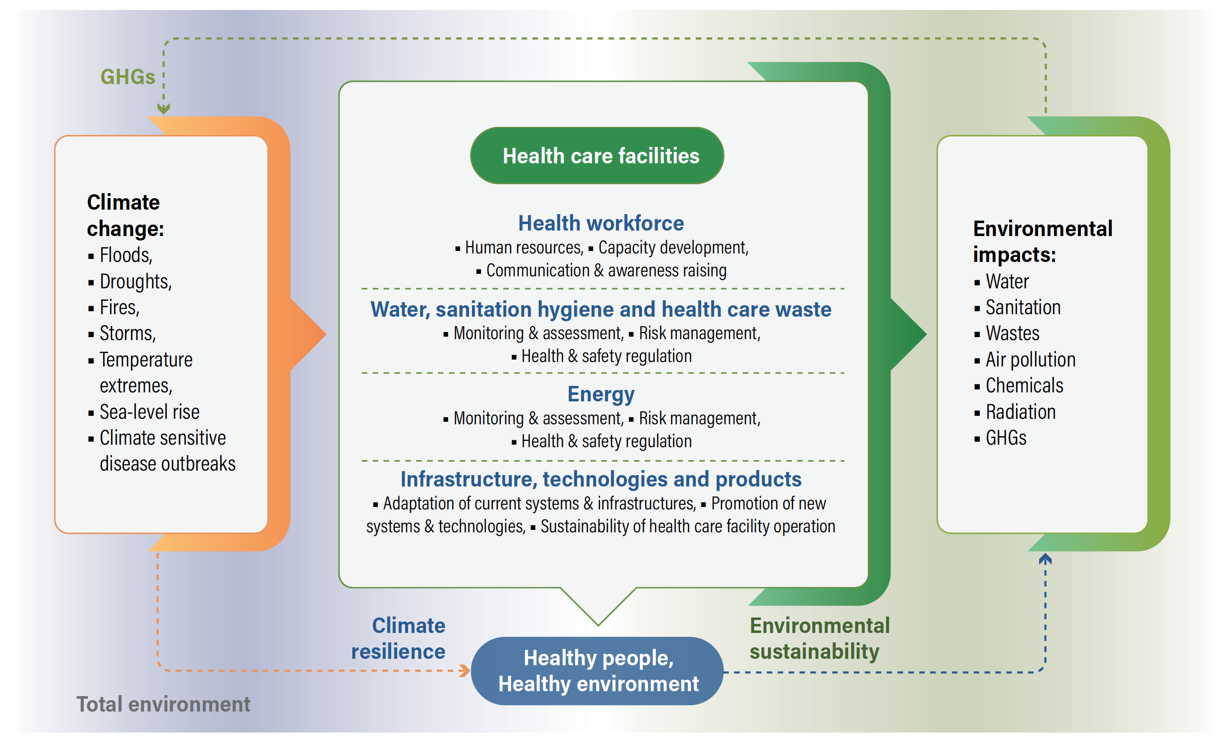
Framework for building climate resilient and environmentally sustainable health care facilities

Slide 9
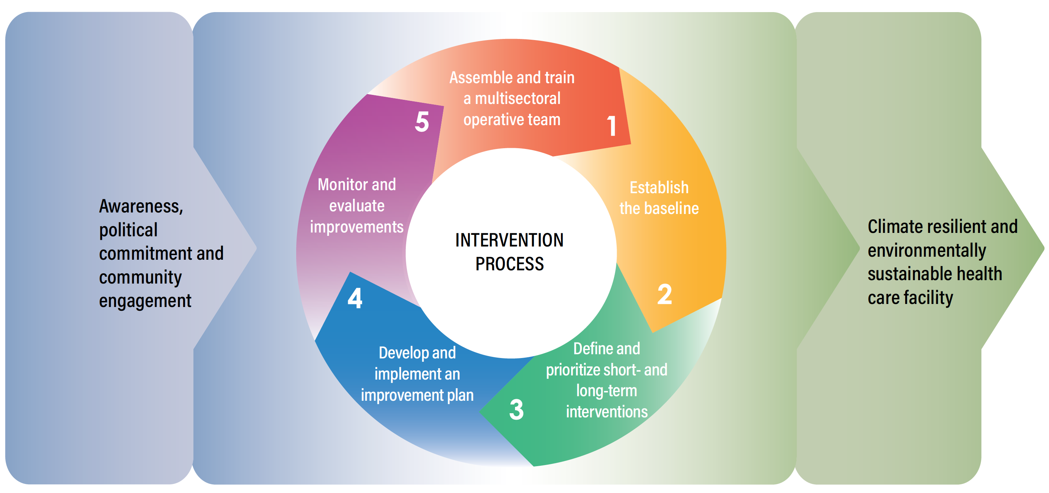
Framework & process for action

Slide 10
Example 1: HEALTH WORKFORCE OBJECTIVES
Health workers have a key role in building climate resilience and environmental sustainability of health care facilities. Because building climate resilience and environmental sustainability are relatively new approaches for health workers, building awareness, training and empowering health workers are key requirements for the successful implementation of interventions.
OBJECTIVES FOR THE IMPLEMENTATION OF THIS COMPONENT
Human resources: Health care facilities having sufficient number of health workers with healthy and safe working conditions, capacity to deal with health risks from climate change, as well as the awareness and empowerment to ensure environmentally sustainable actions.
Capacity development: Training, information and knowledge management targeted at health care workers to respond to climate risks and minimize environmental threats resulting from the operation of the health care facility.
Communication and awareness raising: Communicate, coordinate and increase awareness related to climate resilience and environmental sustainability among health workers, patients, visitors, target communities, and with other sectors.

Slide 11
Example 2: WATER, SANITATION AND HEALTH CARE WASTE OBJECTIVES
The availability of sustainable water, sanitation and environmental, chemical and health care waste management services are essential to quality of care and infection prevention and control in health care facilities.
OBJECTIVES FOR THE IMPLEMENTATION OF THIS COMPONENT
Monitoring and assessment: Information regarding water, sanitation, chemical use and health care waste management considers climate resilience and environmental sustainability for promoting action.
Risk management: Strengthened capacity of health care facilities to manage water, sanitation, chemicals and health care waste risks to workers, patients and served communities, by including assessments of climate resilience and environmental sustainability in responding to hazards and identifying and reducing exposures and vulnerabilities.
Health and safety regulation: Water, sanitation, chemical safety and health care waste regulations are implemented taking into consideration climate variability and change, and environmental sustainability.

Slide 12
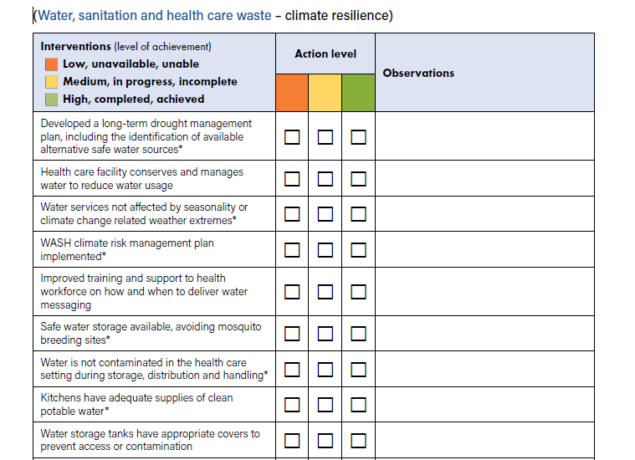
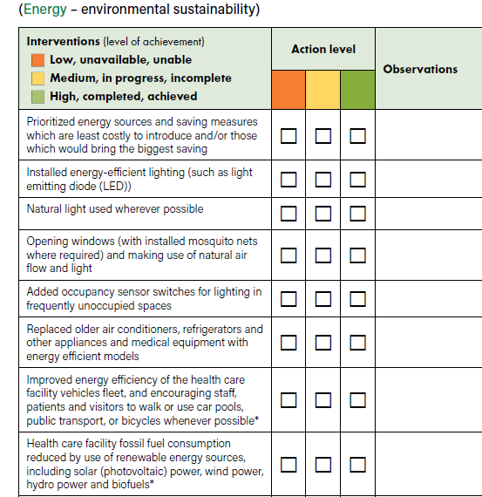
Example 3: INTERVENTIONS

Slide 13

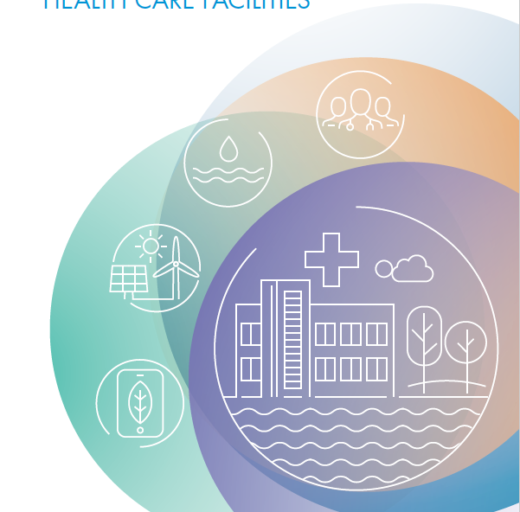
THANK YOU FOR YOUR ATTENTION
WHO GUIDANCE FOR CLIMATE RESILIENT AND
ENVIRONMENTALLY SUSTAINABLE
HEALTH CARE FACILITIES
© Photo by Yoshi Shimizu - Fiji

