Slide 1
COVID-19 Vaccine Implementation Analysis & Insights
COVID-19 Vaccine Delivery Partnership
10 November 2022

Slide 2
Notes & disclaimer
Description: | A standard analytic report produced by the COVID-19 Vaccine Delivery Partnership (CoVDP) of key COVID-19 vaccine implementation data, including 1) daily vaccination rate, 2) population coverage, 3) supply secured & received, and 4) product utilization data, for across COVAX AMC portfolio and CoVDP's Countries for Concerted Support
Data inputs: | COVAX/CoVDP Demand & Supply Planning Mechanism data (Country coverage targets) UN DESA Population Division Population Data (Total population; 12+ population; 18+ population; 60+ population) UNICEF COVID-19 Vaccine Financial Monitoring Database (Total allocated external financing for vaccine delivery) UNICEF COVID-19 Vaccine Market Dashboard Data (Total COVID-19 vaccine doses delivered [all sources]) WHO/UNICEF electronic Joint Reporting Form (eJRF) (Uptake in healthcare worker and 60+ populations, gender-disaggregated uptake) WHO COVID-19 Vaccine Administration Data System (Total doses administered; Individuals with at least one dose; Individuals fully vaccinated)
Methodology: | Methods for analyses presented in this report are contained in the COVID-19 Vaccine Delivery Partnership Data & Monitoring Coordination Manual (link)
Inquiries: | Please contact Donald BROOKS (brooksd@who.int) and Rafael PANLILIO (rpanlilio@unicef.org)
Disclaimer: | The data found in this report have been produced and processed from sources believed to be reliable. While these data and analyses are provided in good faith and to the best of the COVID-19 Vaccine Delivery Partnership’s (the "Partnership") knowledge, The Partnership does not commit to it being up to date. While every effort is made to ensure the data quality, the data and analyses are provided “as is.” The burden of fitness of the data and analyses lies completely with the user. The accuracy of any user’s statistical analysis and any reported findings are not the responsibility of the Partnership. The Partnership does not make any warranty, express or implied, including warranties of fitness for a particular purpose, or assume any legal liability or responsibility for the accuracy, completeness, reliability, or usefulness of any information provided (either isolated or in the aggregate), or represent that its use would not infringe privately owned rights. Maps in this report do not reflect a position by the Partnership on the legal status of any country or territory or the delimitation of any frontiers.

Slide 3
I. AMC92 portfolio analysis

Slide 4
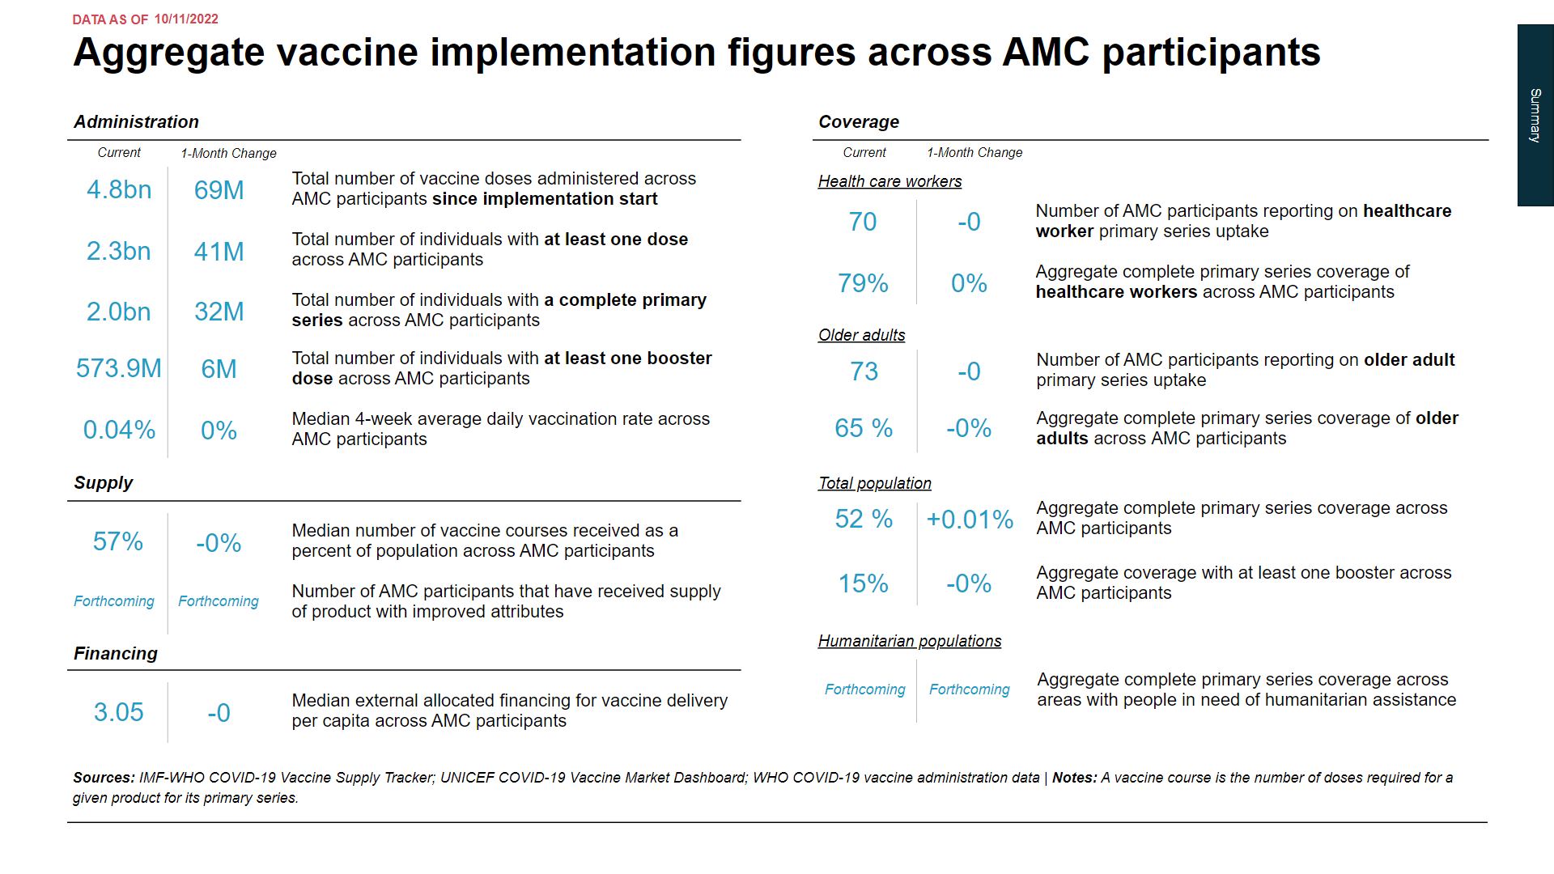

Slide 5
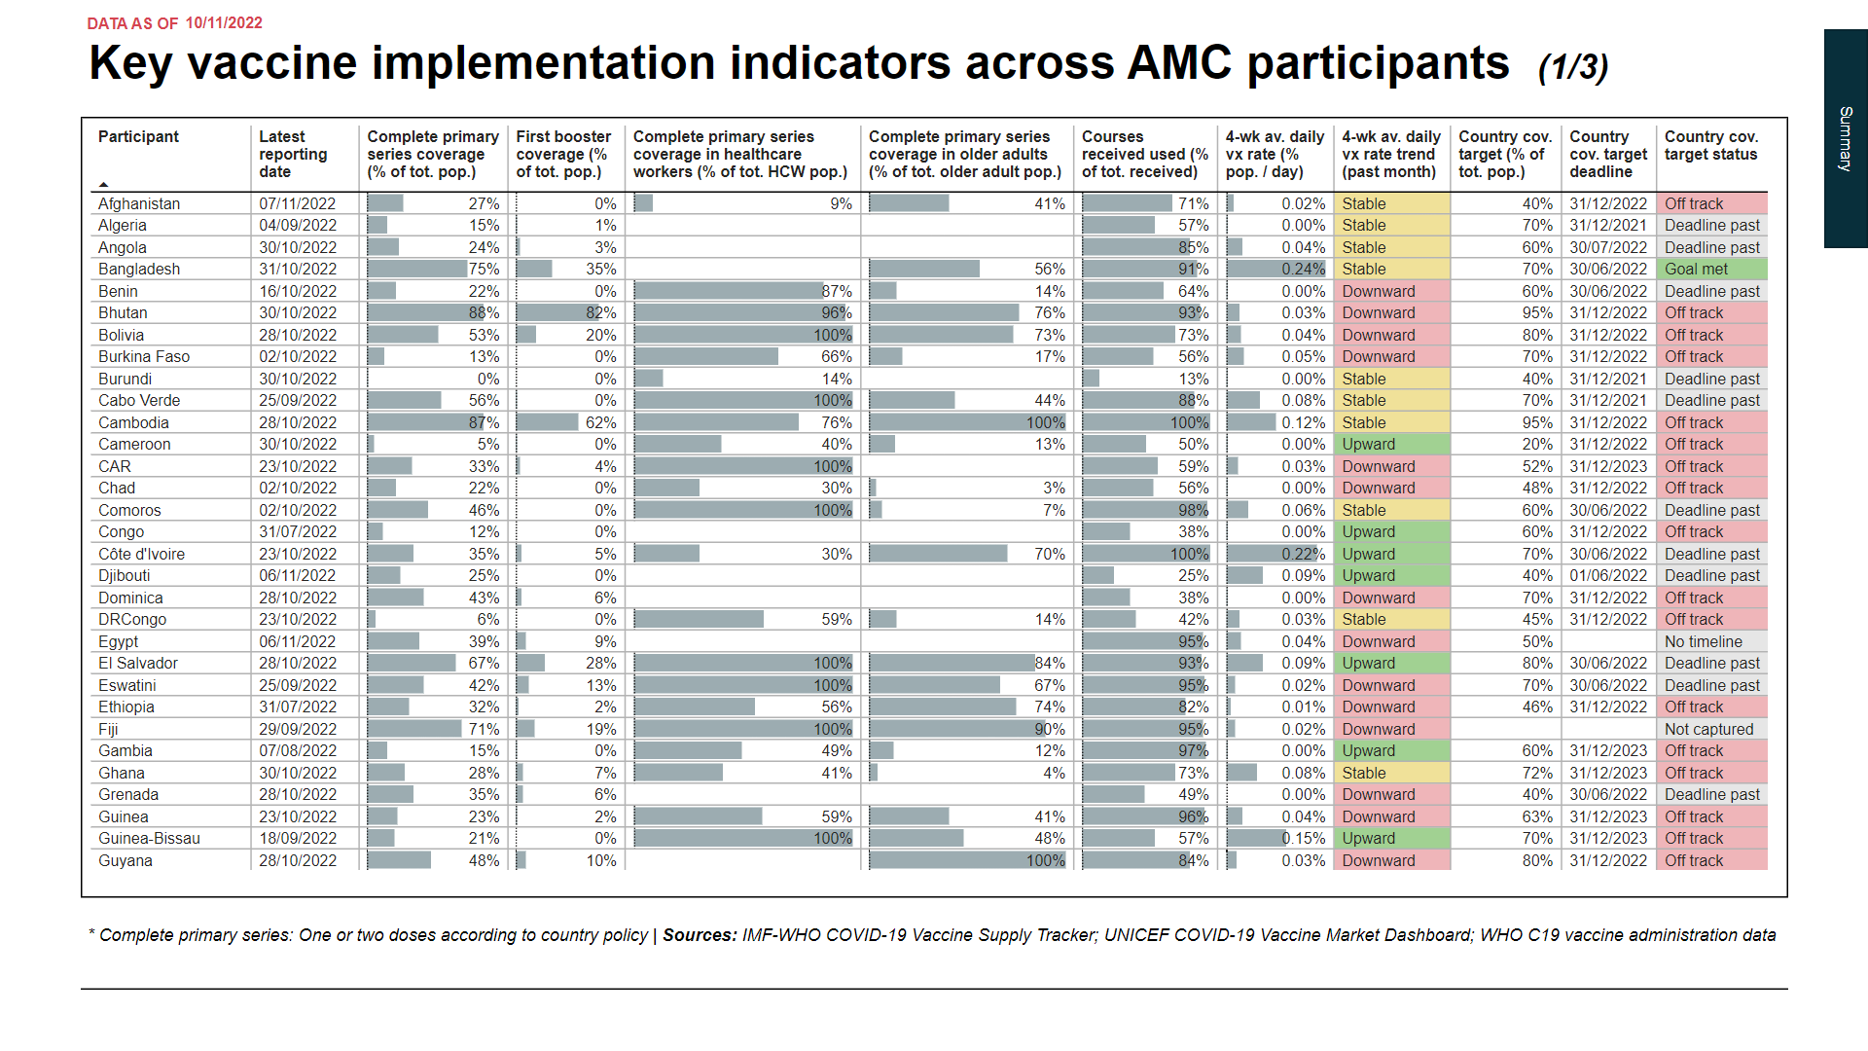

Slide 6
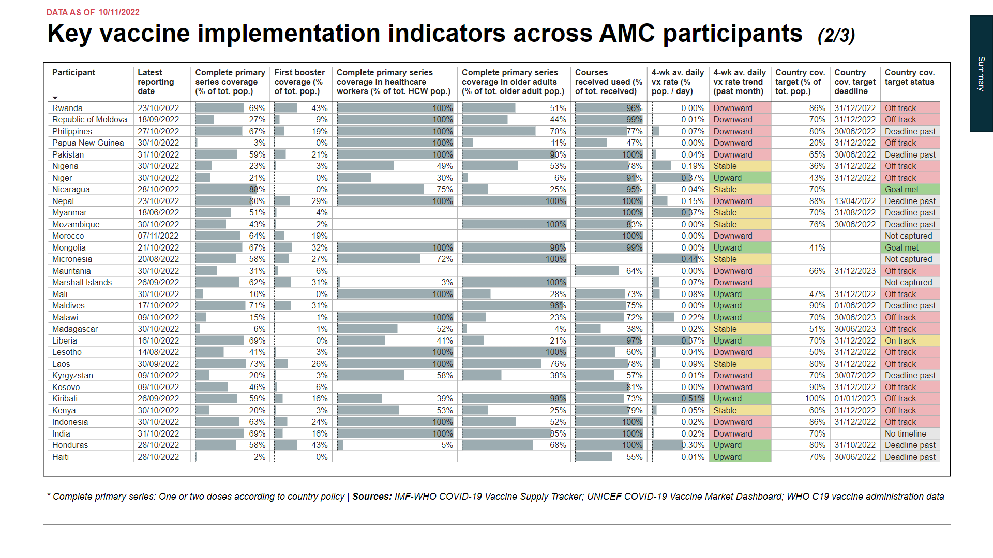

Slide 7
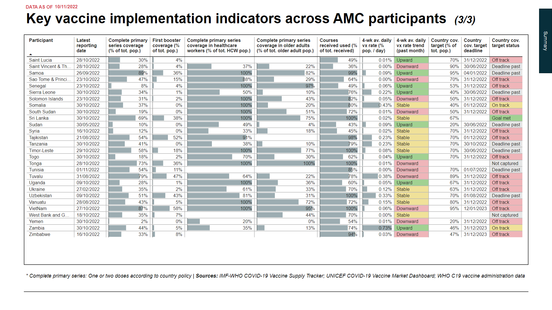

Slide 8
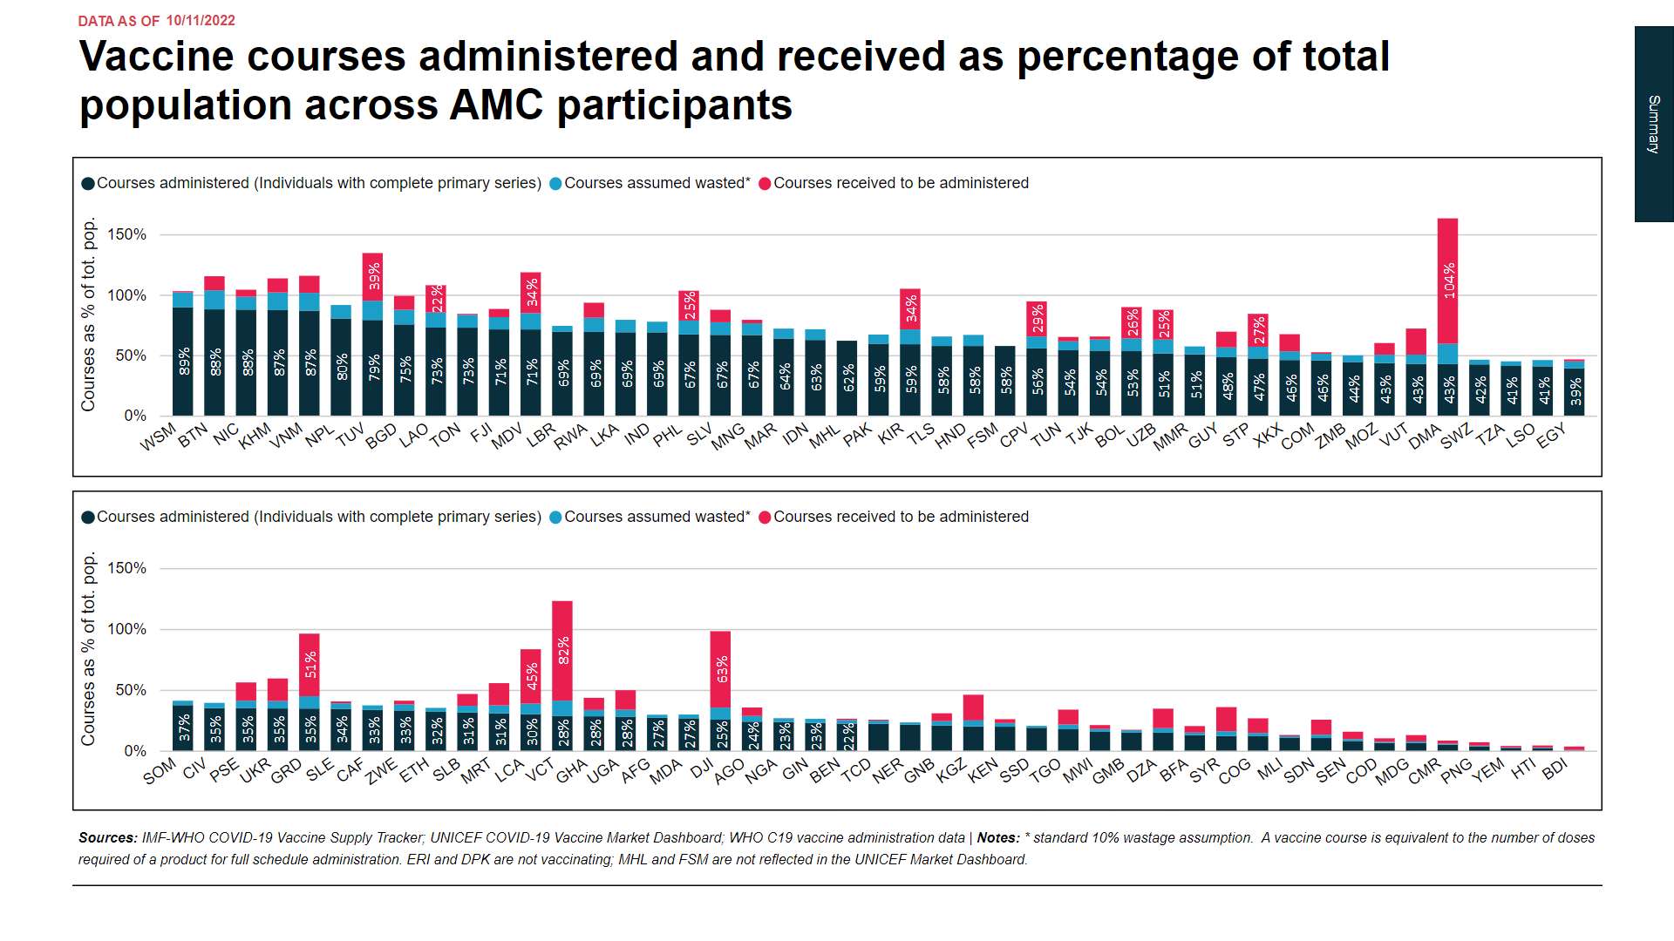

Slide 9
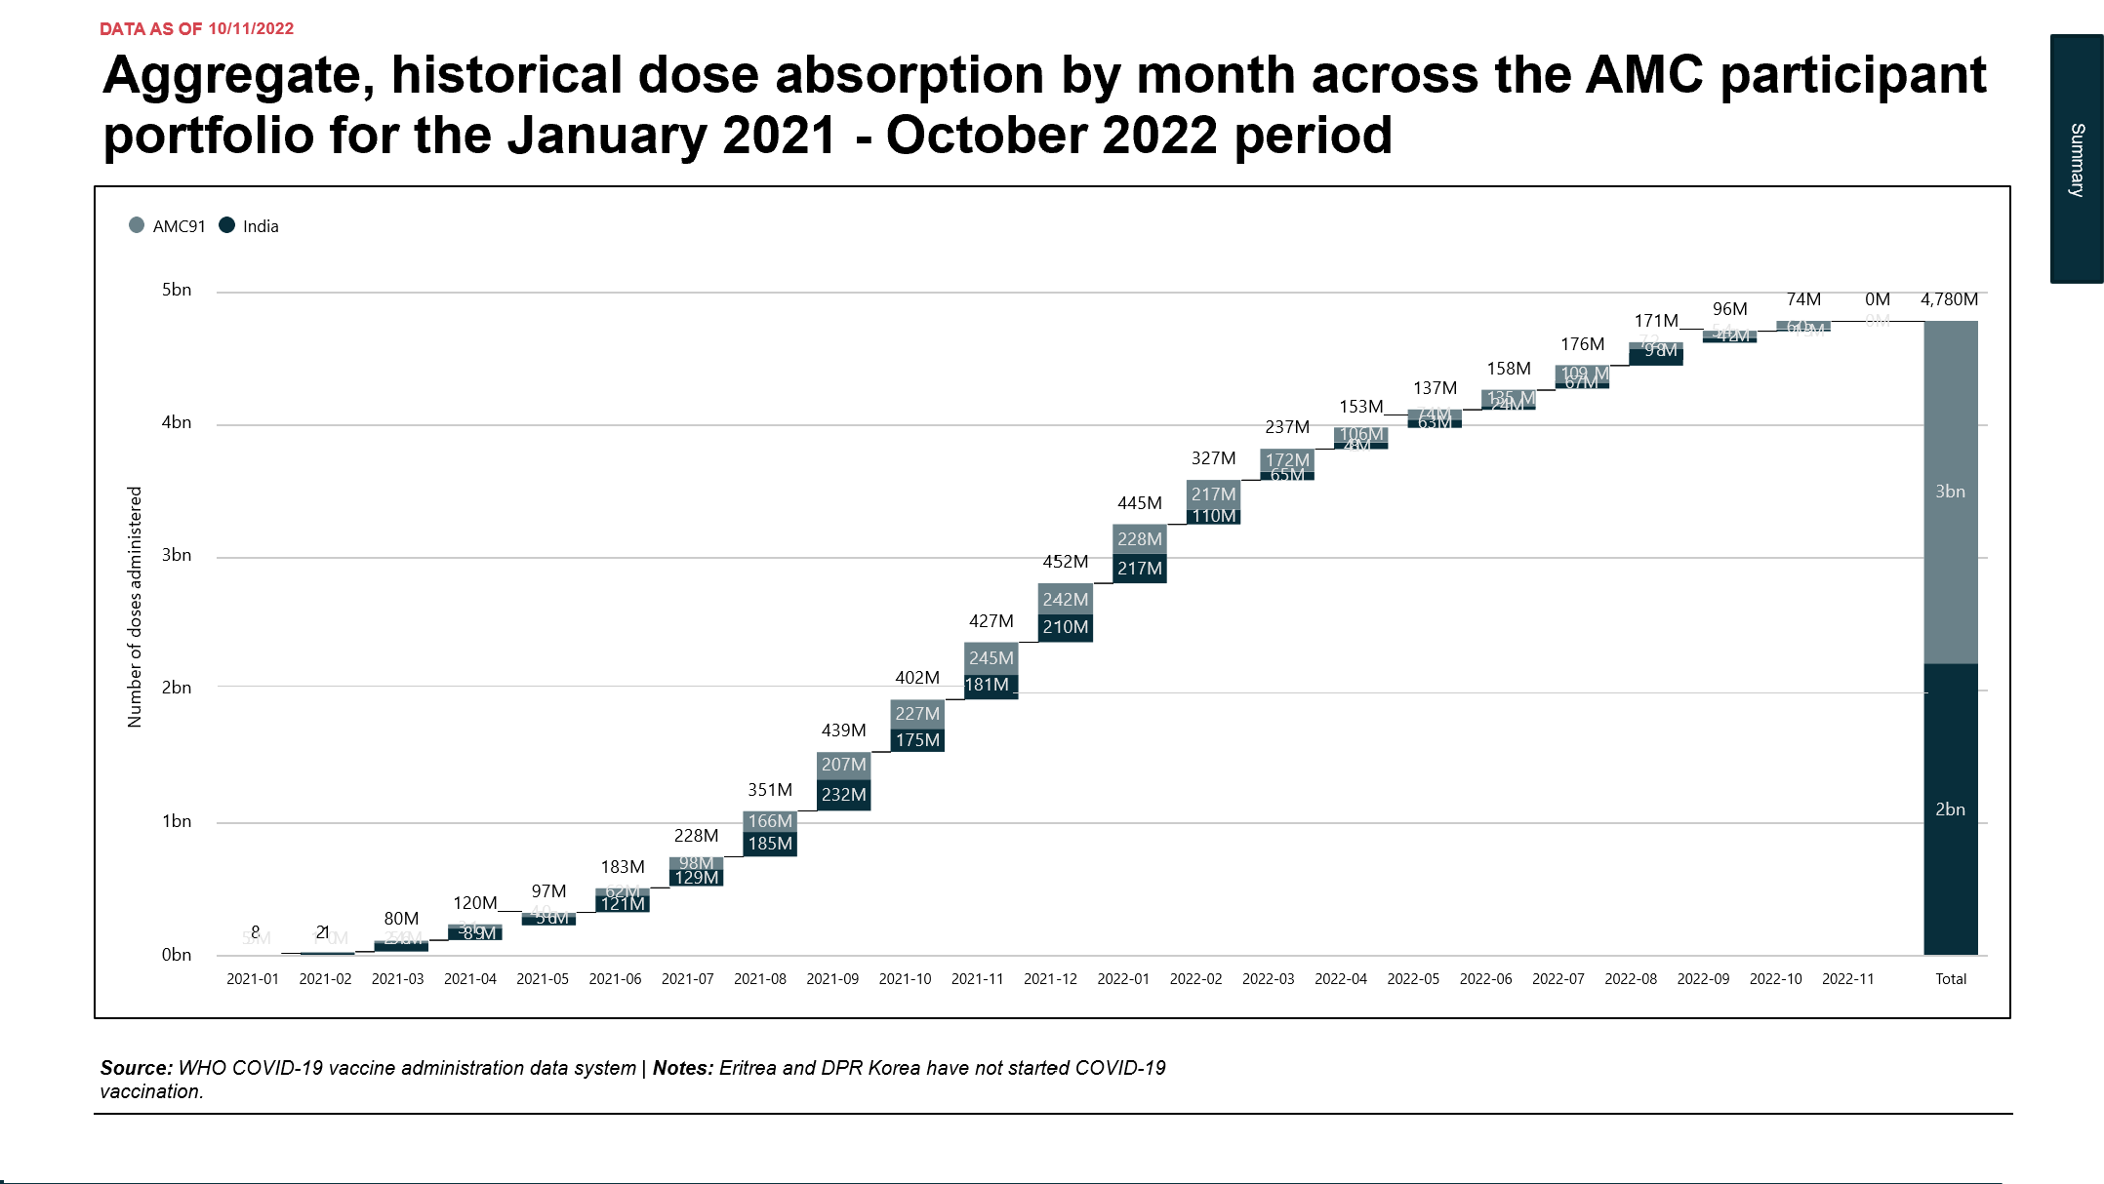

Slide 10
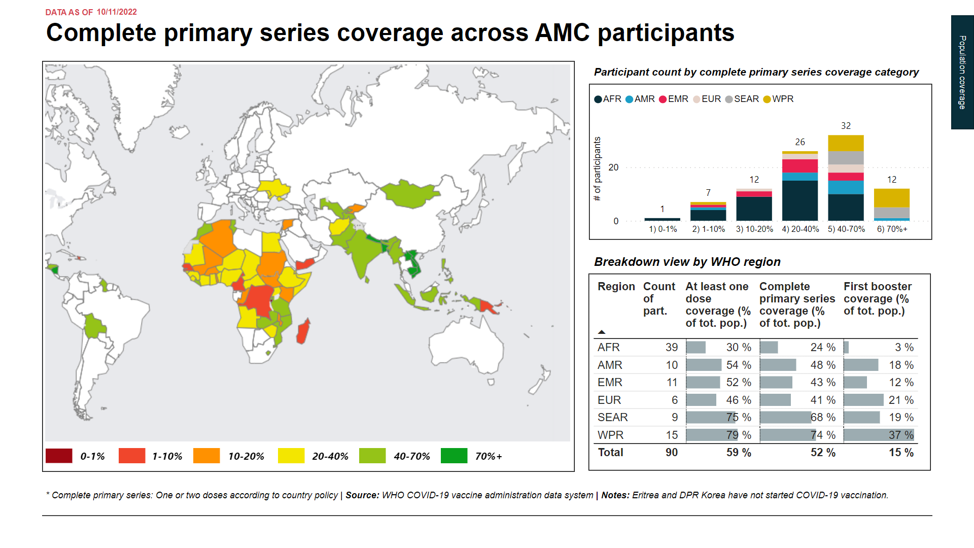

Slide 11
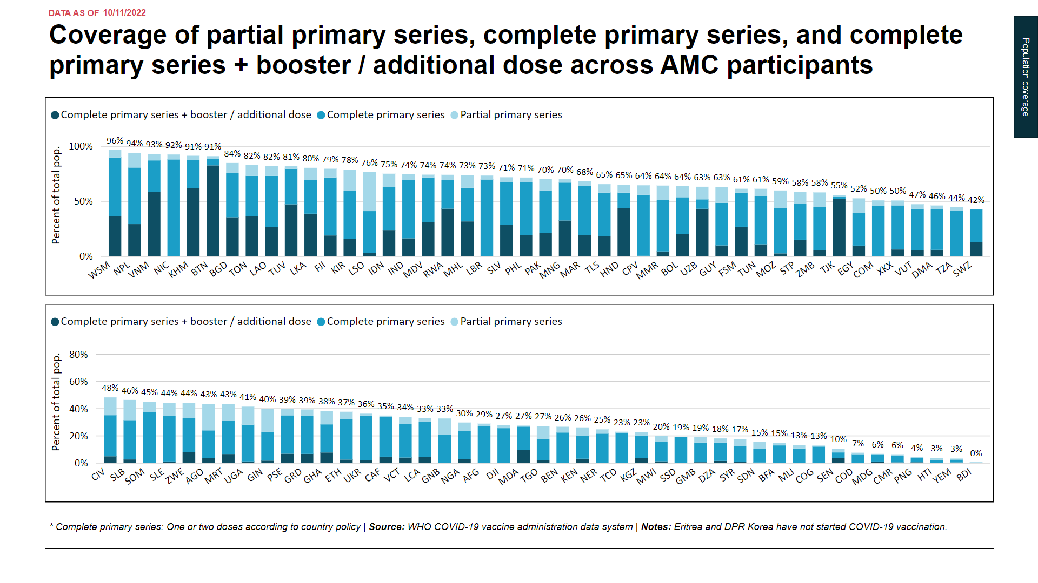

Slide 12
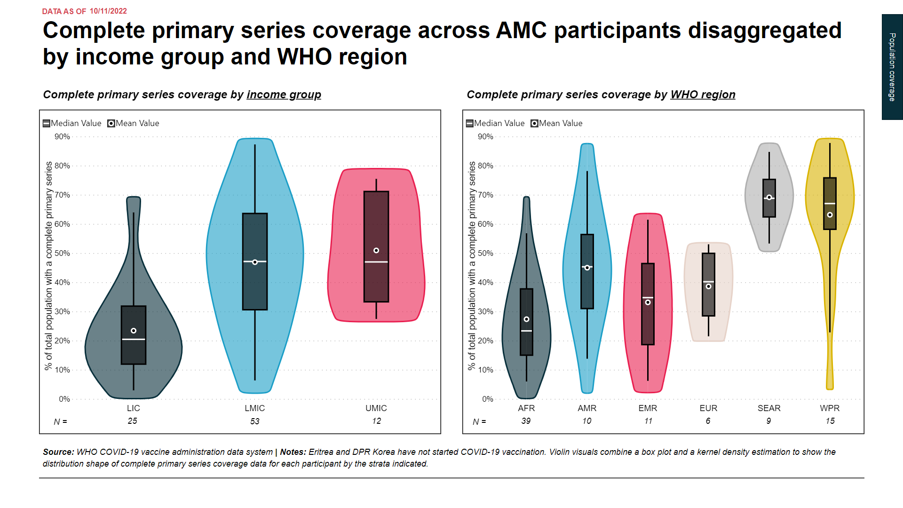

Slide 13
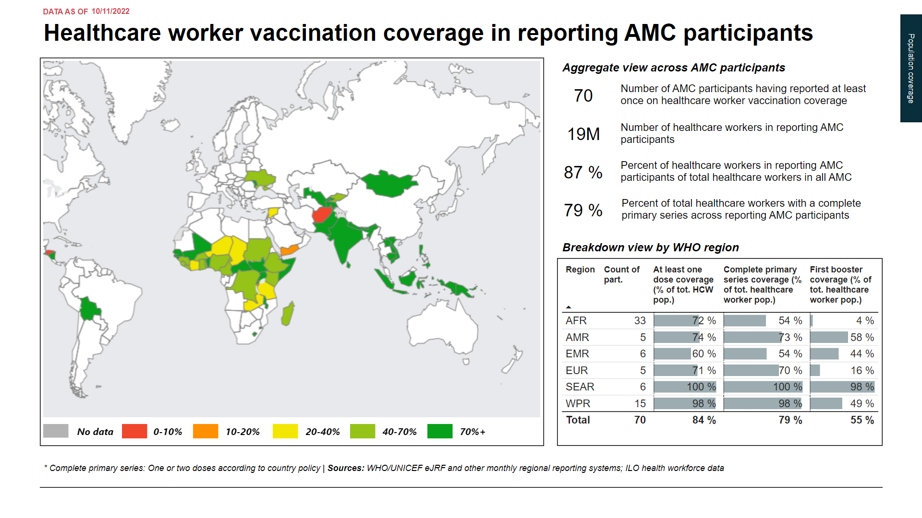

Slide 14
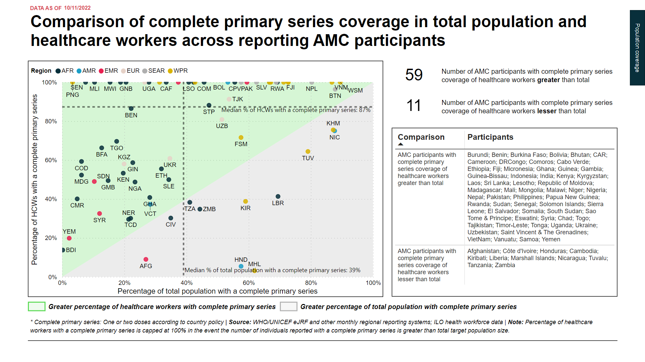

Slide 15
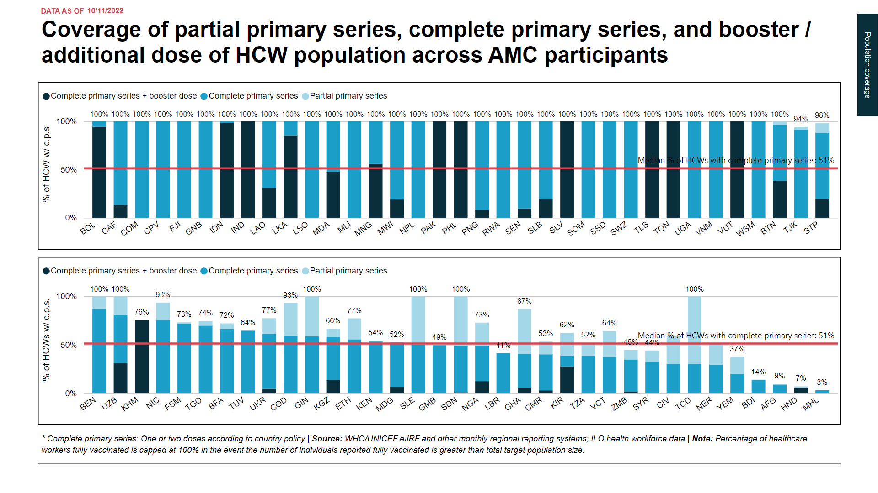

Slide 16
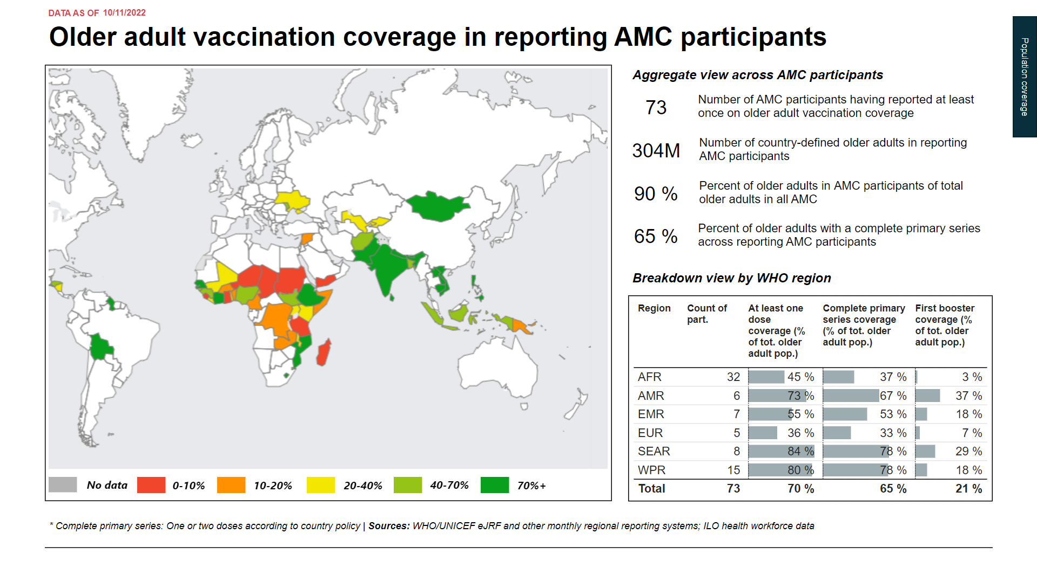

Slide 17
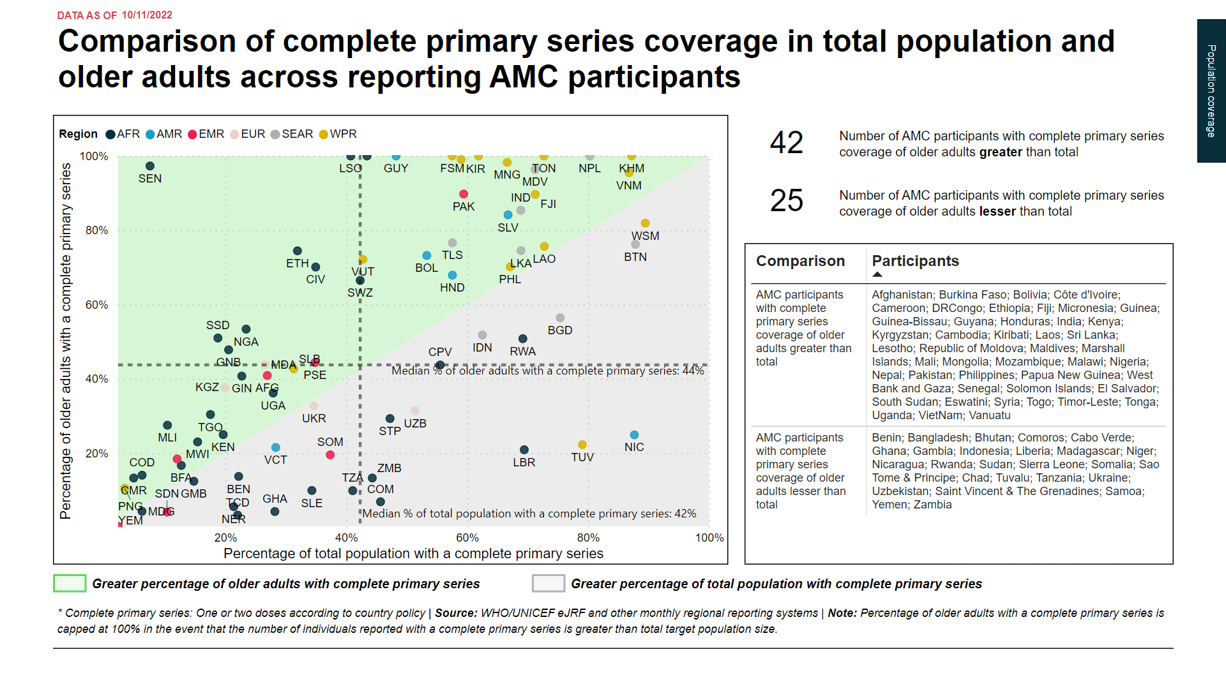

Slide 18
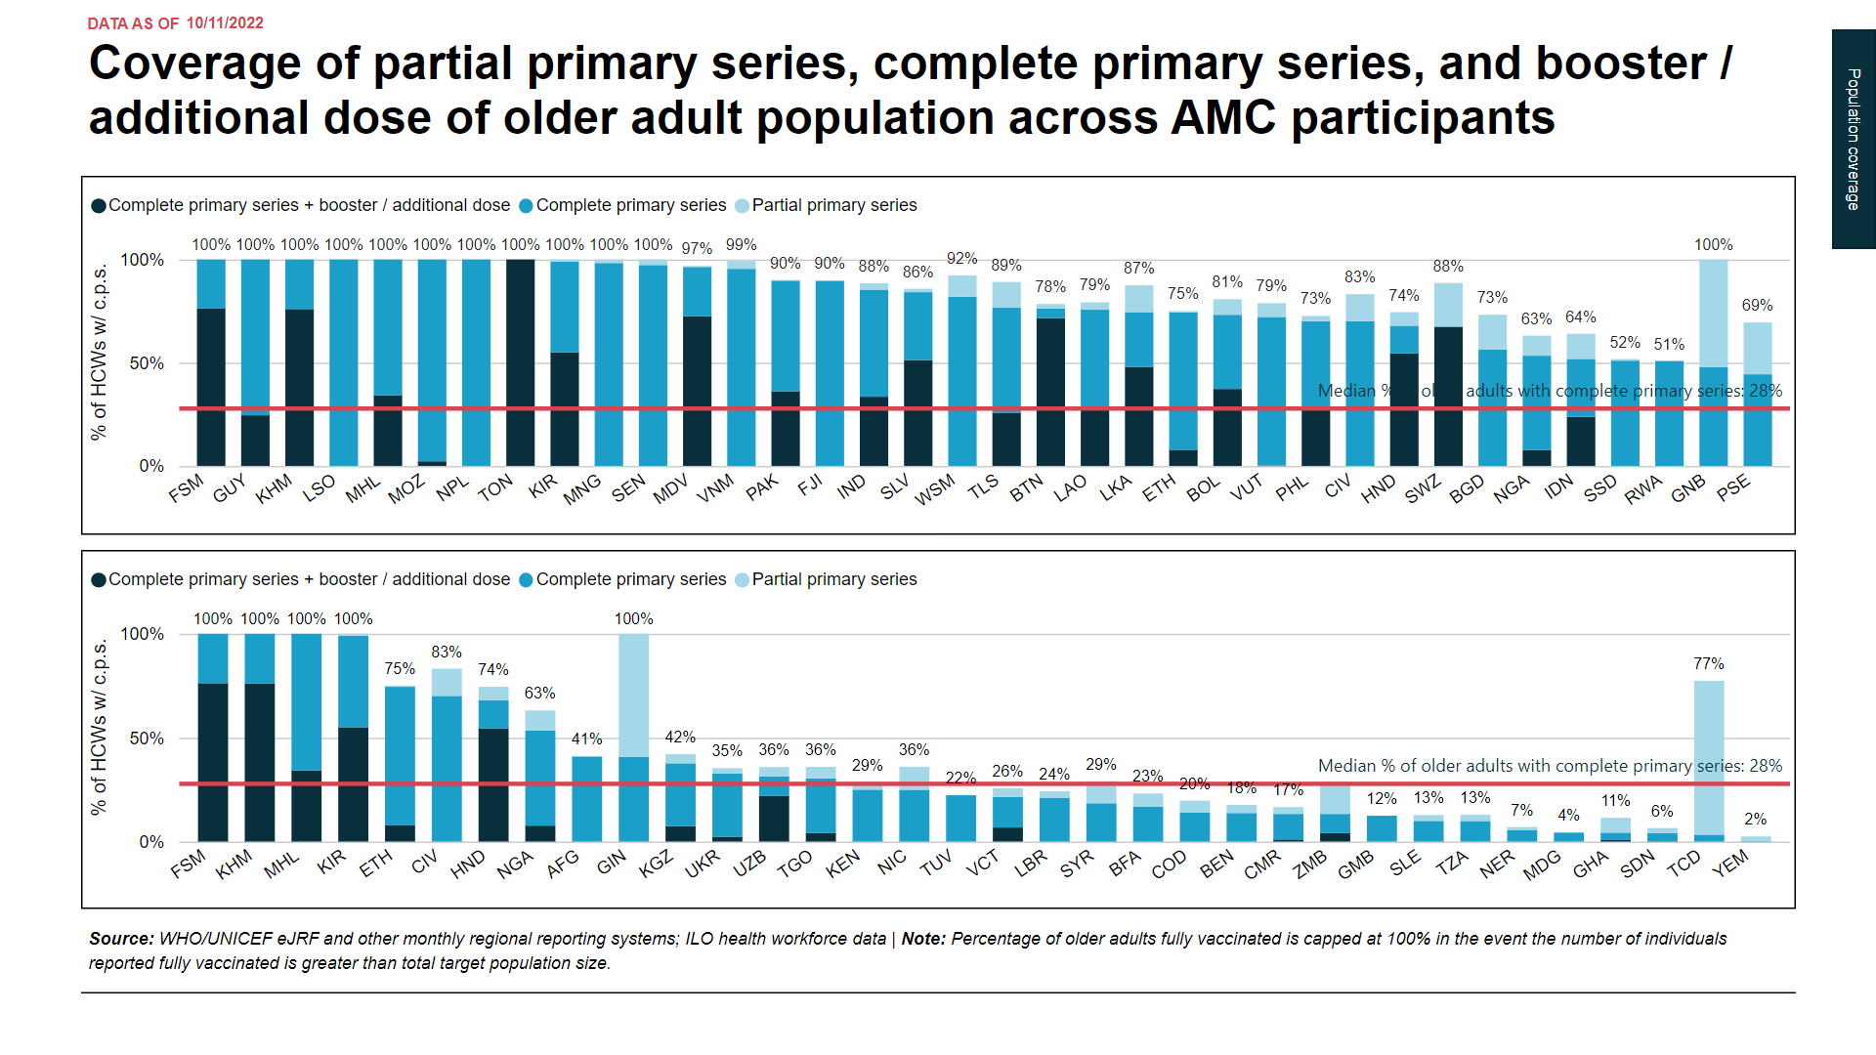

Slide 19
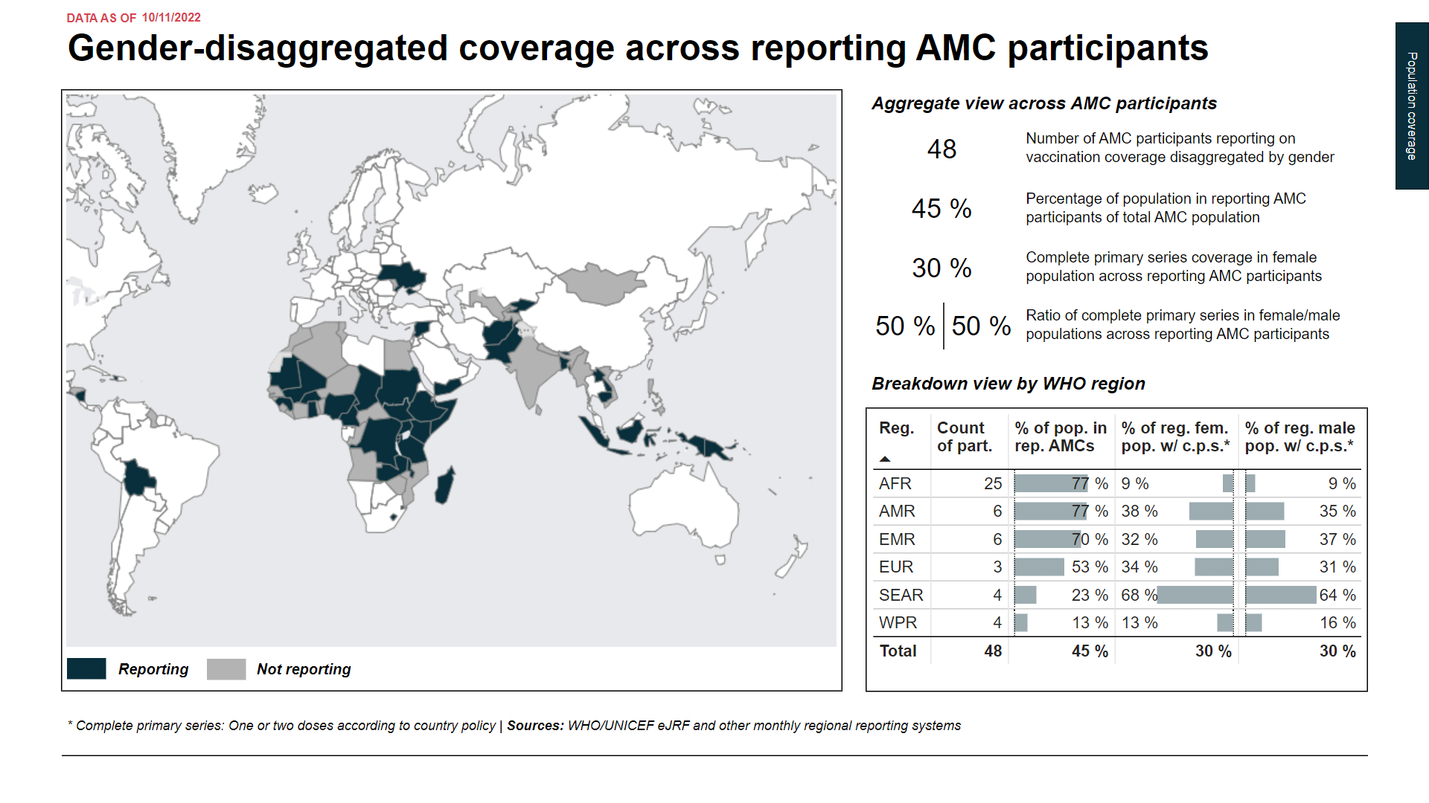

Slide 20
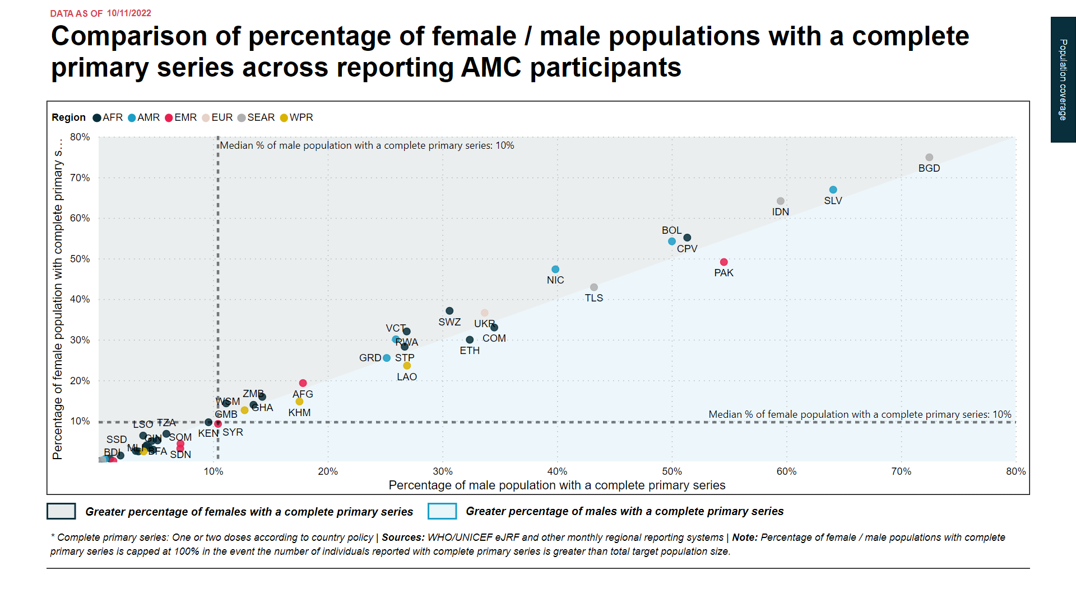

Slide 21
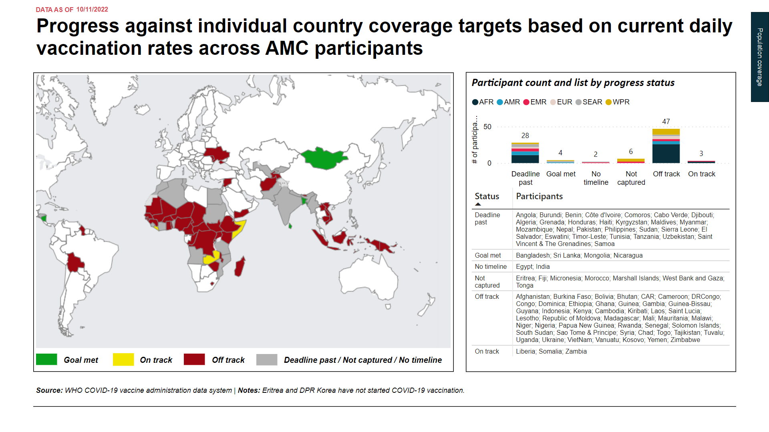

Slide 22
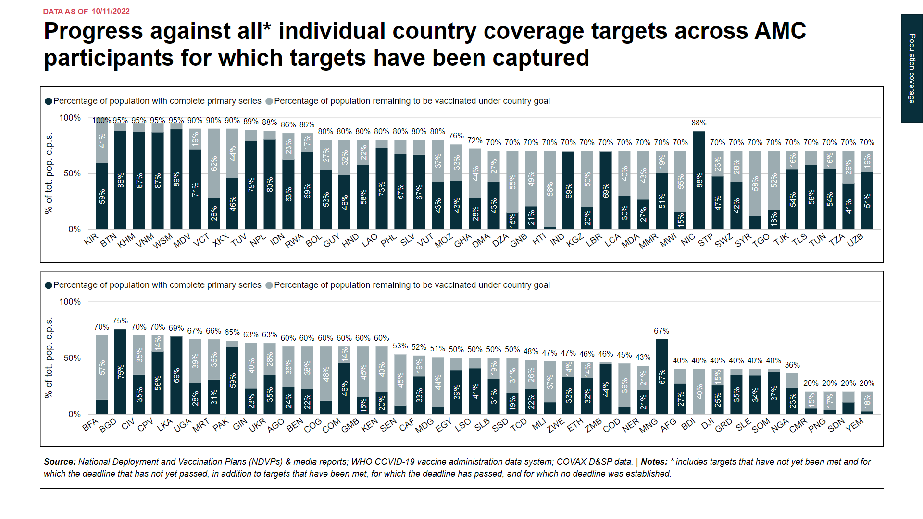

Slide 23
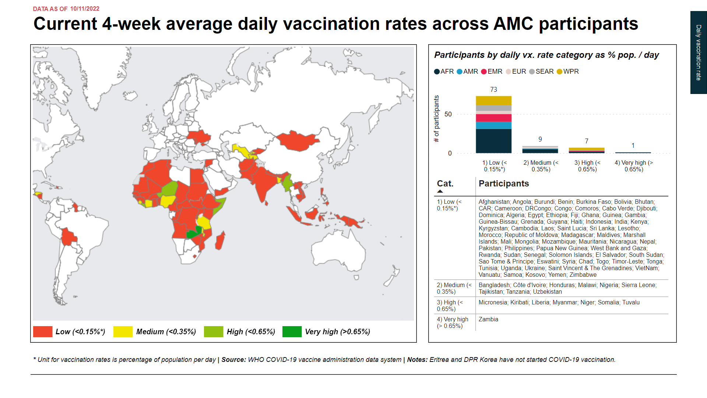

Slide 24
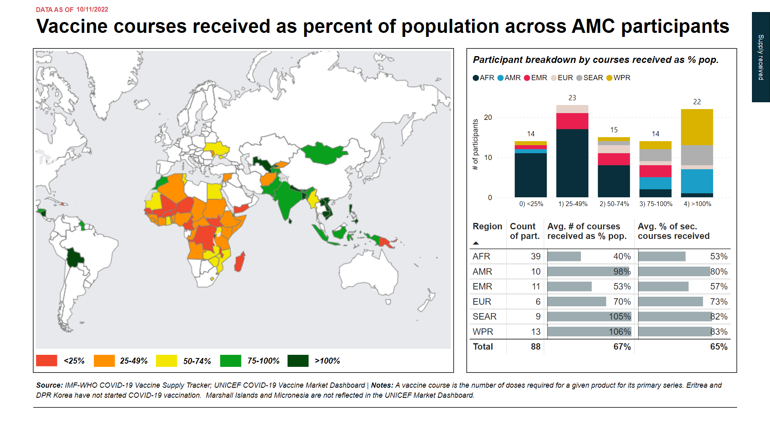

Slide 25
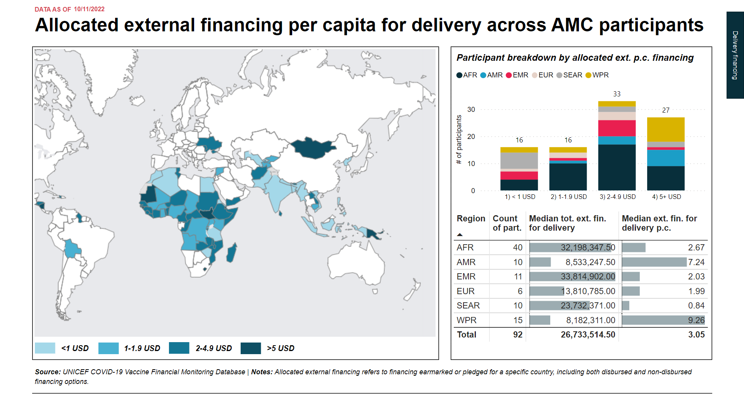

Slide 26
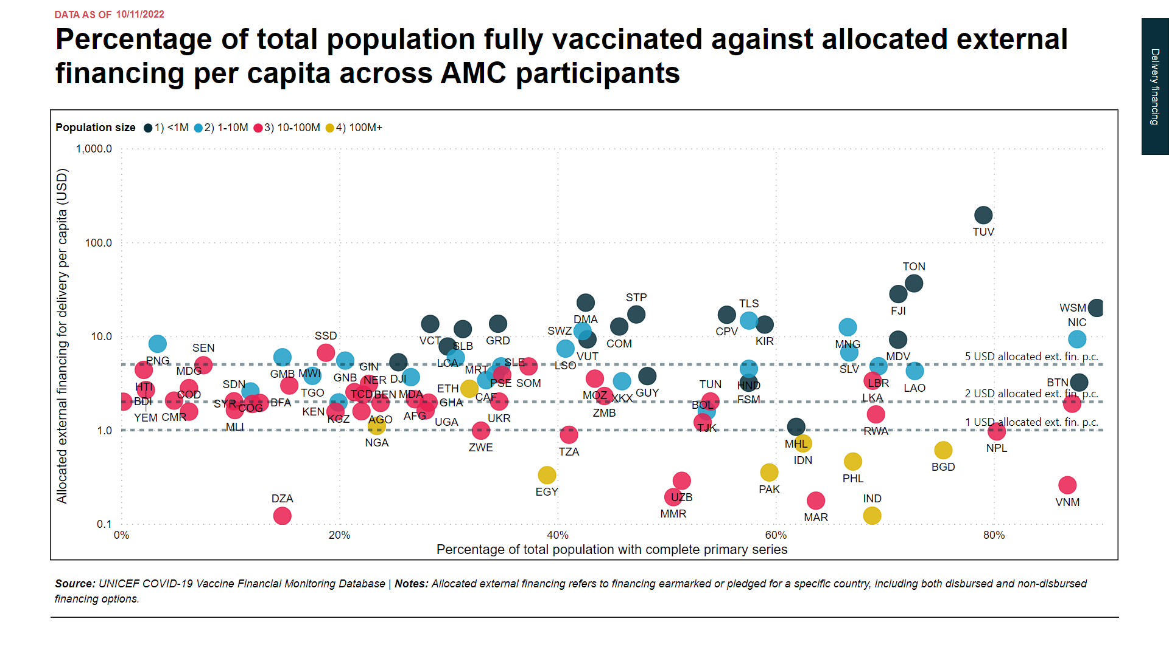

Slide 27
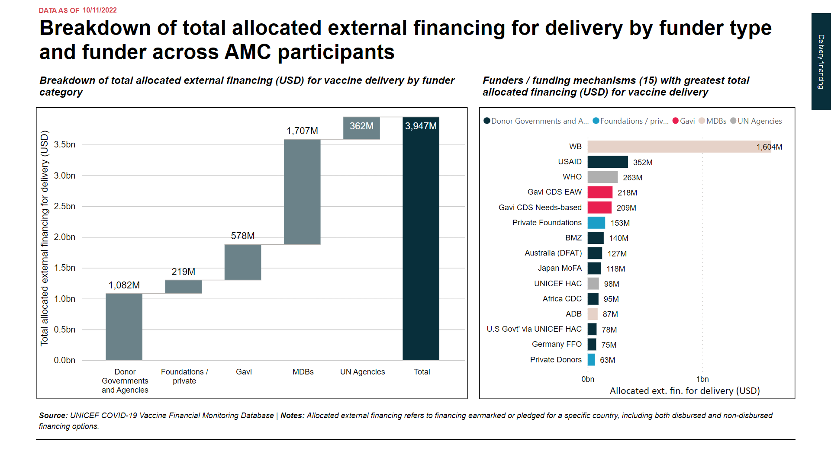

Slide 28
II. Concerted support countries analysis

Slide 29
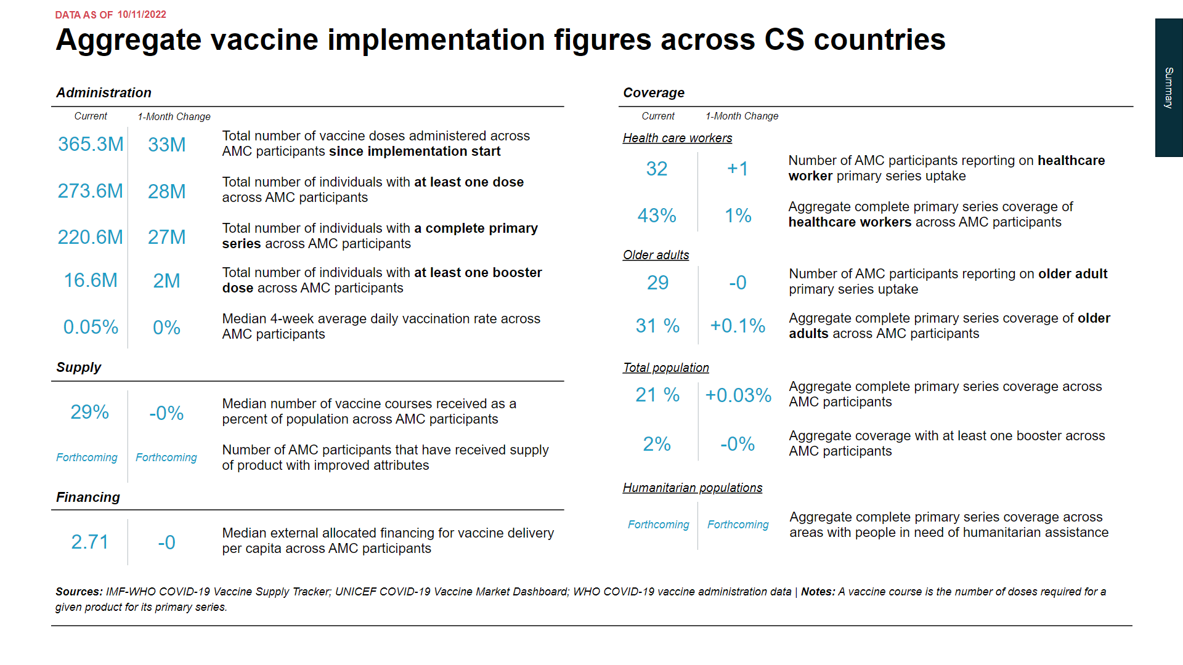

Slide 30
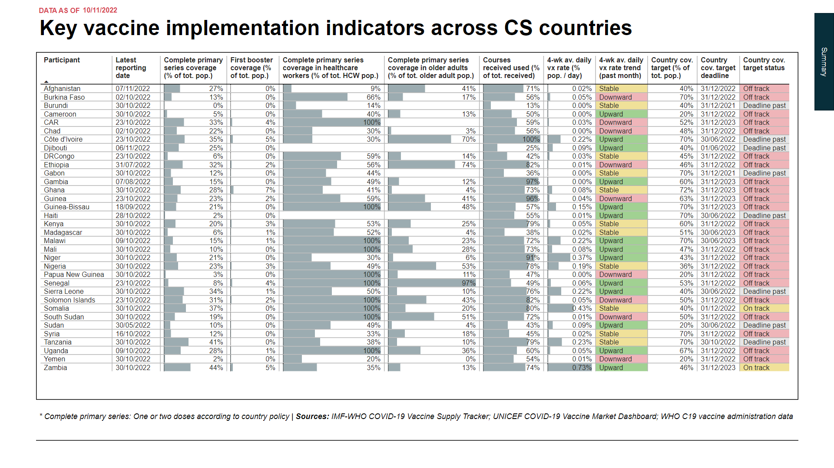

Slide 31
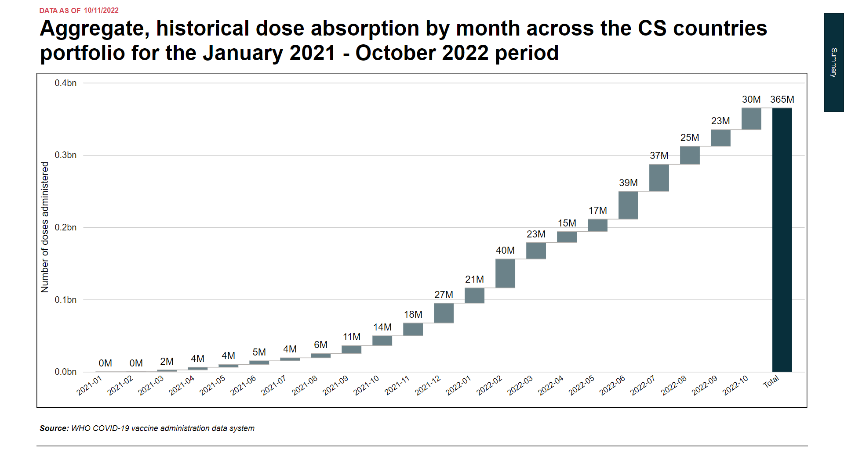

Slide 32
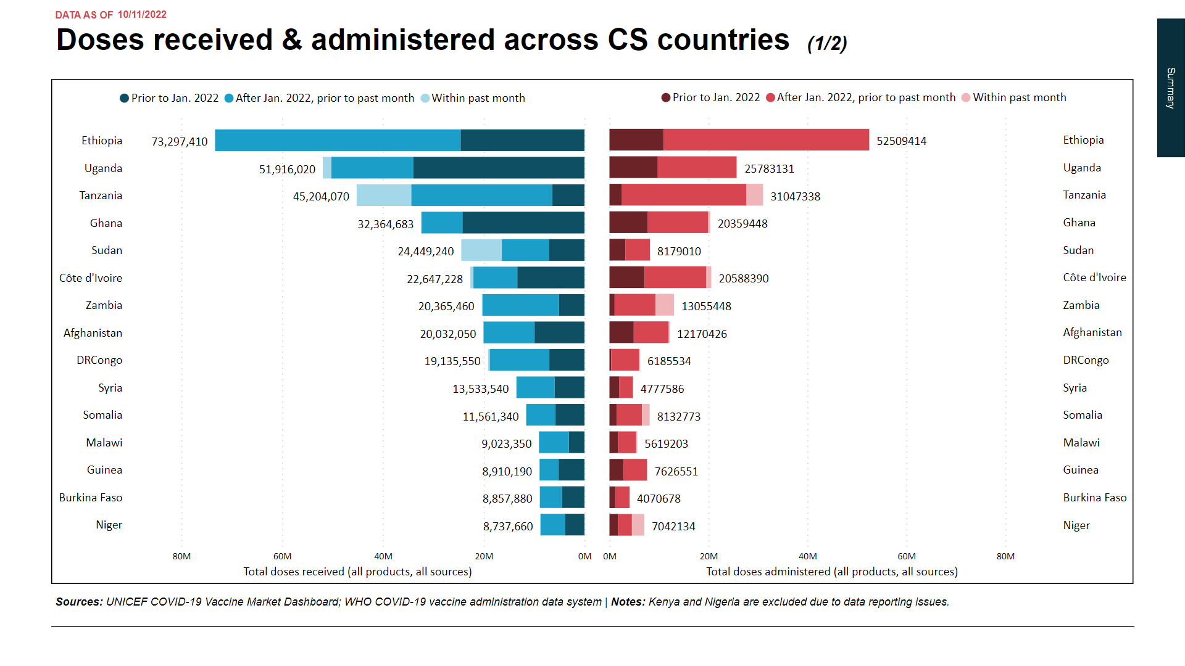

Slide 33
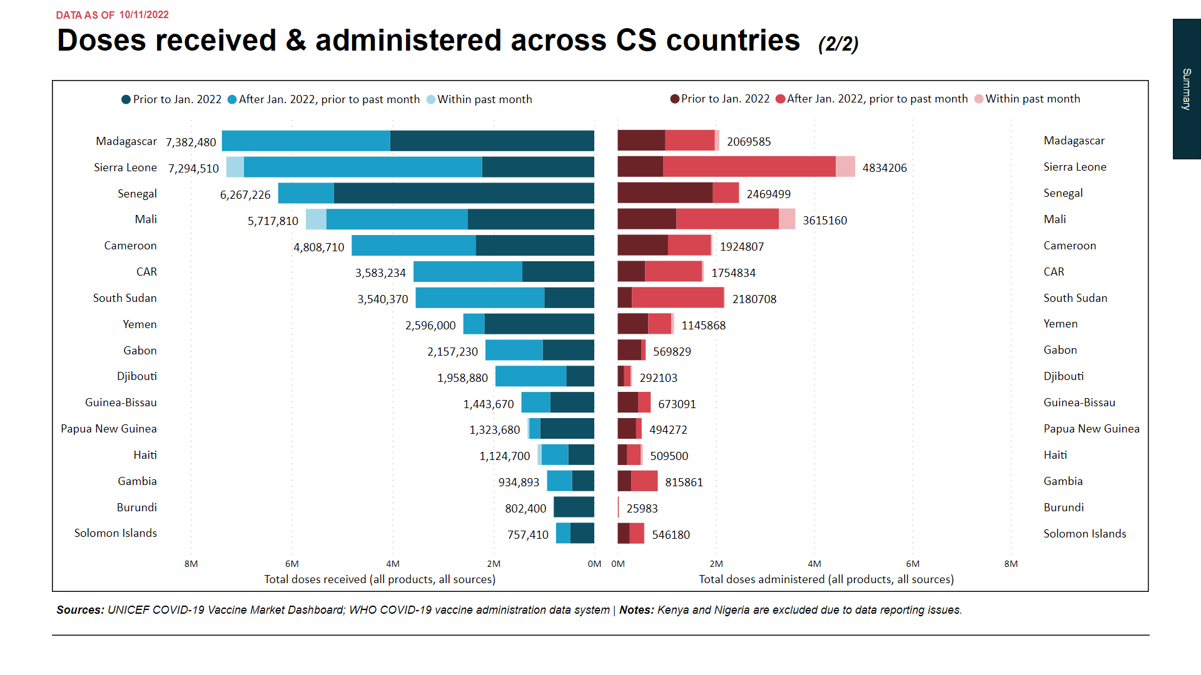

Slide 34
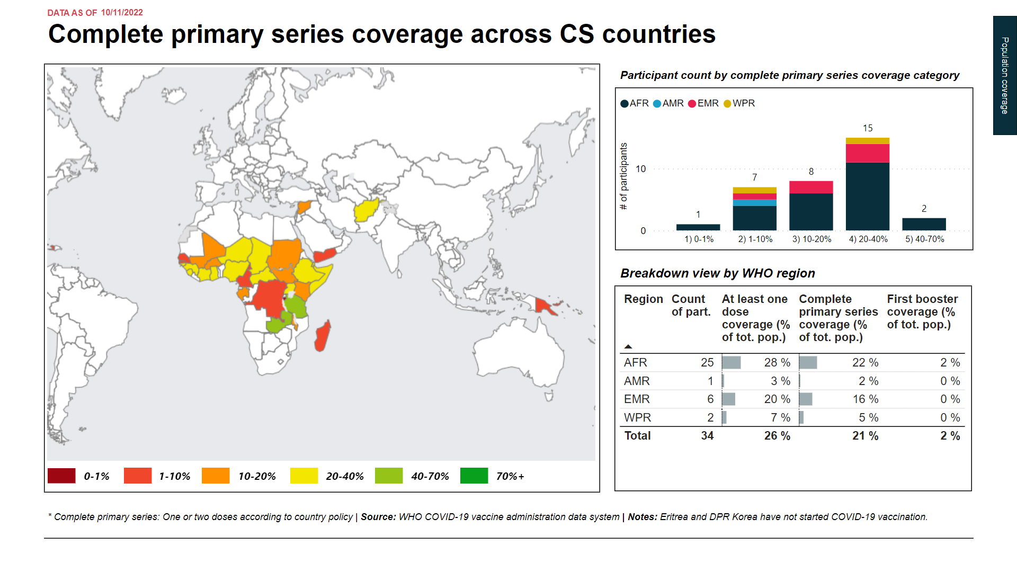

Slide 35
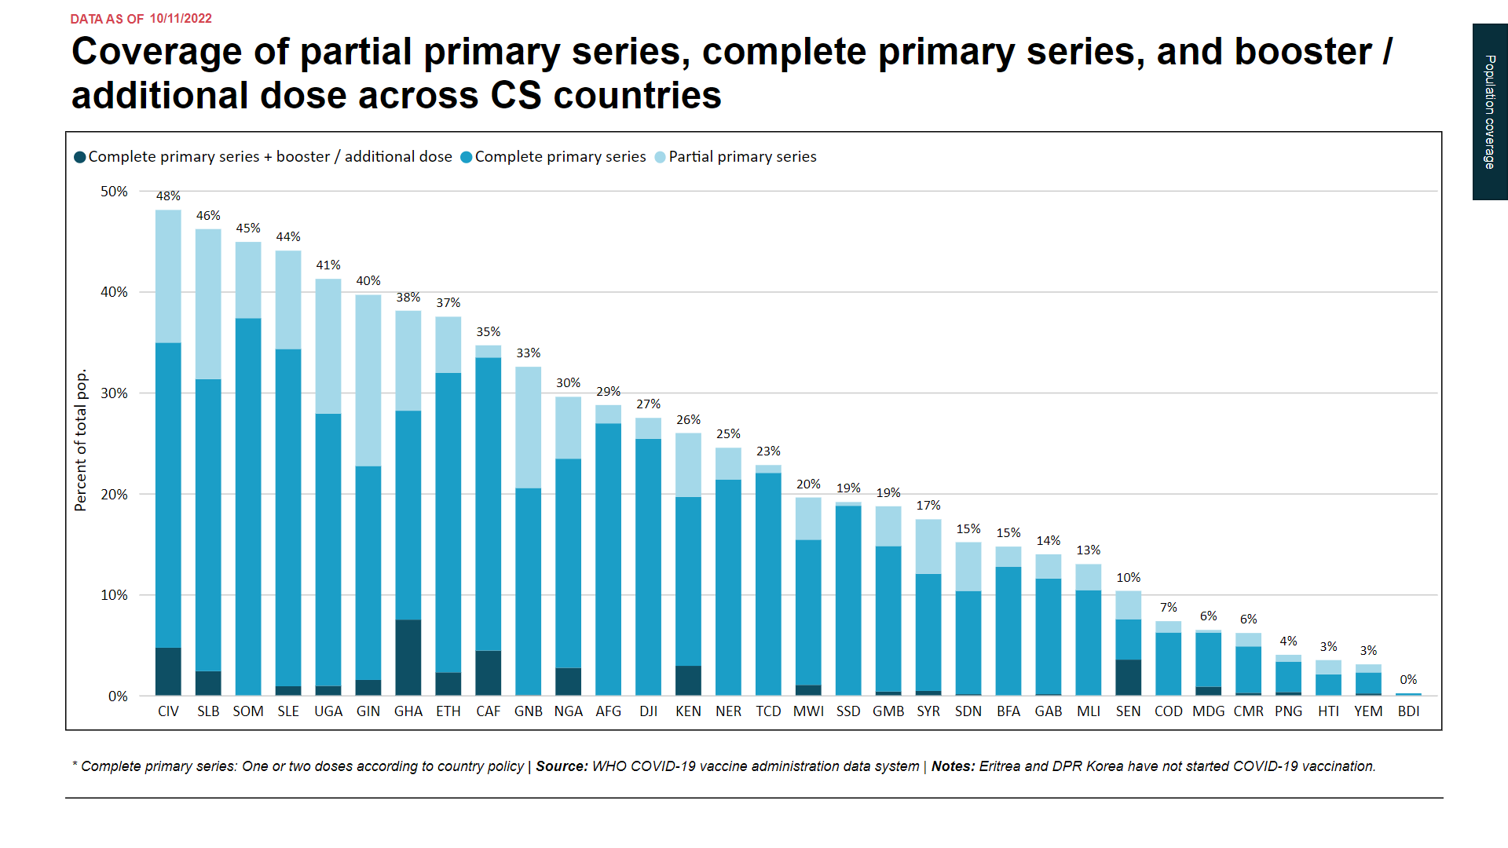

Slide 36
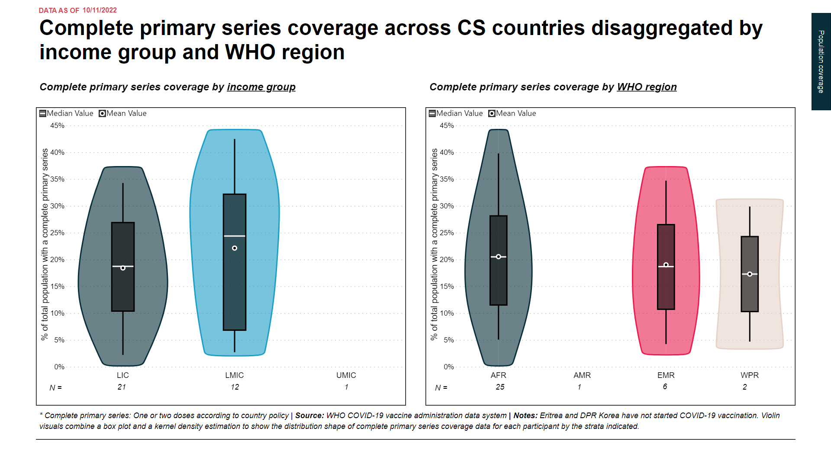

Slide 37
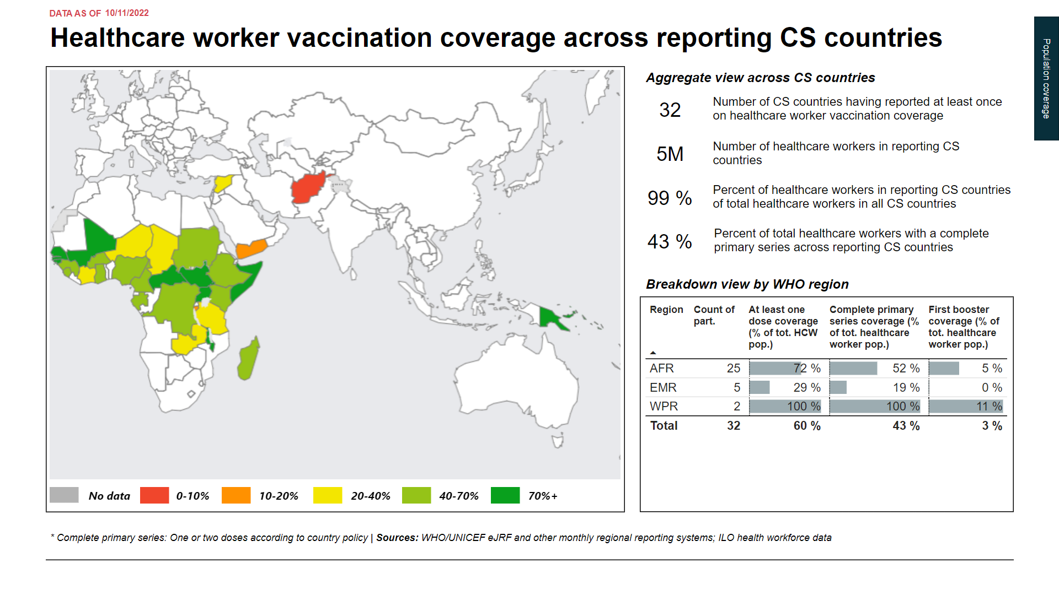

Slide 38
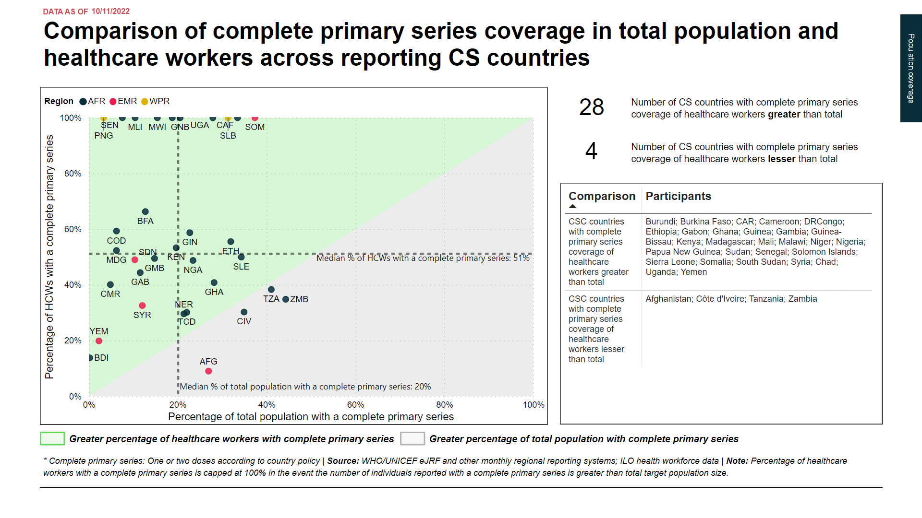

Slide 39
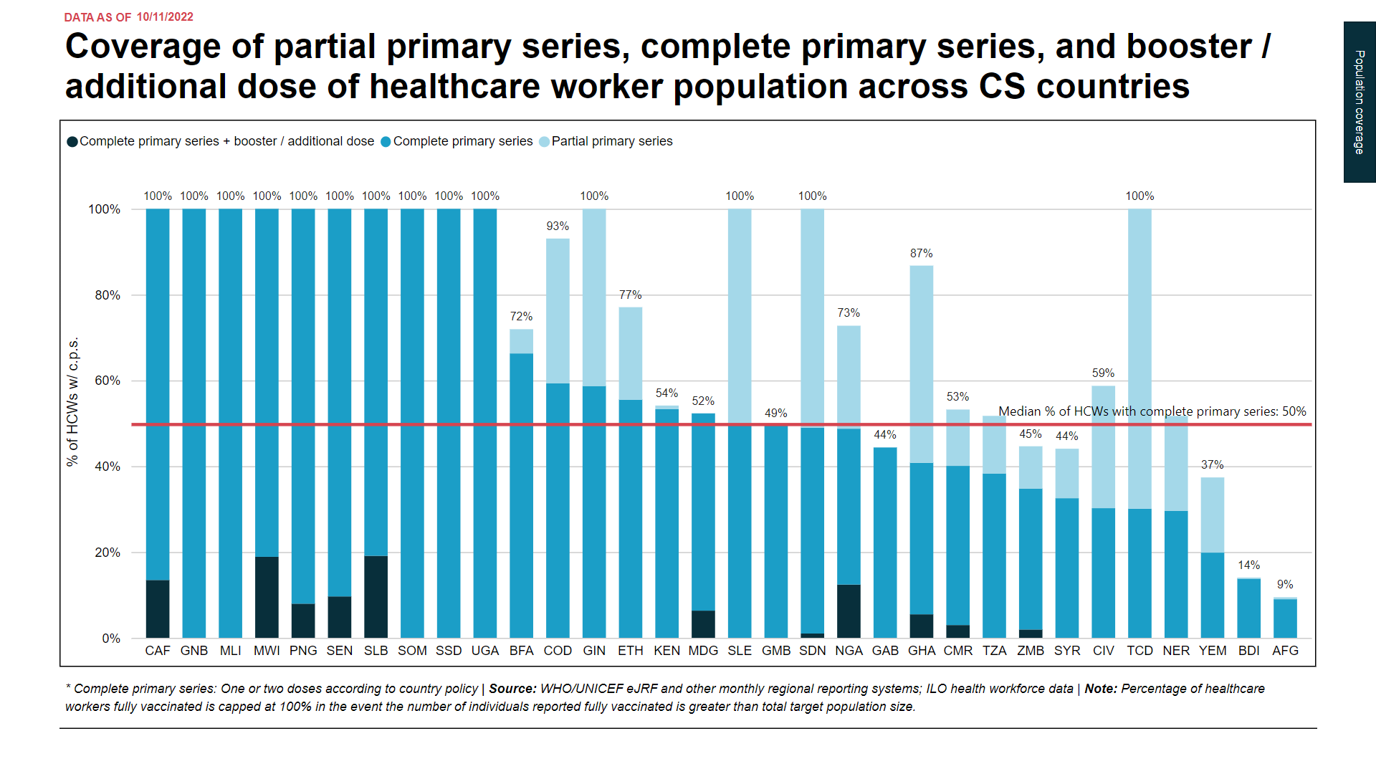

Slide 40
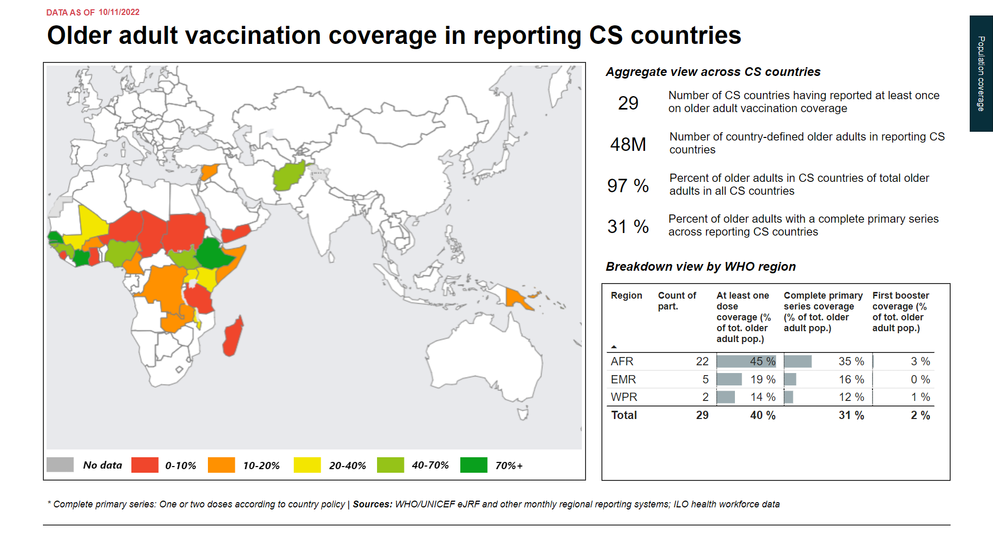

Slide 41
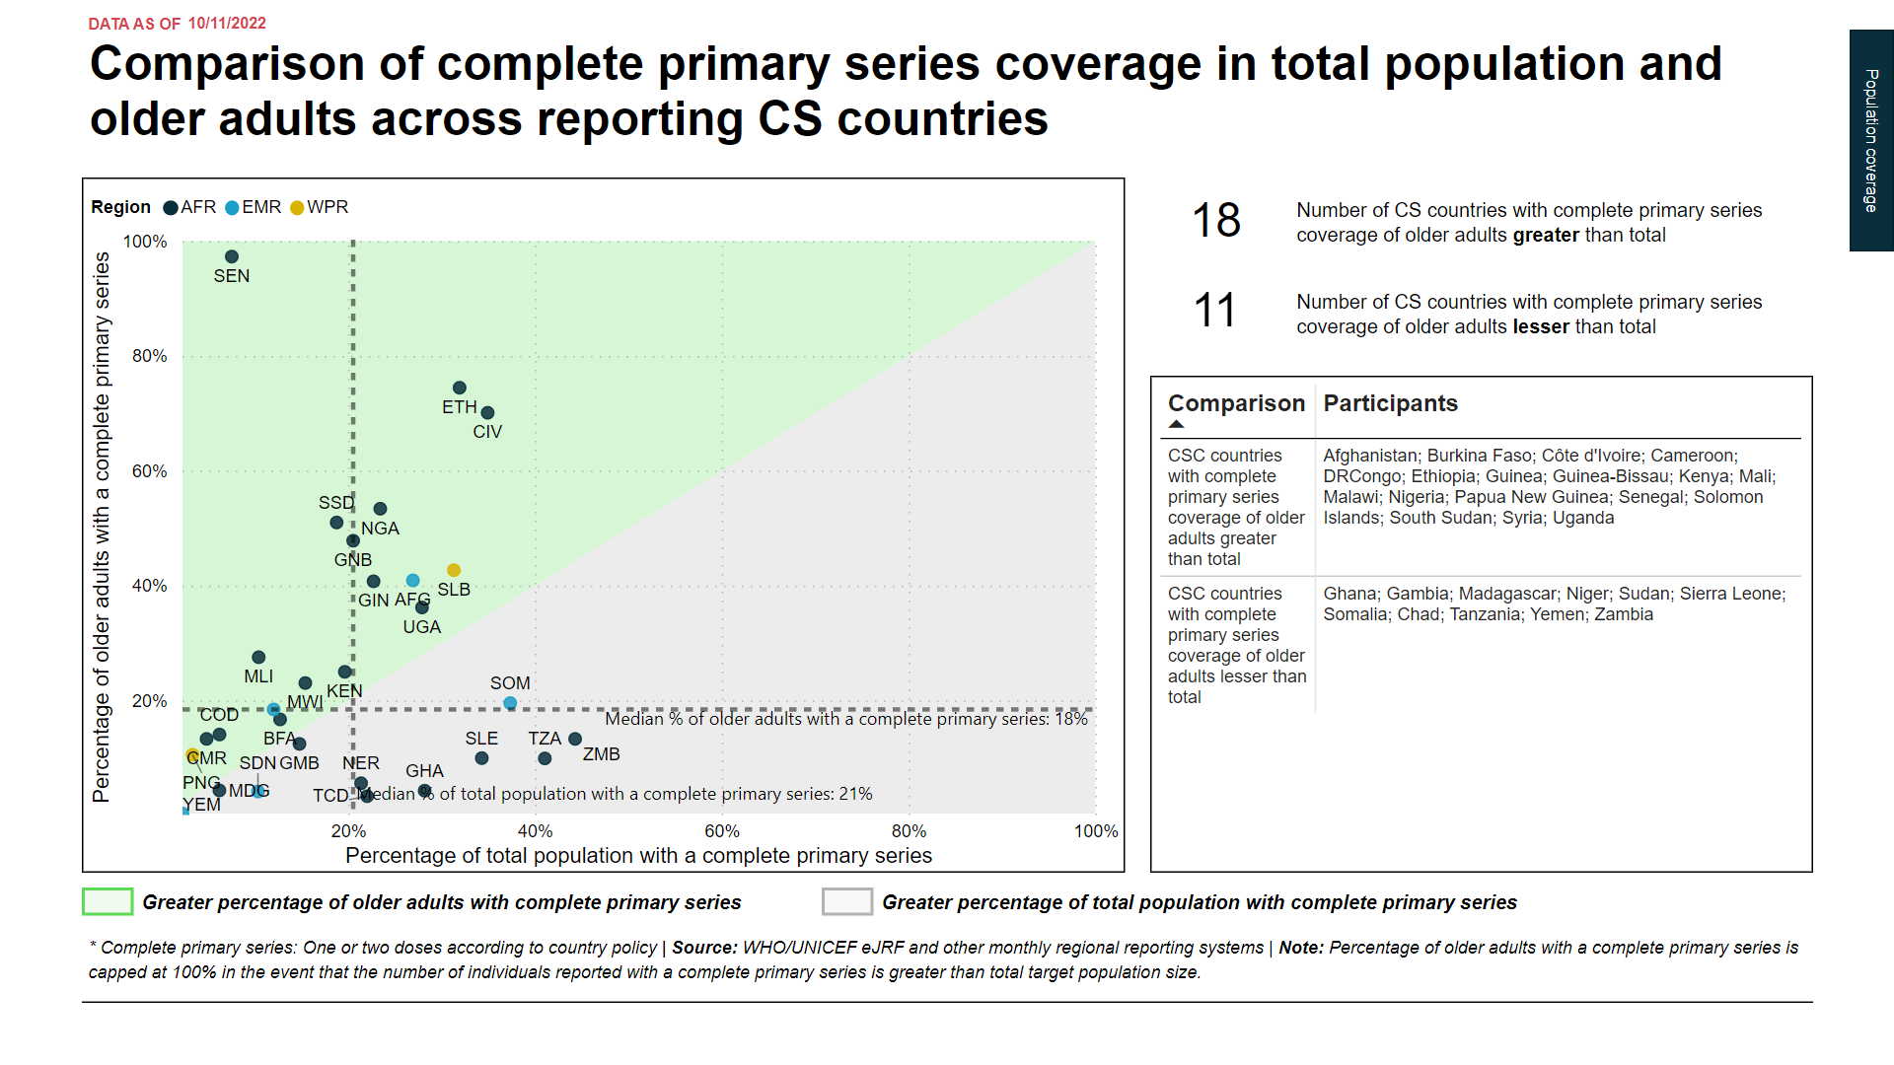

Slide 42
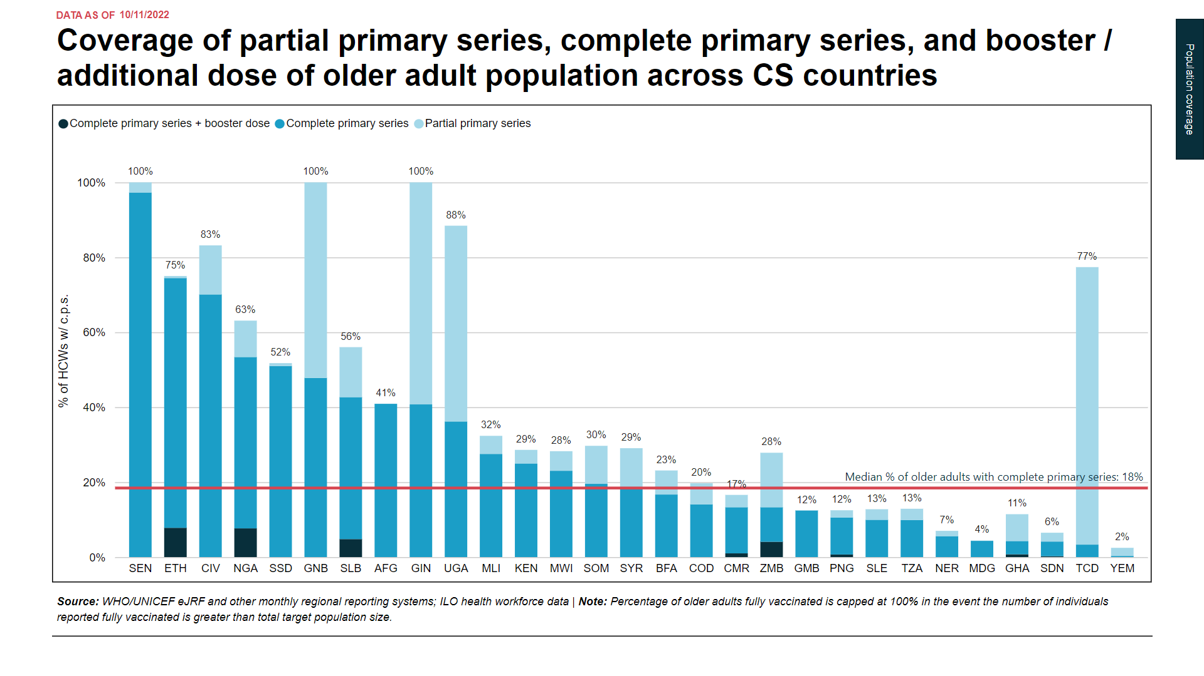

Slide 44
Annex 1: Country codes
Code | Country name
AFG | Afghanistan
AGO | Angola
BDI | Burundi
BEN | Benin
BFA | Burkina Faso
BGD | Bangladesh
BOL | Bolivia
BTN | Bhutan
CAF | CAR
CIV | Côte d'Ivoire
CMR | Cameroon
COD | DRCongo
COG | Congo
COM | Comoros
CPV | Cabo Verde
DJI | Djibouti
DMA | Dominica
DZA | Algeria
EGY | Egypt
ERI | Eritrea
ETH | Ethiopia
FJI | Fiji
FSM | Micronesia
GHA | Ghana
GIN | Guinea
Code | Country name
GMB | Gambia
GNB | Guinea-Bissau
GRD | Grenada
GUY | Guyana
HND | Honduras
HTI | Haiti
IDN | Indonesia
IND | India
KEN | Kenya
KGZ | Kyrgyzstan
KHM | Cambodia
KIR | Kiribati
LAO | Laos
LBR | Liberia
LCA | Saint Lucia
LKA | Sri Lanka
LSO | Lesotho
MAR | Morocco
MDA | Republic of Moldova
MDG | Madagascar
MDV | Maldives
MHL | Marshall Islands
MLI | Mali
MMR | Myanmar
MNG | Mongolia
Code | Country name
MOZ | Mozambique
MRT | Mauritania
MWI | Malawi
NER | Niger
NGA | Nigeria
NIC | Nicaragua
NPL | Nepal
PAK | Pakistan
PHL | Philippines
PNG | Papua New Guinea
PRK | DPRKorea
PSE | West Bank and Gaza
RWA | Rwanda
SDN | Sudan
SEN | Senegal
SLB | Solomon Islands
SLE | Sierra Leone
SLV | El Salvador
SOM | Somalia
SSD | South Sudan
STP | Sao Tome & Principe
SWZ | Eswatini
SYR | Syria
TCD | Chad
TGO | Togo
Code | Country name
TJK | Tajikistan
TLS | Timor-Leste
TON | Tonga
TUN | Tunisia
TUV | Tuvalu
TZA | Tanzania
UGA | Uganda
UKR | Ukraine
UZB | Uzbekistan
VCT | Saint Vincent & The Grenadines
VNM | VietNam
VUT | Vanuatu
WSM | Samoa
XKX | Kosovo
YEM | Yemen
ZMB | Zambia
ZWE | Zimbabwe

Slide 45
Annex 2: Definitions
Term | Definition
Course: | Number of doses required for a given product for its primary series (e.g. 2 doses of Pfizer BioNTech - Comirnaty)
Population coverage: | Percentage of total population fully vaccinated with any COVID-19 vaccine product from any source
Product utilization: | Percentage of total doses of any COVID-19 vaccine product from any source received that have been used
Daily vaccination rate: | Number of doses of any COVID-19 vaccine product from any source administered per unit time as calculated by examining historical dose administration data

