Slide 1

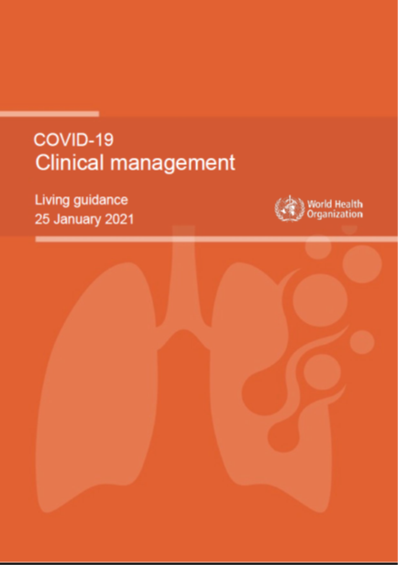
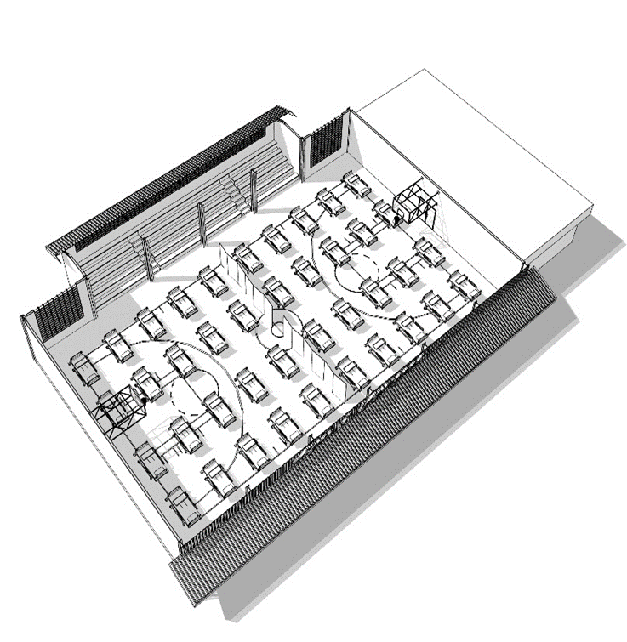

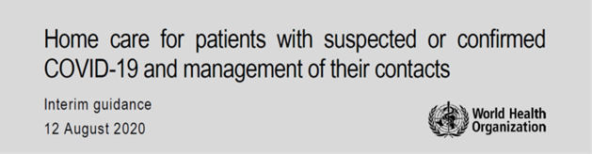
Management of mild/moderate COVID-19 patients: home-based care and community centres
Case Management Team,
WHE/WHO, HQ Geneva

Slide 2
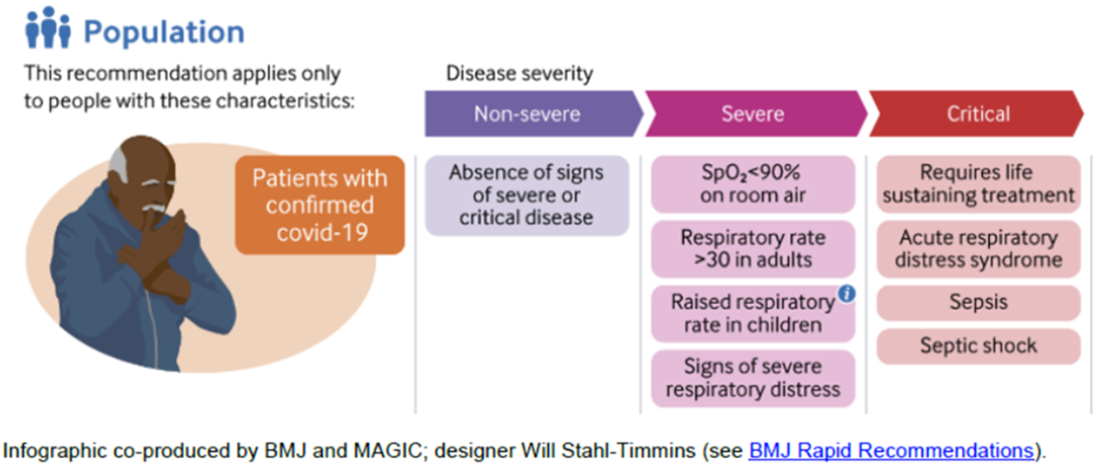
Classification of severity of patients with COVID-19 infection
  See WHO website for most up-to-date case definition: https://www.who.int/emergencies/diseases/novel-coronavirus-2019/technical-guidance

Slide 3
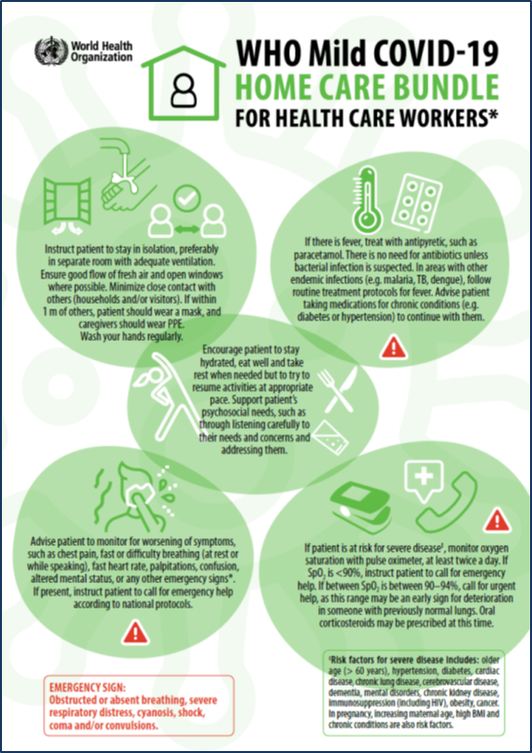
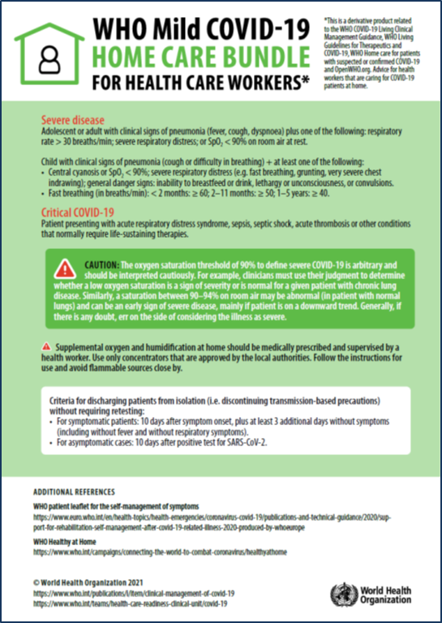
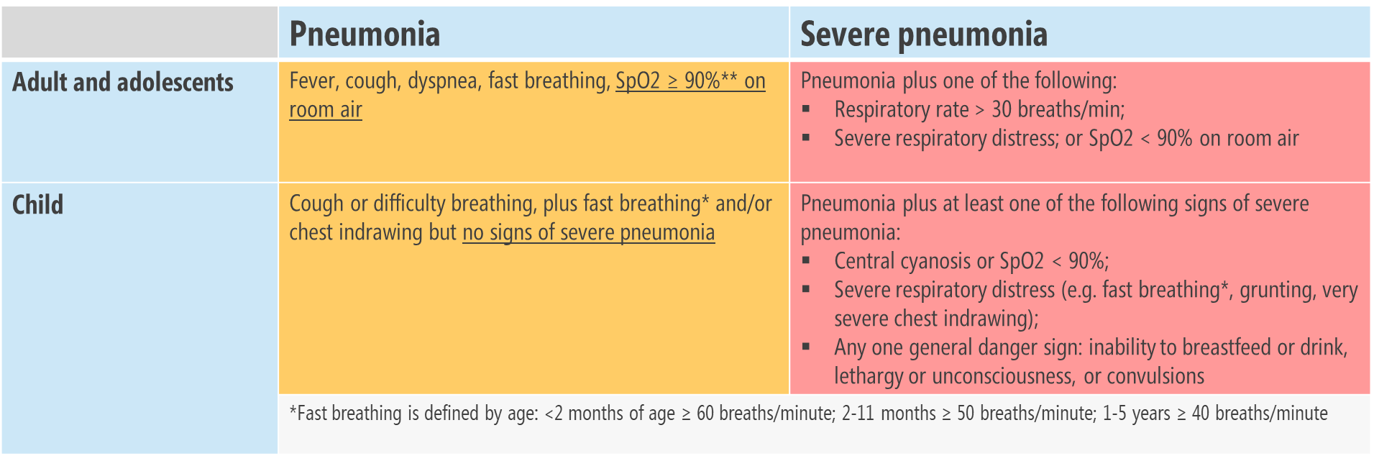
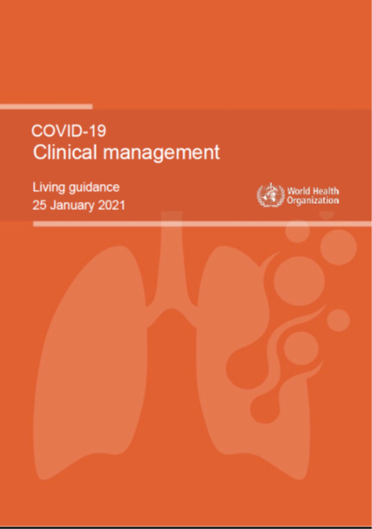
Non-severe COVID-19 infection
MILD disease: Symptomatic patients meeting the case definition for COVID-19 without evidence of pneumonia or hypoxia
MODERATE disease: Patients with clinical signs of pneumonia (fever, cough, dyspnoea, fast breathing) but no signs of severe pneumonia, including SpO2 ≥ 90% on room air.
https://www.who.int/publications/m/item/covid-19-home-care-bundle-for-health-care-workers
https://www.who.int/publications/i/item/WHO-2019-nCoV-clinical-2021-1
https://www.who.int/publications/i/item/WHO-2019-nCoV-clinical-2021-1

Slide 4

Risk factors for severe disease in patients with COVID-19 infection
LOWER RISK: Children and young adults become infected but are less likely to become seriously ill. They can also transmit the disease.
HIGHER RISK: Risk of severe disease increases with age and in those with underlying noncommunicable diseases.
Risk factors for severe disease include:
Older age (> 60 years), overweight/obesity, hypertension, diabetes, cardiac disease, chronic lung disease, cerebrovascular disease, dementia, mental disorders, chronic kidney disease, immunosuppression (including HIV), cancer, smoking.
In pregnancy, increasing maternal age, high BMI, non-white ethnicity, pre-existing comorbidities and pregnancy-specific conditions such as gestational diabetes and pre-eclampsia.

Slide 5
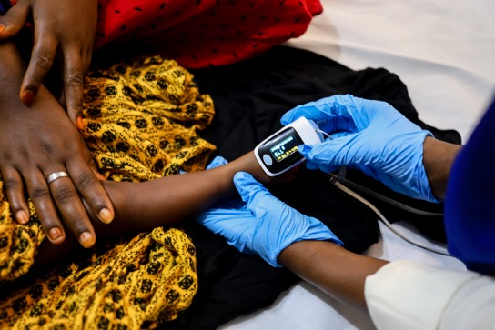

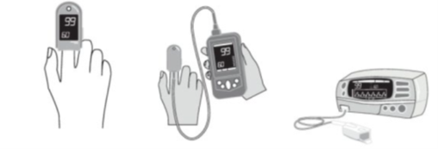
How to monitor a COVID-19 patient who is at risk of severe disease
If a patient is at risk for severe disease*:
Monitor oxygen saturation with pulse oximeter at least twice a day.
If oxygen saturation is lower than 90% instruct patient and caregiver to call for emergency help immediately.
If oxygen saturation is between 90–94% instruct patient and caregiver to call for emergency help, as this range may be an early sign for deterioration.
Oral corticosteroids may be described at this time by a clinician.
Supplemental oxygen at home should be medically prescribed and supervised by a health worker.
Photo: WHO

Slide 6
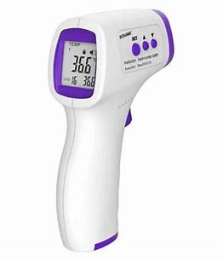
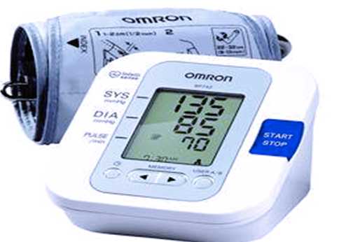
Management of mild/moderate COVID-19 cases at home
Vital signs and assessment measures:
temperature, blood pressure, SpO₂, AVPU

Slide 7
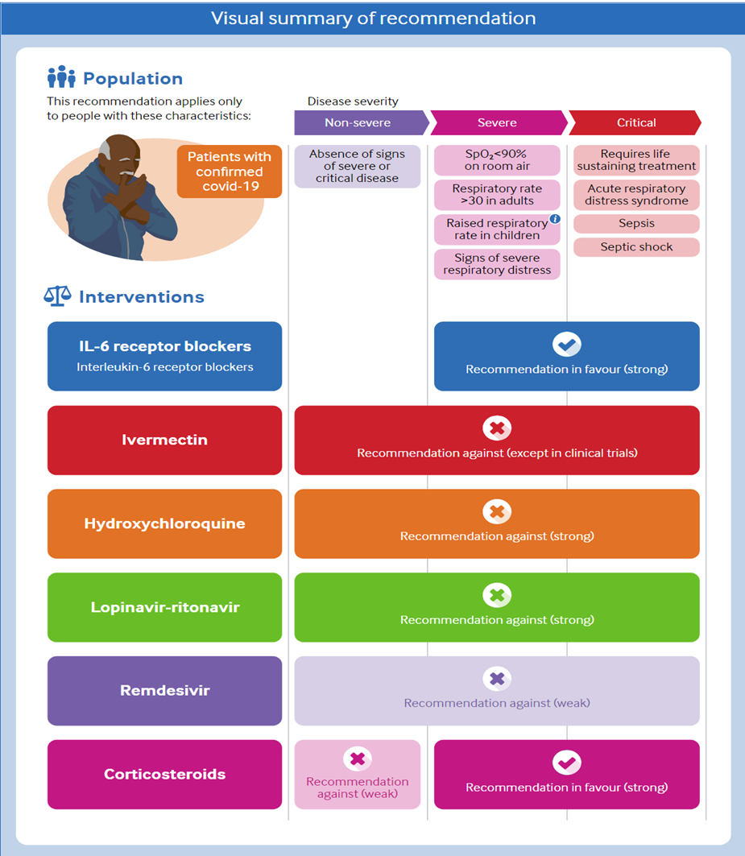
Management of MILD and MODERATE
COVID-19
Antibiotics should NOT be prescribed unless there is explicit clinical suspicion of a bacterial infection (in addition to COVID-19). Few patients with COVID-19 experience a secondary bacterial infection.
- Treat symptoms
  Give antipyretics (paracetamol) for fever
  Ensure adequate nutrition
  Ensure adequate hydration
  - Encourage the patient to take rest when needed but to try to resume activities at appropriate pace.
  - Support of patient’s psychosocial needs
  No specific medication has been approved and recommended against mild and moderate COVID-19
  (https://www.who.int/publications/i/item/WHO-2019-nCoV-therapeutics-2021.1)
https://www.bmj.com/content/370/bmj.m3379
Bacterial co-infection and secondary infection in patients with COVID-19: a living rapid review and meta-analysis. https://www.clinicalmicrobiologyandinfection.com/article/S1198-743X(20)30423-7/fulltext
Empiric antibacterial therapy and community-onset bacterial coinfection in patients hospitalized with coronavirus disease 2019 (COVID-19): a multi-hospital cohort study. https://academic.oup.com/cid/advance-article/doi/10.1093/cid/ciaa1239/5895253

Slide 8
Home-based care for COVID-19 patients: toolkit
COVID-19 home care bundle for health care workers (who.int)

Slide 9

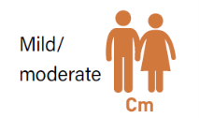
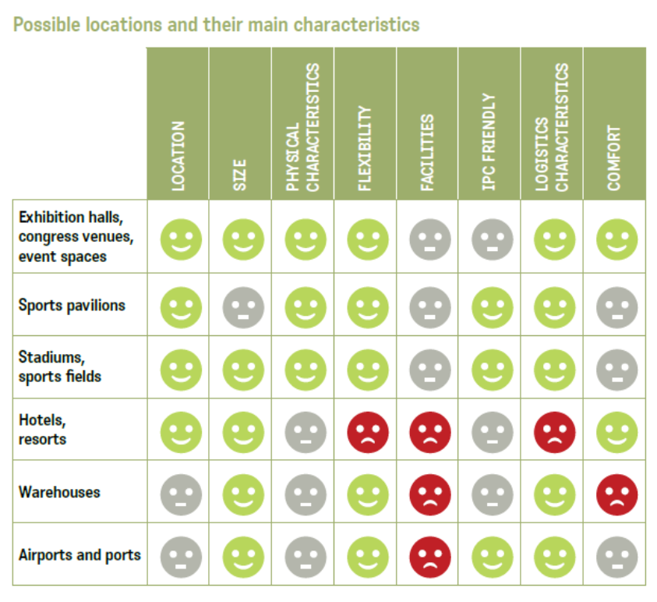
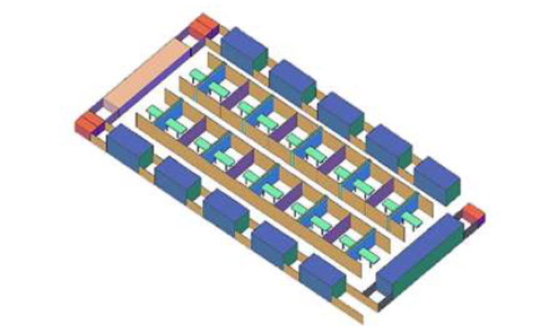
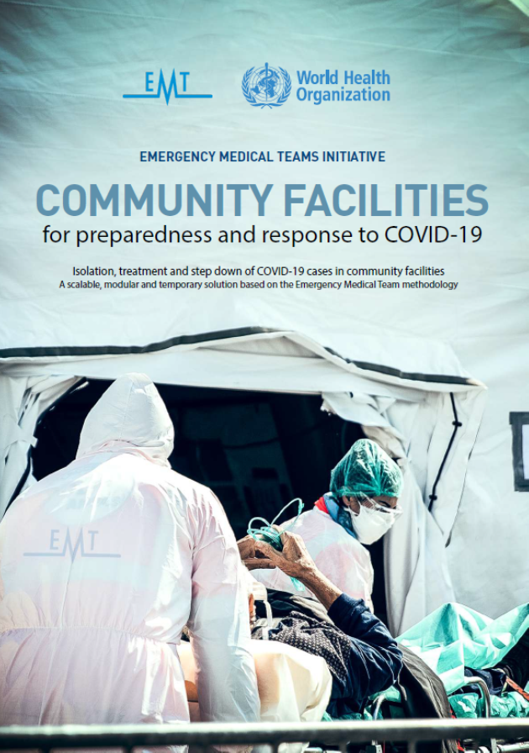
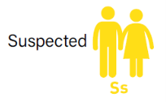
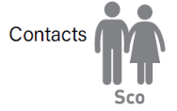
Community centre structure for COVID-19
Types of patients
Confirmed ward:
shared toilets and showers
Suspected and contacts ward:
independent toilets and showers
200828 COMMUNITY FACILITIES for preparedness and response to COVID-19_compressed.pdf
200828 COMMUNITY FACILITIES for preparedness and response to COVID-19_compressed.pdf

Slide 10
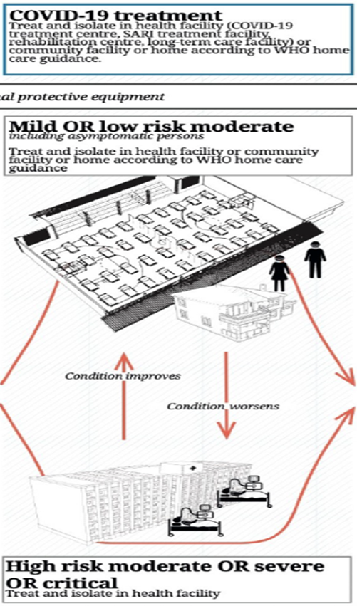

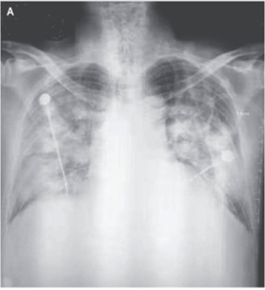
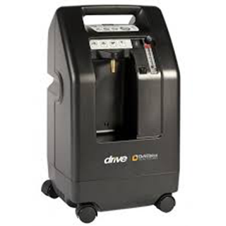

Referral to hospital or health care facility
When to refer to hospital
Severe and critical cases
Moderate cases with risk factors
Mild or moderate cases that
present worsening of symptoms:
- Chest pain,
- Difficulty breathing (at rest or while speaking),
- Confusion or altered mental status,
- Loss of speech or mobility.
Any other emergency sign:

Slide 11
Conclusions
Screening and triage of patients with COVID-19 infection: identify the best plan for case management depending on severity and risk factors.
Monitoring and follow up of patients at home or in community facilities is crucial (measure vital signs: pulse oximeter).
Identification of emergency signs or clinical deterioration – to refer if necessary to the next level of care.

