Slide 1

COVID-19 Case Management Webinar Series: Home/Community Care Management of Patients with Non-Severe COVID-19, WHO, Geneva, 04 August 2021
SONJO: Community Isolation Shelter
for COVID-19 Patients
Rimawan Pradiptyo, PhD
Head, Department of Economics,
Faculty of Economics and Business, Universitas Gadjah Mada
and Initiator of SONJO

Slide 2


COVID-19: Is It a Disaster or a War?
COVID-19 is a common enemy (non rival & non excludable)
No one knows when the pandemic will last (as if playing an infinitely repeated game)
The sustainability of the movement is paramount.
The dominant strategies are:
  Expect the unexpected: in term of the impact of the pandemic;
  Thinking Innovatively: in term of the alternative solutions.
  Resource mobilization to tackle the COVID-19 and its impacts in our region/ neighborhood

Slide 3

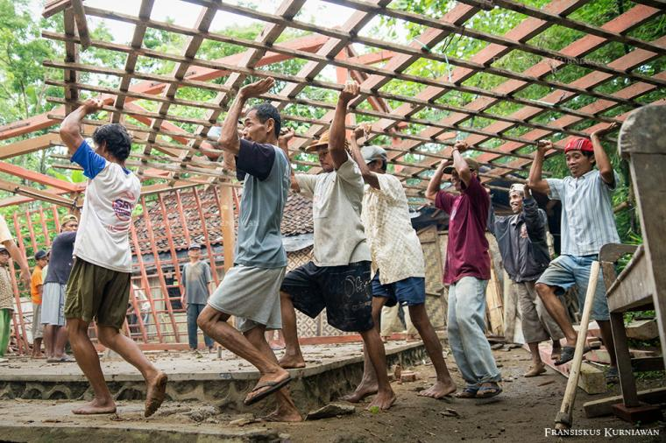
We are not in the sea & we are linked by internet
The poster which was so popular in Indonesia in March 2020
The way of thinking in SONJO since 24 March 2020

Slide 4

How to Mobilize Resources?
During war/ pandemic/ economic crisis, logistic (resource) is a paramount
Where are the resources? The state budget of Indonesia is only 1/6 of the GDP and 5/6 of the GDP are own by the households and businesses.
The SMEs contribute to 50% of the economy.
Sambatan is a traditional form of communal work in Jawa, which transforms time and abandon labor to compensate the lack of capital.
SONJO (Sambatan Jogja) uses a similar approach with using WAGs.
State Budget
Strict rules
1/6 of the GDP
HH and Businesses
More Flexible
It may not be in term of money
5/6-6/7 GDP

Slide 5

SONJO (Sambatan Jogja)
SONJO is a humanitarian movement to minimize the impact of Covid-19 in the province of Yogyakarta. The SONJO was formed on 24 March 2020.
We use WhatsApps Group (WAG) to coordinate and to conduct communal works in the areas of health, economy and education.
A study shows, on average, individuals in Indonesia spent 3,5 hours/day to access social media in various forms.
Cultural consideration is heavily used in the programs of the SONJO.
The Focus of the SONJO:
  Vulnerable people and people at risk owing to the pandemic Covid-19
The Values of the SONJO:
  Integrity, Transparency, Empathy, and Sinergy
Hastag:
#OraAnaSingKeri (#NoOneLeftInDespair)
Website: Sonjo.id/

Slide 6

The Development of 24 WAGs of the SONJO
24/03/20
SONJO HQ, 241 members*
22/06/20
SONJO Pendidikan, 55 members*
26/09/20
SONJO Wedding & Wisata, 116 members*
06/01/21
06/12/20
14/12/20
SONJO Kebijakan, 93 members*
SONJO Rewangan, 107 members*
SONJO Tangguh, 103 members*
26/03/20
27/03/20
SONJO Database, 119 members*
SONJO Pangan-1, 256 members**
28/03/20
29/03/20
SONJO Inovasi, 72 members*
SONJO Legawa, 188 members*
31/03/20
SONJO Media, 44 members**
17/04/20
SONJO Pembelajaran, 56 members **
20/06/20
SONJO Pangan-2, 162 members*
25/01/21
SONJO Rukti Jenazah, 22 members*
21/02/21
SONJO Pertanian, 88 members
SONJO Srikandi, 59 members*
Database Shelters, 87 members*
26/02/21
07/04/21
SONJO Ekspor, 80 members*
11/05/21
29/05/21
SONJO Saras, 20 members*
Rereongan Jawa Barat, 110 members*
24/06/21
08/06/21
Sambatan Lingkar Muria, 94 members*
Komando Tes PCR, 26 members*
19/06/21
04/07/21
Sambatan OTO, 34 members*
11/07/21
Rupil Ancol & SONJO
*) technical WAG; **) supporting WAG

Slide 7
The Development of SONJO
Compliant Committee
SONJO HQ
SONJO Pangan (2 WAG)
SONJO Inovasi
SONJO Legawa
SONJO Database
SONJO Media
SONJO Pembelajaran
SONJO Pendidikan
SONJO Wedding & Wisata
SONJO Tangguh
SONJO Kebijakan
SONJO Rewangan
SONJO Rukti Jenazah
SONJO Pertanian
SONJO Ekspor
SONJO Database Shelter
SONJO Srikandi
SONJO Saras
Website
SONJO
Database
Apps
24 March 2020
Social Media
Present Day

Slide 8

No Funding Required
Self
Help Group
Charity
SONJO is not a charity
  SONJO is not depended on funding from other institutions, including the government.
SONJO is a movement (self-help group)
  Sharing burden, sharing responsibility
  Focus on improving resiliency of society
  No funding is required, and each member contributes according to their skills/expertise
  SONJO creates public goods aims to reduce transaction costs of people during the COVID-19 pandemic.

Slide 9


Reducing Transaction Costs by Creating Public Goods
Health
Economy
Education
Public Goods
Source: celebrity.okezone.com
Source: pngegg.com

Slide 10
Coverage of the SONJO
Health
Education
SONJO
Economy
SONJO Kebijakan (Policy)
SONJO Angkringan (webinar)
SONJO Migunani (transfer of skills)
Propose policies in relation to COVID-19 to the government (Regency, Province, Central Government)
Weekly webinar. Topic: problems related to COVID-19 faced by the members. Up to episode #57
Sharing skills and experience among members of the SONJO. Up to episode #9
SONJO Solidarity Journey
Webinars, sharing experience of developing social capital (SONJO) to international audiences. Up to episode #2.

Slide 11
Programs in Economy
#1. Database Sonjo Pangan (Database of grocery stores, traditional markets and restaurants)
#2. SONJO Ngabuburit (promoting culinary products during the holly mount of Ramadan)
#3. Etalase Pasar SONJO (EPS) (a show room app for SMEs)
#5. SONJO Jagong (promoting health protocol for weddings and events)
#6. SONJO Ekspor (Promoting SMEs to export their products)
#7. SONJO PasarDesa (supporting logistic to patients in shelters using local market place)
#4. SONJO HampersFest (promoting parcel for special occasion)

Slide 12
Programs in Health
#2. SONJO Husada
(supporting hospital and health center with PPE, hand sanitizer, etc)
#3. SONJO Inovasi (Supporting innovators to discover new equipment for Covid-19)
#1. SONJO Poster
(online dissemination of Covid-19)
#5. SONJO Database Rewangan
(Referral system for Covid-19 patients across hospitals)
#6. SONJO Husada Tangguh
(collaborative fund raising to support shelters & teams of volunteers)
#12. SONJO Rukti Jenazah
(Infectious Dead Body Handling for COVID-19 funeral)
#4. SoHibKoe (SONJO Husada Konvalesen) Registering volunteers for plasma donors
#7. Database Shelter
(Developing database for monitoring of shelters)
#8. Database of Patients in Shelter (SISTERKU)
#9. SONJO Saras (volunteers to supervise shelters)
#10. LiveDokter (Teleconsultation)
#11. SONJO Uwuh (a pilot project of medical waste management for shelters)

Slide 13

SONJO Rewangan (Patients Referral System
Among Hospitals)
Surge of Patients
Local elections
Long holidays
Problems with the Referral System
Specific referral
The system built pre pandemic
SONJO Rewangan
Alternative referral system
Double auction approach
Dec 20 – Feb 21
WAG and Excel
The WAG was proposed by health workers in SONJO on 13-Dec-20
The program/WAG has been operating since 14-Dec-20

Slide 14
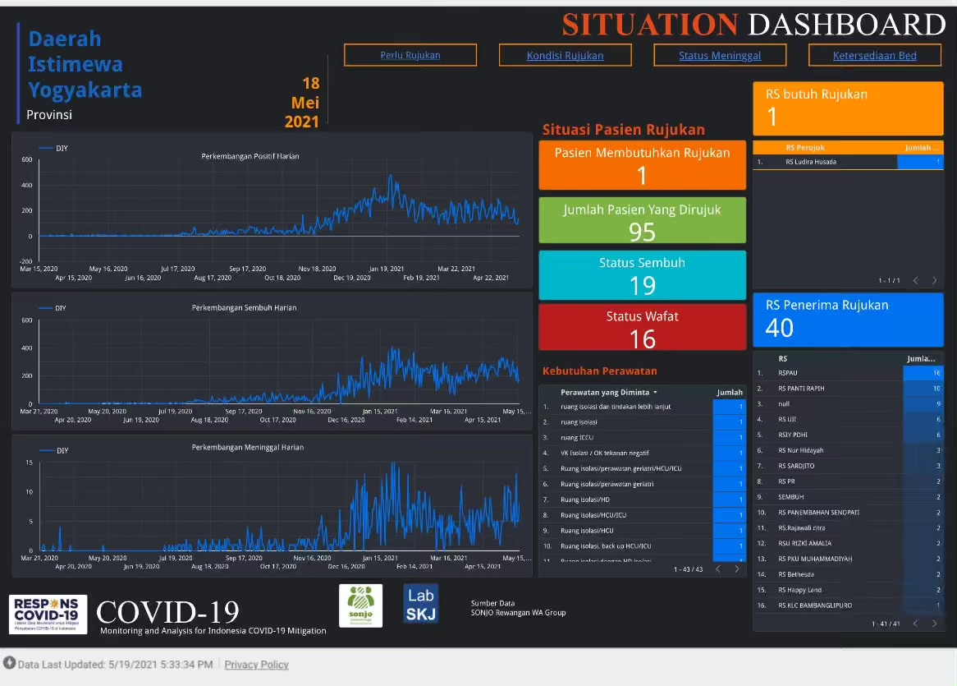
During the peak of the surge patients, Dec 2020, the waiting list for the referral reached 26 patients!!
Emergency Rooms in some hospitals were closed temporarily due to the surge of patients
It drove a triple helix cooperation in the development of the resilient shelter (shelter tangguh) at regency level: ex Padmasuri Hospital (capacity 60 beds) in January 2021.
Source: https://datastudio.google.com/s/jDFjhrJ-mHA

Slide 15
Health Office of Bantul’s Multilevel Shelters
& Dual Referral System
If a patient is getting better
Sub-Village Shelters
Village Shelters
Regency Shelters
Temporary Hospital (RSLKC)
Designated Hospitals
Patients with medium to critical symptoms
Patients with medium symptom
Patients with light symptom
Asymptomatic patients
Patients waiting for PCR test results
If a patient is getting worse

Slide 16
Collaboration between SONJO & Bantul Health Office
Health
Economy
SONJO
Education
Sub-village shelters
Village Shelters
Regency Shelters
Dual Referral System
(Health Office of Bantul)

Slide 17

Technical Assistant:
How to Develop Shelter
Technical Assistant #8 had been conducted by:
  dr. Tarsisius Glory (Bantul Health Office)
  dr. Sri Aminah (Yogyakarta Regional Hospital)
Coverage Areas/Corporations
  Kudus, Pati, Demak, Jepara
    WAG Sambatan Lingkar Muria (SaLiRa)
  Bandung Barat, Bandung, Karawang
    WAG Rereongan Jawa Barat
  PT. OTO, PT. IFG
    WAG Sambatan OTO
  PT Pembangunan Ancol
    WAG Rupil Ancol & SONJO
  Bangkalan, Sumenep (Madura Island)
Materials: https://sonjo.id/en/sonjo-migunani-en/the-extensification-of-shelter-construction-to-support-hospitals/

Slide 18
Type of Shelters
Regency (mild symptom)
University (asymptomatic)
Islamic Boarding School (Pesantren) (asymptomatic)
Corporation (asymptomatic)
District
(asymptomatic)
Village (asymptomatic)
Sub-Village (asymptomatic
Shelter
The original version of the shelters in Bantul are: regency, village and sub-village shelters.
The pesantren (Islamic boarding school) shelters have been developed in Sleman (Yogyakarta) and Kudus (Central Java)
The university shelters have been developed in Sleman (Yogyakarta), Kudus (Central Java) and Bandung (West Java)
The corporation shelters have been developed in Bogor (West Java) and Jakarta.

Slide 19
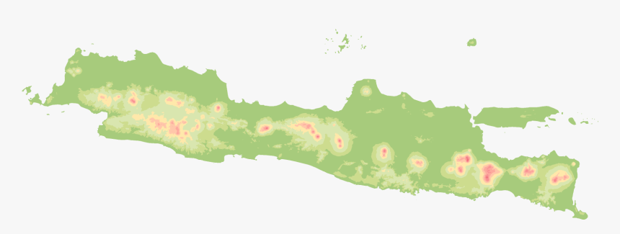
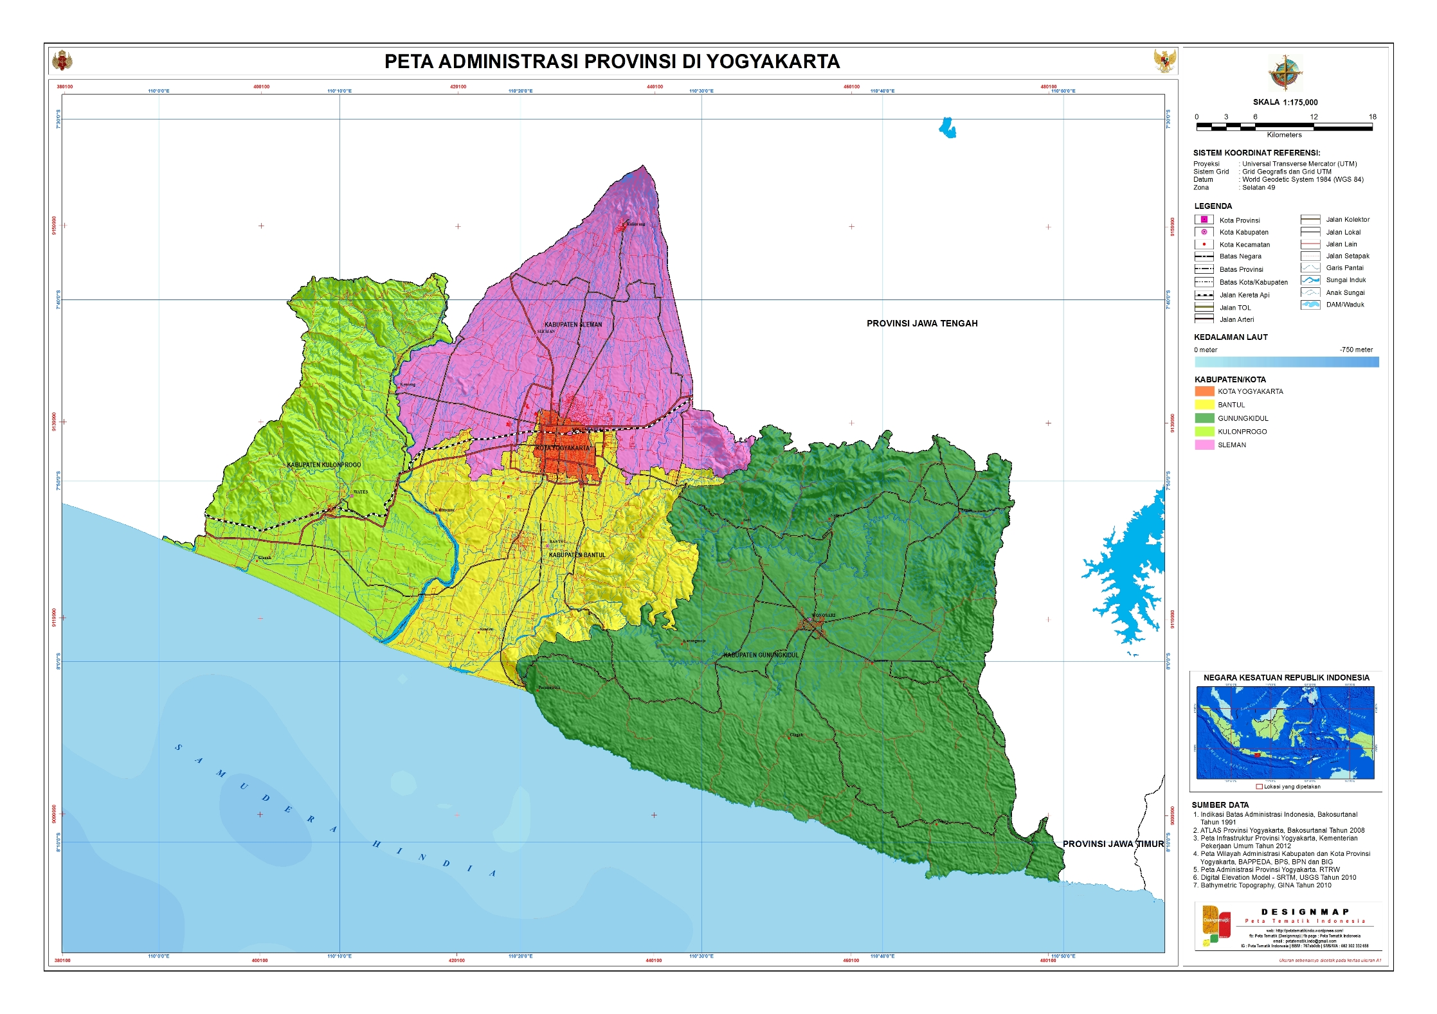
Mainstreaming of the Shelters through Join WAGs
Attempts have been made to mainstream shelters outside Yogyakarta by developing join WAGs.
The members of the WAGs are volunteers of SONJO and volunteers from other regions. (Central Java, West Java and Jakarta)
The existence of the join WAGs enable us to transfer of knowledge and experience of developing shelters.

Slide 20

Join WAGs Aim to Develop Shelters
There are variations in the development of shelters in other areas. Local conditions and also culture is heavily considered.
WAG Sambatan Lingkar Muria (4 regencies): 22 shelters
  MCCC – NU Peduli – SONJO – Local Society
WAG Rereongan West Java (province): 3 shelters
  MCCC – NU Peduli – SONJO – CISDI – PUSPA- Local Society
WAG Sambatan OTO (1 shelter)
  OTO Ltd & SONJO
WAG Rupil Ancol & SONJO (1 shelter)
  Pembangunan Ancol Ltd & SONJO

Slide 21
The Triage System & 3T
Triage
Public Health Center
Hospital
Asymptomatic or Mild Symptom
Shelters
If a patient is worser, he/she is referred to hospital
Medium to Critical Symptom
Hospital
If a patient is better, he/she is referred to shelters.
The system puts public health center (Puskesmas) as an important role in the triage system.
The shelters play an important role on trace, test and treatment (isolate).

Slide 22
Supporting Programs of Shelters
Logistic for patients (SONJO PasarDesa)
Logistic for shelters and volunteers (SONJO Husada Tangguh)
Database monitoring of shelters and patients (SITangguh & SISTERKU)
Quality assurance of the shelters (SONJO Saras, in collaboration with FK-KMK, UGM)
Teleconsultancy (LiveDokter, in collaboration with Kagamadok & FK-KMK, UGM)
Waste management for shelters (pilot project) (SONJO Uwuh)
Infectious Corpse Handling (SONJO Rukti Jenazah): https://sonjo.id/en/sonjo-migunani-en/sonjo-migunani-6-infectious-covid-19-corpse-handling-by-community/
SONJO Husada Tangguh
(collaborative fund raising to support shelters & volunteers)
Infectious Corpse Handling (SONJO Rukti Jenazah)
SITangguh & SISTERKU
(Databases for monitoring shelters and patients)
SONJO PasarDesa (provision of healthy food groceries for patients in shelters/ or at home)
Quality Assurance of Shelters (SONJO Saras, collaboration with FK-KMK UGM)
Teleconsultancy (LiveDokter, collaboration with Kagamadok and FK-KMK UGM)
Waste management for shelters (SONJO Uwuh)

Slide 23
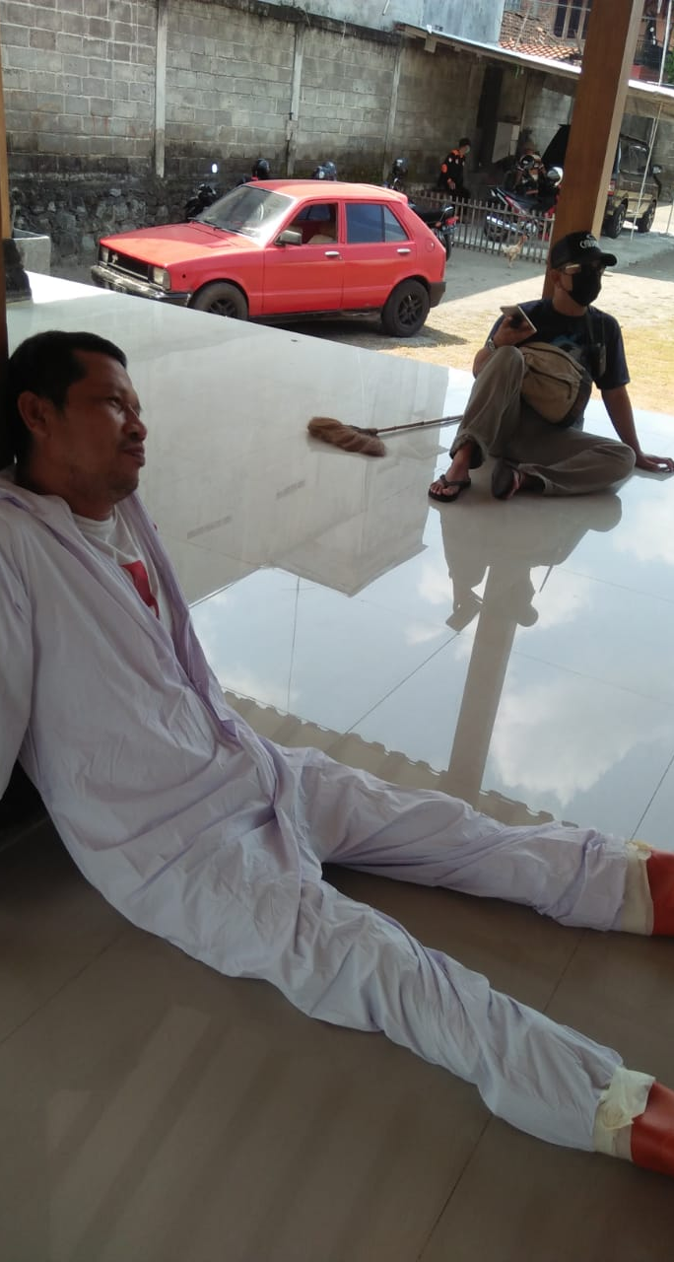
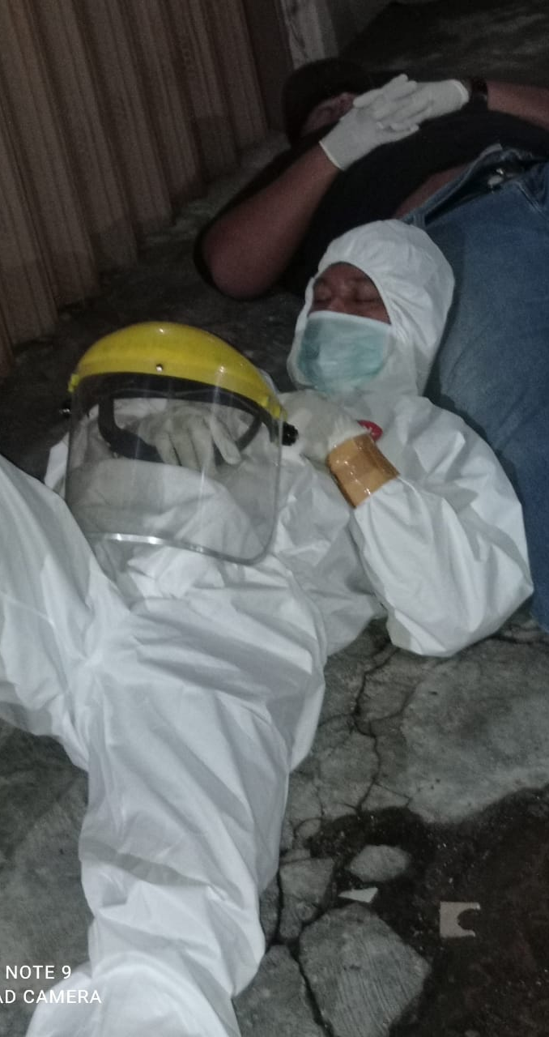
Complexities
The system tends to be suboptimum if the shelters do not link with a hospital
Public health center plays a crucial role in disaster pre-hospital triage, however, the existence of the shelters depends on head of region (village/ regency)
The bottom-up approach tend to be pursued by pesantren, university, and corporation
People in the neighborhood may refuse the shelter, but this may be solved by pro-active local government.

Slide 24


Matur Sembah Nuwun

Slide 25

Appendix:
Supporting Programs

Slide 26
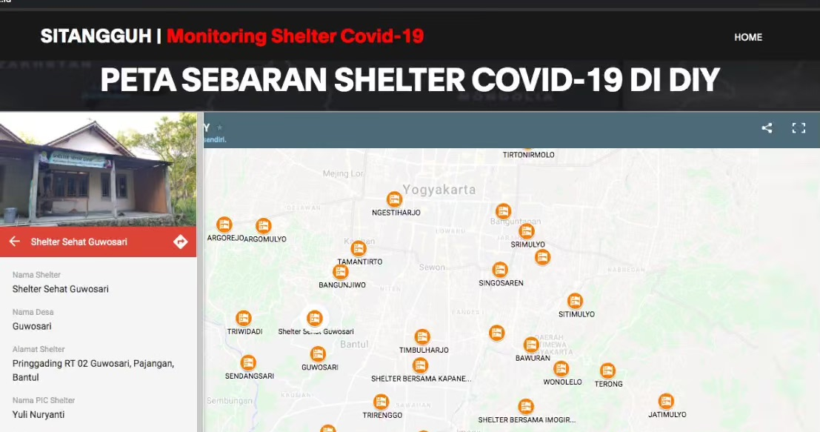
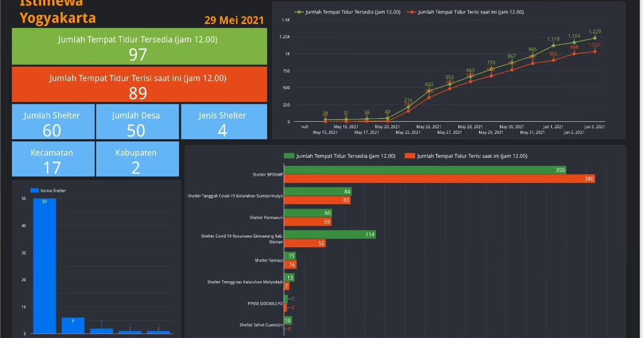
SITangguh: Database of Shelters in Yogyakarta
The WAG of Database Shelter was formed on 11 May 2021.
We developed SITangguh (Information System of Shelter Tangguh)
Aims: Developing database of shelters in the Province of Yogyakarta to mitigate the second wave of the Covid-19.
Thus far 60 shelters are registered in Bantul and Sleman. Currently we support Sleman regency to develop more shelters to anticipate the 2nd wave surge of patients.
The variation across regencies is due to the local government policies.
Source: shelter.gamabox.id

Slide 27
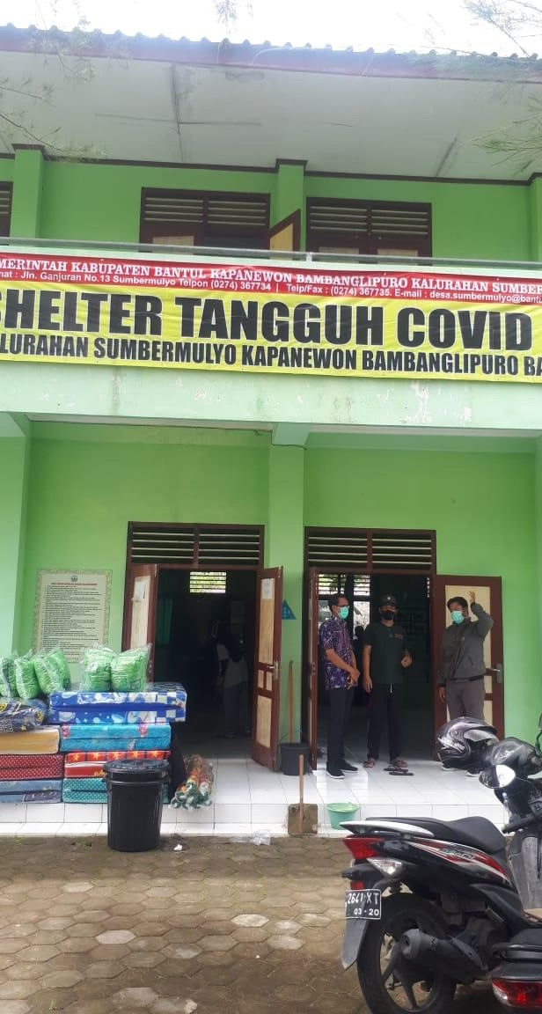
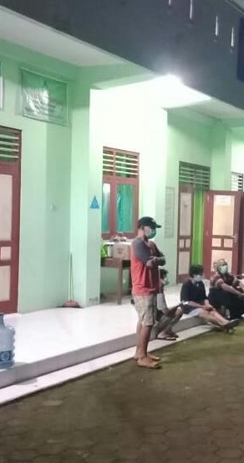
SISTERKU
SISTERKU is an IT system of patients in shelters
All patients in a shelter have to join a WAG
They have to report their temperature and saturation of O₂ in regular basis using WAG.
SONJO has developed SISTERKU to help the health office of Bantul in managing and monitoring patients across shelters
This system has been extended to include teleconsultation. This program will be launched within a week.

Slide 28


SONJO Husada Tangguh
The WAG SONJO Tangguh was formed on 6 Jan 2021
Members: head of villages, CSOs, volunteers (MCCC, etc), health experts, PPE producers, politicians, bureaucrats, etc.
Aims: promoting collaboration across stakeholders to support shelters
It has a program of identifying demand and supply of provisions for the shelters
Collaborative fund raising has been done by several CSOs in the WAG.
The donation has been used to support:
  Shelters in Bantul, Sleman and Kudus
  Teams of volunteers in Bantul, Sleman, Kulon Progo, Gunung Kidul and Yogyakarta City
  Hospitals in Bantul, Sleman, Kulon Progo
  Hundreds of isolation patients in pesantren in Bantul and Sleman, and self isolation patients in Yogyakarta City.

Slide 29
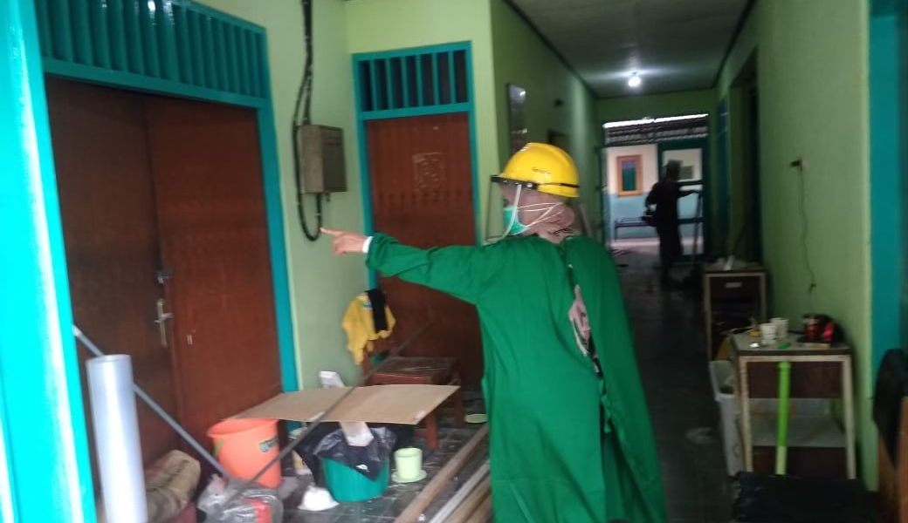
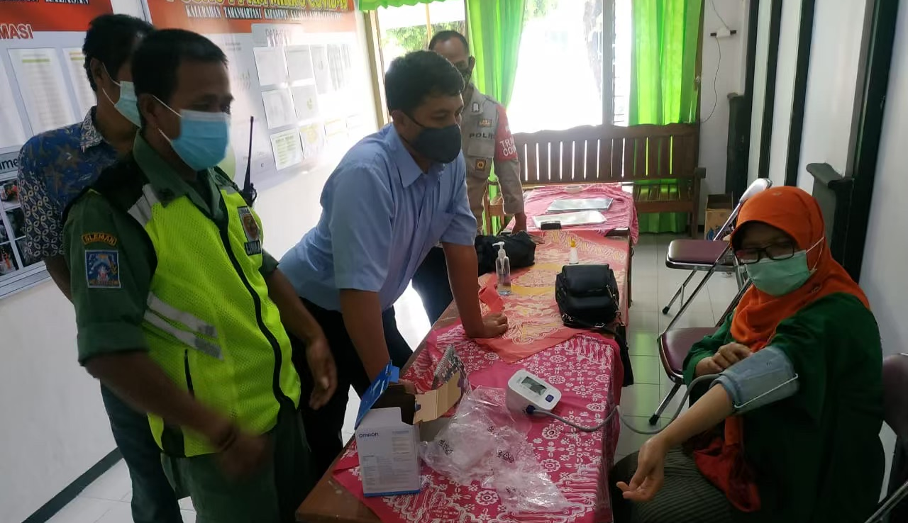
SONJO Saras
The program provides technical assistant to village, sub-village and also pesantren (Islamic boarding school) to develop, and to ensure the quality of the shelters.
Students and lecturers from the Faculty of Medicine, the Faculty of Pharmacy of several universities joint this program.
Dr. Sri Aminah and her team wrote guide books on how to develop both village and pesantren shelters. The guide books are available for free in SONJO.id.

Slide 30

LiveDokter
(Online Consultation)
This teleconsultation and telemedicine programs are the collaboration of Kagamadok - FK-KMK UGM and SONJO
The program has attracted about 200 volunteer medical doctor (some of them are quite senior)
The coverage of the program: to all people in Indonesia
SISTERKU (apps for monitoring patients) has been developed by Faculty of Science of UGM team.
The first 24 hours, the program has attracted more than 250 inquiries.

Slide 31

SONJO Rukti Jenazah
If a COVID-19 patient passed away at home, the community has to handle the infectious corpse
Handling infectious COVID-19 corpses should be conducted correctly to avoid further spread of the COVID-19
At the same time, this should also conform with guidance of the religions on handling the corpses.
This program provides guidance on how to handle infectious COVID-19 corpses from the perspective of Islam and Christianity. The guidance may be downloaded for free at: https://sonjo.id/en/uncategorized-id/sonjo-migunani-6-infectious-covid-19-corpse-handling-by-community/

Slide 32
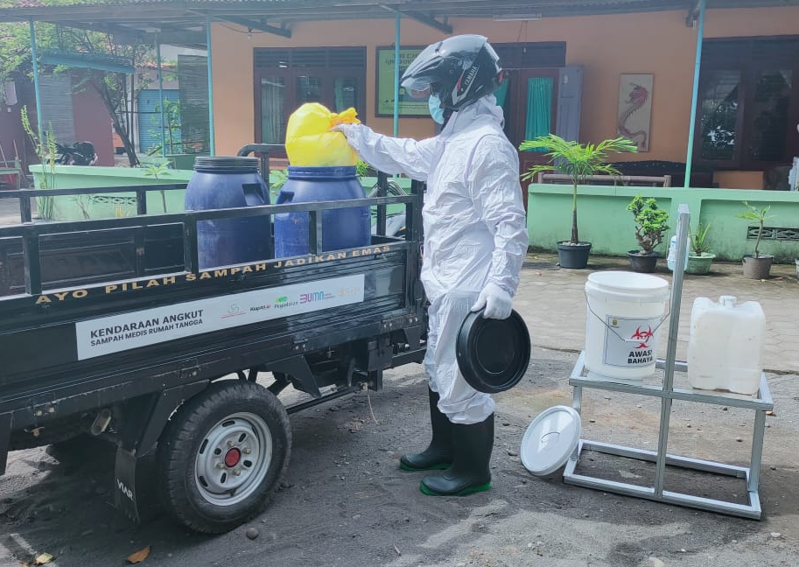
Pilot Project: SONJO Uwuh
There is no intervention using needle in the shelters, however, the shelters produced substantial medical waste (masks, PPEs, etc.).
The project is a collaborative work between SONJO and Panggungharjo village, which has an incinerator.
The projects covers 80 dasawisma (ten households in each dasawisma) in Panggungharjo village. Extension will be conducted to cover additional 10 shelters of the neighboring villages.
The pilot project is for three month commencing April 2021.

Slide 33
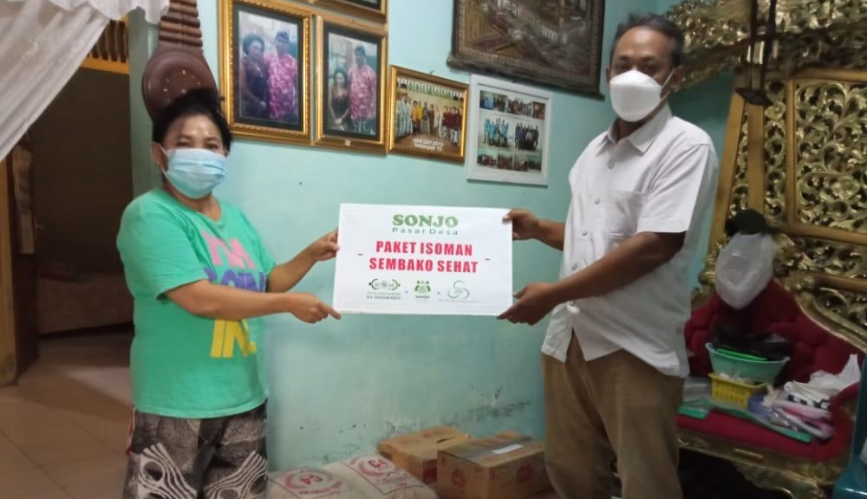
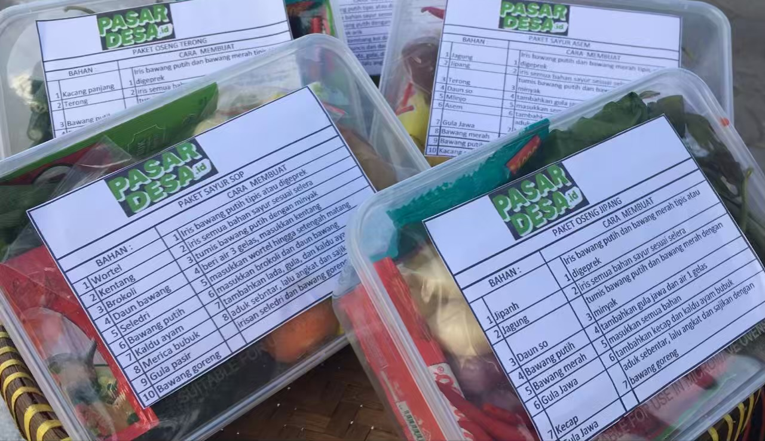
SONJO-PasarDesa
There is a budgetary constraint for the operational costs of the shelters.
A pilot project was conducted in Bantul, Sleman and Kudus (each of which 200 packages)
Currently the program has been designated to pesantren and self-isolation with low income HH.
Each patient of the shelter receive food voucher worth USD 12.5 (Rp180.000) for 10 days, and the healthy groceries are provided by pasardesa.id.
The program links among shops, farmers, traders, and delivery courier to patients in the shelters or in their home.

Slide 34
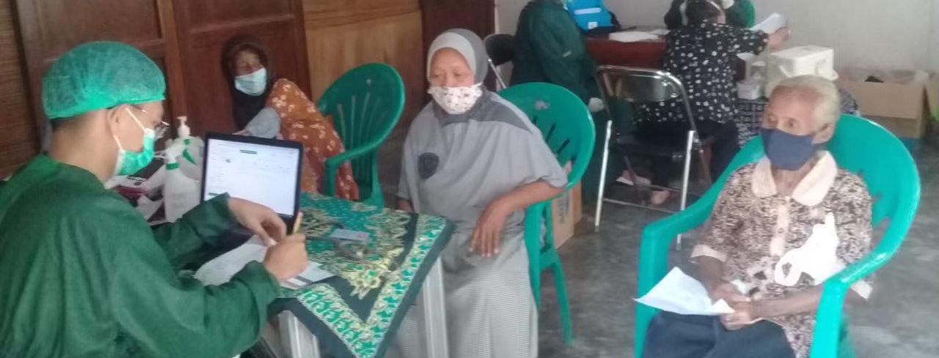
SONJO Tetuko (Mass Vaccination)
This is a join project among regency health office – PKK (women association) – SONJO
It was formed prior to the Emergency PPKM
The program will be held after the Emergency PPKM.

