Slide 1
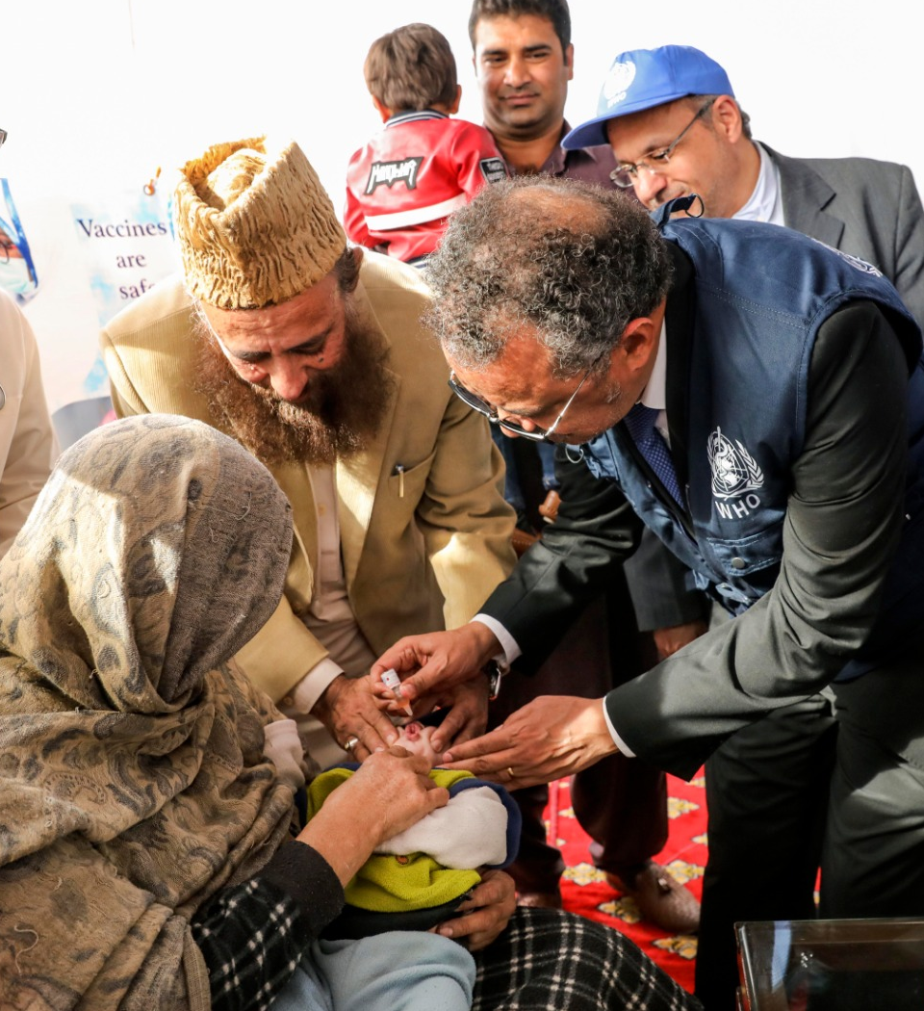


WORLD IMMUNIZATION WEEK
#VACCINESWORK
“We cannot achieve health for all without vaccines for all.”
DR TEDROS ADHANOM GHEBREYSUS
Director-General
World Health Organization
PROTECTED
TOGETHER

