Slide 1

Communicating risk and IEC for COVID-19
IPC Webinar
Dr Anuj Sharma
Technical Officer – AMR, Labs, IPC
WHO Country Office for India
sharmaan@who.int
Strengthening Infection Prevention & Control for COVID-19 in Healthcare Facilities – focus on Private Sector | 4 May 2020

Slide 2
Outline
Risk communication in the context of COVID-19
MoHFW resources
WHO resources (www.who.int)
Training resources

Slide 3
COVID-19 risk communication
COVID-19 virus is creating fear
  Communication needs to be direct, transparent & consistent
Potential of panic is very high
  Positive tone, a sense of reassurance as 81% of cases are mild*
Prevention is crucial, provides meaningful rationale
  Enhance understanding of risks/risk factors among public and high risk groups
  Everyone has a role to play
*Source: WHO EPI-WIN

Slide 4
MoHFW (1)
28 March COVID-19 Frontline Worker Toolkit in English
  1. Facilitator Guide
  2. PPT with seven sessions including for Urban
  3. A digital pocket book for front line workers
  4. Training Protocols and guidelines
  5. Training Plan template
25 March Role of Frontline Workers in Prevention and Management of CORONA VIRUS- English
25 March Role of Frontline Workers in Prevention and Management of CORONA VIRUS - Hindi
22 March KIDS, VAAYU & CORONA : Comic book for children to provide correct information about COVID-19 - Part 2
09 March KIDS, VAAYU & CORONA : Comic book for children to provide correct information about COVID-19
06 March Watch all COVID-19 management videos here
06 March TV and Radio Spots (English & Hindi) for COVID-19

Slide 5
MoHFW (2)
28 March COVID-19 Health Service Providers Toolkit: General Health Facilities
  1. A letter from HFM to the Health Administrators
  2. Community leaflet
  3. What is Novel Coronavirus?
  4. Is your Healthcare facility ready to manage patients with COVID-19?
  5. How to use the handrub?
  6. When and How to wear mask?
  7. Guidelines on the use of materials
28 March COVID-19 Health Service Providers Toolkit: Designated Hospitals
  1. A letter from HFM to the Health Administrators
  2. Community leaflet
  3. What is Novel Coronavirus?
  4. Is your Healthcare facility ready to manage patients with COVID-19?
  5. How to protect all health workers at designated hospital?
  6. What are my moments of hand hygiene?
  7. How to manage Suspected or confirmed COVID-19 patients at designated hospital?
  8. Guidelines on the use of materials

Slide 6
MoHFW (3)
11 April Video on use of reusable face cover (English) - Part 1
11 April Video on use of reusable face cover (English) - Part 2
08 April Video on Salutations to Coronavirus Warriors - I
08 April Video on Salutations to Coronavirus Warriors - II
08 April Know how to use your own Homemade Reusable Face Cover
07 April Know how to use your own Homemade Reusable Face Cover
04 April Video on Lockdown - Staying Active at Home
02 April Aarogya Setu App for staying informed and alert against COVID-19 Download link
31 March Handling Public Grievances pertaining to COVID-19 in MoHFW
29 March Video from experts from AIIMS, New Delhi sharing basic steps on hand washing to fight against COVID-19 – English
29 March Video from experts from AIIMS, New Delhi sharing basic steps on hand washing to fight against COVID-19 - Hindi
29 March Video from experts from AIIMS Advising Stay Home Stay Safe – English
29 March Video from experts from AIIMS Advising “Stay Home Stay Safe” – Hindi

Slide 7
MoHFW IEC (4)
29 April Awareness Material for front line workers of COVID-19 - Hindi
29 April Awareness Material for front line workers of COVID-19 - Punjabi
29 April Awareness Material for front line workers of COVID-19 - Bengali
29 April Awareness Material for front line workers of COVID-19 - Marathi
29 April Awareness Material for front line workers of COVID-19 - Telegu (Telangana)
29 April Awareness Material for front line workers of COVID-19 - Telegu (Andhra Pradesh)
29 April Awareness Material for front line workers of COVID-19 - Malayalam
29 April Awareness Material for front line workers of COVID-19 - Kannada
29 April Awareness Material for front line workers of COVID-19 - Tripura
29 April Awareness Material for front line workers of COVID-19 - Tamil
29 April Awareness Material for front line workers of COVID-19 - Gujrati
29 April Awareness Material for front line workers of COVID-19 - Odia
20 April Audio Visual on Addressing Stigma Related to COVID-19
18 April Information for public on use of necessary medicines for COVID19 (Poster)
18 April Information for public on use of necessary medicines for COVID19 - Audio Visual

Slide 8
06 March
Do's and Don’t
Poster in English
Do's and Don’t
Poster in Hindi

Slide 9
17 March
When to wear mask?: English
When to wear mask?: Hindi

Slide 10
19 March
Posters for Indians traveling from abroad - English
Posters for Indians traveling from abroad - Hindi

Slide 11
23 March
Posters for Safety measures against COVID-19 - English
Posters for Safety measures against COVID-19 - Hindi

Slide 12
28 March
When to get tested for COVID-19 English
When to get tested for COVID-19 Hindi

Slide 13
29 March Poster on Social distancing in a market place during COVID-19 English
Poster on Social distancing in a market place during COVID-19 Hindi

Slide 14
National Guidelines for IPC in HCF
MoHFW – NCDC
WHO Country Office for India
National IPC experts
https://ncdc.gov.in/index1.php?lang=1&level=1&sublinkid=118&lid=144
https://www.mohfw.gov.in/pdf/National%20Guidelines%20for%20IPC%20in%20HCF%20-%20final%281%29.pdf

Slide 15
COVID-19 IPC Sameeksha
WCO India compilation of IPC resources
Scientific publications
MoHFW/GoI guidelines
WHO guidelines
Training/IEC
https://www.who.int/india/emergencies/novel-coronavirus-2019/covid-19-infection-prevention-and-control-sameeksha

Slide 16
Key websites
MoHFW https://www.mohfw.gov.in/
NCDC https://ncdc.gov.in/
ICMR https://covid.icmr.org.in/
AIIMS https://covid.aiims.edu/
iGOT https://diksha.gov.in/igot/
HISI http://www.hisindia.net/
WHO https://www.who.int/

Slide 17
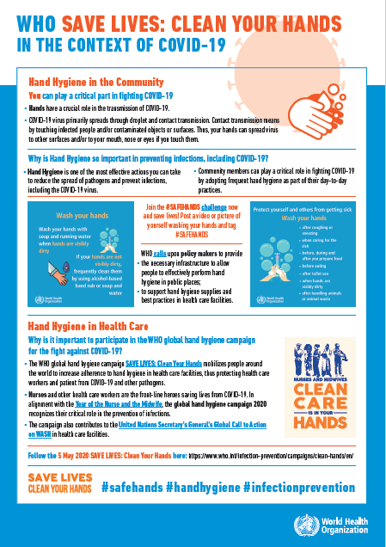
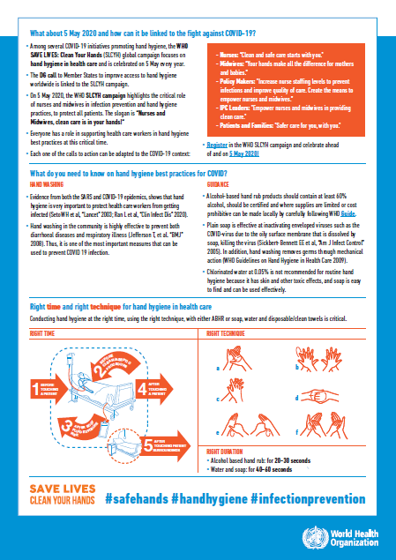
WHO’s annual hand hygiene campaign
5 May 2020
SAVE LIVES: Clean Your Hands

