Slide 1
IPC for COVID-19 – standard and transmission-based precautions, and risk assessment
Dr Mala Chhabra
Consultant, Microbiology
ABVIMS & Dr RMLH, New Delhi
malachhabra@yahoo.co.in

Slide 2
Human Coronaviruses
Community-acquired HCoVs
1.HCoVs 229E
2.OC43( Organ culture)
3.NL63 (New Heaven Coronaviruses )
4.HKU-1
SARS (Severe Acute Respiratory Syndrome) CoV – 2003 -2004
Middle East respiratory syndrome coronavirus, or MERS‐CoV - 2012
Notes:
Cause mild but occasionally more severe community-acquired acute respiratory infections in humans.
SARS – 8439 cases, 812 deaths, 30 countries in 7-8 months, CFR 9.6%
MERS – 27 countries, 80% Saudi Arabia, CFR - ~ 35%

Slide 3
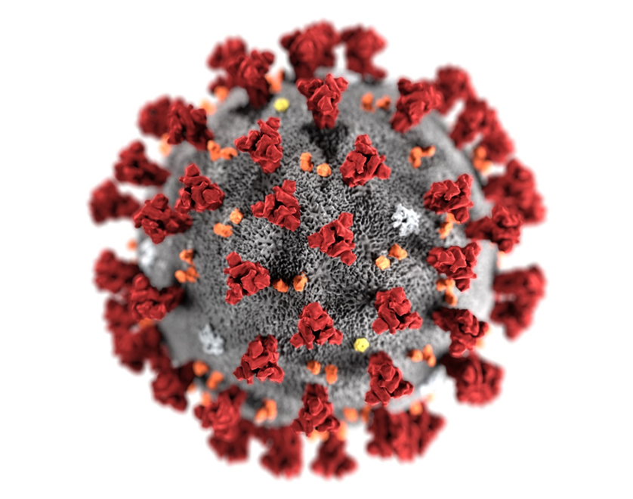

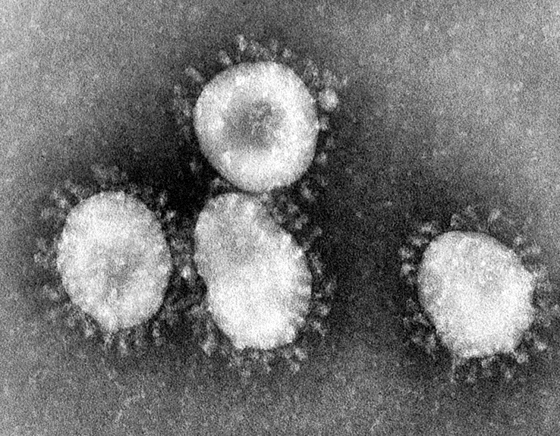
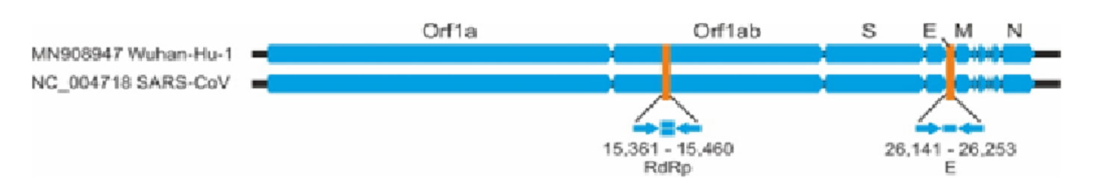
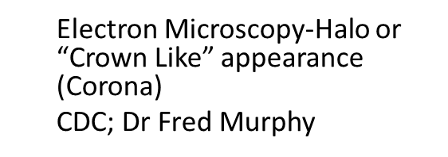
Novel Coronavirus - SARS-CoV-2
Disease – COVID 19
Enveloped RNA virus
Size: 1.2 microns
4 structural proteins and a strand of RNA
S-spike; E-envelope; M-membrane; N-nucleocapsid
Notes:
RNA virus, approx 30 kilobases, positive sense, single stranded.
N protein holds the RNA genome, and the S, E, and M proteins together create the viral envelope

Slide 4
Modes of transmission of SAR-CoV-2
Primarily transmitted through
  Droplet transmission – respiratory droplets (>5-10 μm) – close contact (1 m)
  Contact
    Direct with infected patient
    Indirect – fomites
  Airborne transmission – droplet nuclei (<5 μm) – only during aerosol generating procedures
  Airborne transmission may be possible in specific circumstances in which procedures or support treatments that generate aerosols are performed e.g. endotracheal incubation, open suctioning, manual ventilation before intubation, non-invasive positive pressure ventilation, tracheostomy and cardiopulmonary resuscitation etc.
WHO | Scientific brief | 29 March 2020 | available online
Notes:
Droplet transmission occurs:
When person is in close contact (within 1.5 m) with some one who has respiratory symptoms (e.g. coughing/sneezing)
Risk of having his/her mucosae (mouth or nose) or conjunctiva exposed to potentially infective respiratory droplets
Contact transmission occurs:
Direct contact with infected people
Indirect contact with surfaces or fomites in the immediate environment around the infected person or with objects used on the infected person (e.g. stethoscope, thermometer)
WHO continues to recommend
Droplet and contact precautions
Airborne precautions for AGP according to risk assessment
Importance of rational and appropriate use of PPE
Hand hygiene, respiratory etiquette & environmental cleaning/disinfection
Physical distancing and avoidance of close, unprotected contact with people
AGP – endotracheal intubation, bronchoscopy, open suctioning, administration of nebulized treatment, manual ventilation before intubation, turning the patient to prone position, disconnecting the patient from ventilator, non-invasive positive-pressure ventilation, tracheostomy and cardiopulmonary resuscitation

Slide 5
What is infection prevention and control?
Infection prevention and control is
a scientific approach with
practical solutions designed to prevent harm, caused by infections, to patients and health care workers
grounded in principles of infectious disease, epidemiology, social science and health system strengthening, and
rooted in patient safety and health service quality
Source: WHO Infection Prevention and control web pages;; https://www.who.int/gpsc/ipc/en/
Notes:
Infection prevention and control (IPC) is a scientific approach and practical solution designed to prevent harm caused by infection to patients and health workers. It is grounded in infectious diseases, epidemiology, social science and health system strengthening. IPC occupies a unique position in the field of patient safety and quality universal health coverage since it is relevant to health workers and patients at every single health-care encounter.

Slide 6







Who is at risk of infection?
Everyone
Notes:
Who is at risk of infection?
( Give participants about 10-15 seconds then click and the word everyone will appear)

Slide 7
Benefits of IPC
Protecting yourself
Protecting your family, community & environment
Protecting your patients
WHO2015 Safe & Quality Health Services Package
Notes:
Source: WHO2015 Liberia Safe & Quality Health Services Package
Proper adherence to standard infection prevention and control practices can help to protect you, as the health care worker, your patients and ultimately, your family and community,

Slide 8
IPC goals in outbreak preparedness​
To reduce transmission of health care associated infections​
To enhance the safety of staff, patients and visitors​
To enhance the ability of the organization/health facility to respond to an outbreak ​
To lower or reduce the risk of the hospital (health care facility) itself amplifying the outbreak​

Slide 9
Role of the IPC focal point, team or committee
Knowledge: have an understanding of the IPC strategies needed for outbreaks/epidemics, etc.
Assessment, preparedness and readiness
Policy and SOPs development
Participate in response and recovery
Participate in surveillance & monitoring
Patient management
Infrastructure for patient management
Education
Notes:
We won’t have enough time for this part of the session but what do you think is the role of the IPC Focal Point, the IPC Team or Committee in Outbreak Preparedness. Please write just one on a post-it.
These next few slides should help to add some clarity to the role of The IPC focal point/team/committee in outbreak preparedness.
As the IPC focal point, your first responsibility is your knowledge. You need to have a good understanding of IPC and the strategies needed to reduce risks and be prepared for outbreak situations. This is acquired through face-to-face or online courses participated during your academic study, training/s you have participated, readings, experience, research and networking. IPC requires continuous learning.

Slide 10
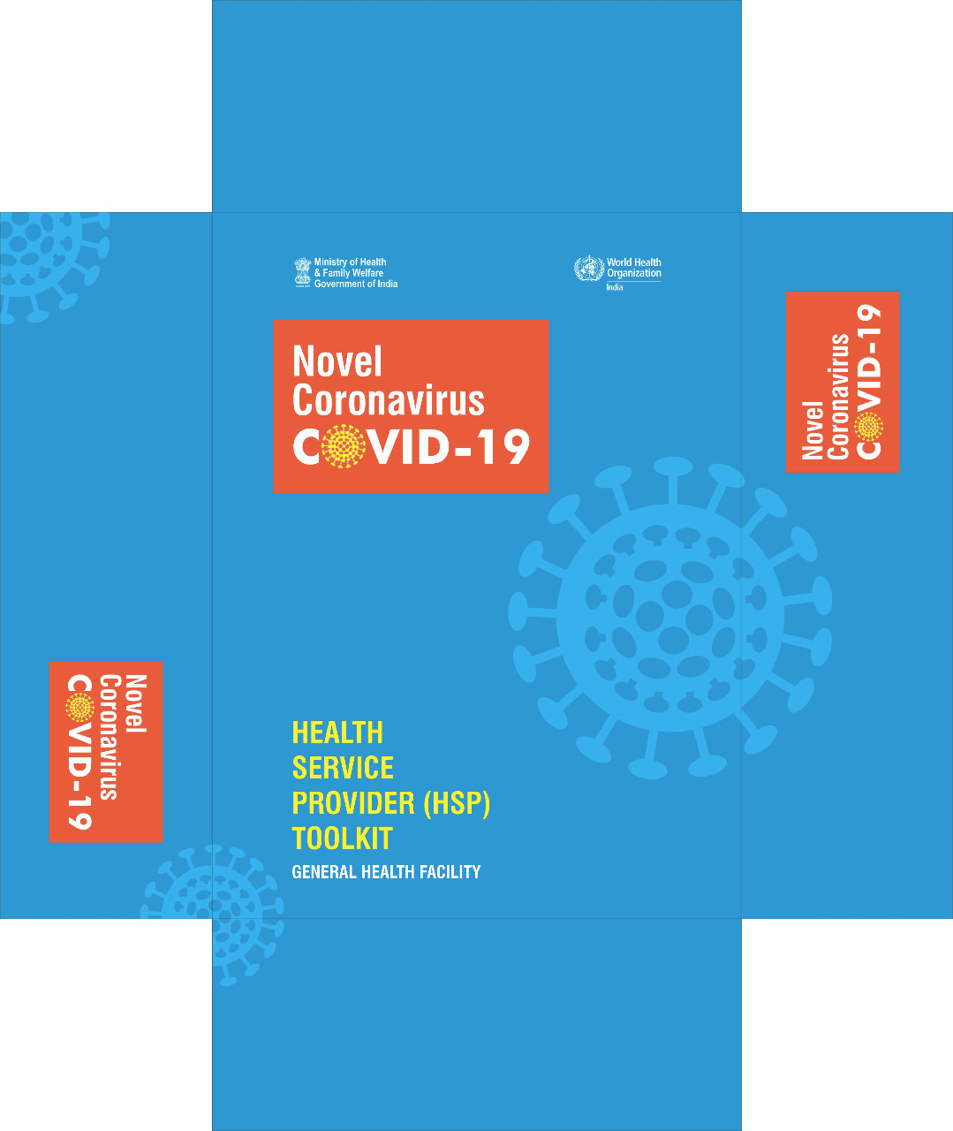
IPC strategies

Slide 11
IPC strategies for preventing/limiting the spread of COVID-19
Applying standard precautions for all patients
Ensuring triage, early recognition, and source control
Implementing empiric additional precautions for suspected cases of COVID-19 infection
Implementing administrative controls
Using environmental and engineering controls

Slide 12
Standard Precautions

Slide 13
Standard precautions
The basic level of IPC precautions, to be used for ALL patients at ALL times regardless of suspected or confirmed status of the patient
Notes:
Standard precautions are the cornerstone for prevention in all health care settings. They are a set of precautions aiming to protect both HCW and patients from infectious agents. Standard precautions are recommended for care of all patients regardless of their suspected or confirmed diagnosis in any health care setting.
Transmission-based precautions are additional precautions used for patients that are suspected or confirmed to be infected or colonized with certain pathogens for which the mode of transmission is known. They are used in addition to Standard Precautions.
Transmission-based Precautions include:
Contact
Droplet
Airborne
The type of precaution assigned to a patient will depend on the mode of transmission of the suspected or confirmed pathogen. This will be discussed n a later module.
Risk assessment is a concept that every health care worker should be able to do; identifying sources of infection or actions that can lead to infections both for themselves or their patients. It relies on an understanding of “why” IPC is implemented, and not just memorization of “what.”.
All r health care workers should constantly assess risk related to their activities.

Slide 14
Elements of Standard Precautions
Hand hygiene
Respiratory hygiene (etiquette)
PPE according to the risk
Safe injection practices, sharps management and injury prevention
Safe handling, cleaning and disinfection of patient care equipment
Environmental cleaning
Safe handling and cleaning of soiled linen
Waste management
Notes:
There are several core elements to Standard precautions. These include
1. Clean your hands
2. Practice respiratory hygiene-cougher your coughs and sneezes
3. Wear protective equipment-according to your risk assessment
4.Handle sharps carefully, use aseptic technique to deliver injections
5.Properly clean and disinfect/sterilize patient care equipment
6. Maintain a clean and disinfected environment
7. Safe handling and cleaning of soiled linen
8. Properly dispose of waste
We will go through all of these in more detail later.

Slide 15
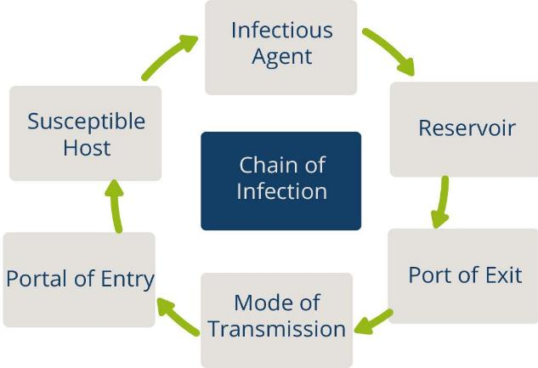
Chain of Transmission
For an infection to spread, all links must be connected
Breaking any one link will stop disease transmission!
Notes:
An infection occurs when a microorganism enters the body, increases in number, and damages tissues in the body. The diagram represents the chain of infection. For any infection to spread, all steps in the chain must occur. The key to stopping the spread of infection is to break at least one link within the chain.

Slide 16
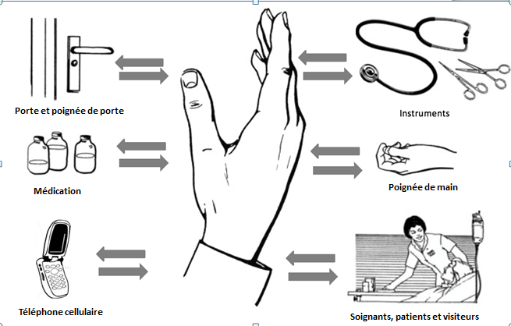
Hand Hygiene
Best way to prevent the spread of germs in the health care setting and community
Our hands are our main tool for work as health care workers- and they are the key link in the chain of transmission
Door handles
Instruments
Medication
Cellphones
Caregivers
Notes:
Why is hand hygiene important? Studies have shown that the best way to prevent the spread of germs (micro-organisms) in health care settings and in your community is through good hand hygiene practices.
Up to 30% of health care infections are preventable, many through proper hand hygiene.
Good hand hygiene protects you, your patients and your co- workers

Slide 17
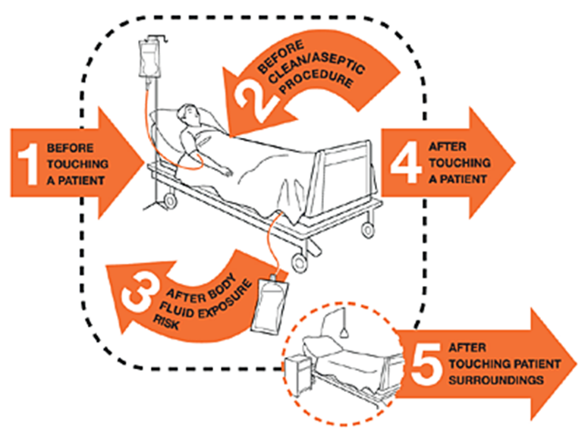
Hand hygiene: WHO 5 moments

Slide 18
Hand hygiene: HOW
Use appropriate product and technique
Alcohol-based hand rub product is preferable, if hands are not visibly soiled
  Rub hands for 20–30 seconds!
Soap, running water and single use towel, when visibly dirty or contaminated with proteinaceous material
  Wash hands for 40–60 seconds!
https://www.who.int/infection-prevention/tools/hand-hygiene/en/
Notes:
Source: Hand hygiene link: https://www.who.int/infection-prevention/tools/hand-hygiene/en/

Slide 19
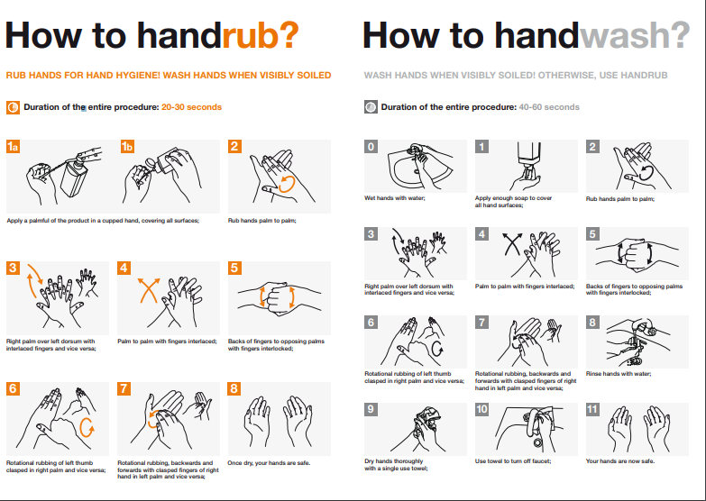
https://www.who.int/infection-prevention/tools/hand-hygiene/en/
Notes:
Source: Hand hygiene link: https://www.who.int/infection-prevention/tools/hand-hygiene/en/

Slide 20


Respiratory hygiene/etiquette
Reduces the spread of microorganisms (germs) that cause respiratory infections (colds, flu)
  Turn head away from others when coughing/sneezing
  Cover the nose and mouth with a tissue.
  If tissues are used, discard immediately into the trash
  Cough/sneeze into your sleeve if no tissue is available
  Clean your hands with soap and water or alcohol based products
Do not spit here and there!
Image source: https://www.who.int/emergencies/diseases/novel-coronavirus-2019/advice-for-public
Notes:
Some basic measures we can all do ourselves and encourage our patients and family or community members to do are:
Turn your head away from others when coughing/sneezing
Cover your nose/mouth with a tissue-and then immediately dispose of it n the garbage/trash
If there is no tissue available, cough into your sleeve –not your hands!
Always clean your hands with soap and water or alcohol hand sanitizer after coughing, sneezing or blowing your nose.

Slide 21

Promoting respiratory hygiene
Encourage handwashing for patients with respiratory symptoms
Provide masks for patients with respiratory symptoms
Patients with fever + cough or sneezing should be kept at least 1m away from other patients
Post visual aids reminding patients and visitors with respiratory symptoms to cover their cough
Notes:
There are some additional steps we can take in the health care setting to protect our patients and ourselves. These include :
Encouraging our patients to clean their hands if they re coughing/sneezing
Provide a mask for a patients who has respiratory symptoms and patients who have a fever and a cough or sneezing should be kept at least 1m or more away from other patients.
Can you think if this is possible in your health care setting( are beds >1m apart? What about in the waiting room of a hospital emergency room or a health clinic? Where do you put patients who have a fever and are coughing?
Consider having tissues and masks available for patients in patient care areas. Finally, we an post signs reminding patients to cover their coughs and wash their hands.

Slide 22
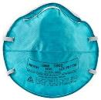
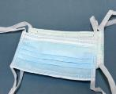
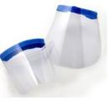
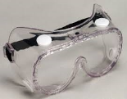
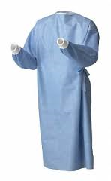

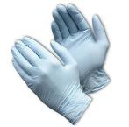
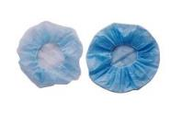
PPE for use in health care for COVID-19
Face Mask
N95 Mask
Face shield
Goggle
Nose + mouth
Nose + mouth
Eyes + nose + mouth
Eyes
Gown
Apron
Gloves
Head cover
Body
Body
Hands
Head + hair
Notes:
Source: WHO2015 Liberia Safe & Quality Health Services Package
These are some examples of the different types of PPE.
( review the slide)
*NOTE-this is an opportunity to highlight the products available in your facility- If you have some samples bring them with you

Slide 23
Minimize direct unprotected exposure to blood and body fluids
Risk assessment for
appropriate use of PPE
EYE-WEAR | MEDICAL MASK | GOWN | GLOVES | HAND HYGIENE | SCENARIO
 |  |  |  | x | Always before and after patient contact, and after contaminated environment
 |  |  | x | x | If direct contact with blood and body fluids, secretions, excretions, mucous membranes, non-intact skin
 |  | x | x | x | If there is risk of splashes onto the health care worker’s body
x | x | x | x | x | If there is a risk of splashes onto the body and face
Rational use of PPE : https://www.mohfw.gov.in/pdf/GuidelinesonrationaluseofPersonalProtectiveEquipment.pdf
https://www.mohfw.gov.in/pdf/AdditionalguidelinesonrationaluseofPersonalProtectiveEquipmentsettingapproachforHealthfunctionariesworkinginnonCOVIDareas.pdf

Slide 24
Principles for using PPE (1)
Always clean your hands before and after wearing PPE
PPE should be available where and when it is indicated
  in the correct size
  select according to risk or per transmission based precautions
Always put on before contact with the patient
Always remove immediately after completing the task and/or leaving the patient care area
Notes:
There are a few important principles that need to be followed when using PPE.
PPE should be available where an when it is needed. If you have to go to anther place to get your PPE ,chances are you won wear it when needed. So it is very important that management and supervisors ensure PPE is always available.
If you cant find the PPE you need, you need to inform your supervisor or manager.
PPE should fit –it needs to be the correct size in order to provide adequate protection. For example, gloves that are too small may tear, gloves that are too big may allow body fluids to get inside or make tasks difficult to perform.
Always perform a risk assessment before selecting your PPE. WE will talk more about this.
Always put on PPE before contact with the patient or the task you are going to do and remove it immediately after you are finished.
Remove PPE as soon as you are finished the care or task and before leaving the patient area.( do not walk to another area or patient bed in your PPE! )
Disposable PPE must never be reused. Reusable PPE must be cleaned and disinfected between each use

Slide 25
Principles for using PPE (2)
Change PPE immediately if it becomes contaminated or damaged
PPE should not be adjusted or touched during patient care
Specifically
  Never touch your face while wearing PPE
  If there is concern and/or breach of these practices, leave the patient care area when safe to do so and properly remove and change the PPE
  Always remove carefully to avoid self-contamination (from dirtiest to cleanest areas)
Notes:
A few more points to remember. Always remove PPE carefully so you don’t contaminate yourself. WE will practice this later.
If you PPE becomes damaged or contaminated , stop what you are doing and change it immediately
If the PPE is disposable- never reuse it. Discard it appropriately.

Slide 26
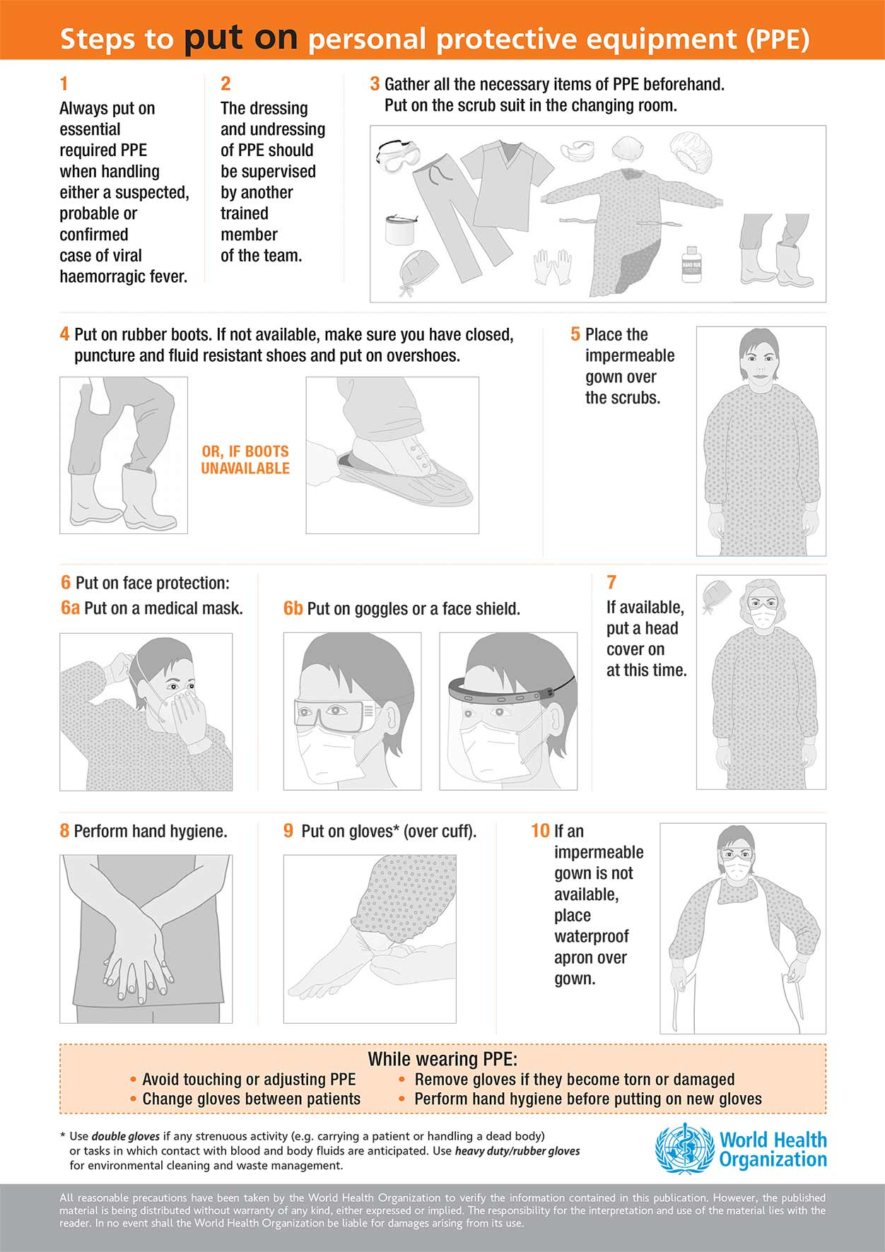
Train Yourself
When in doubt- ASK
Contact
IPC Personnel

Slide 27
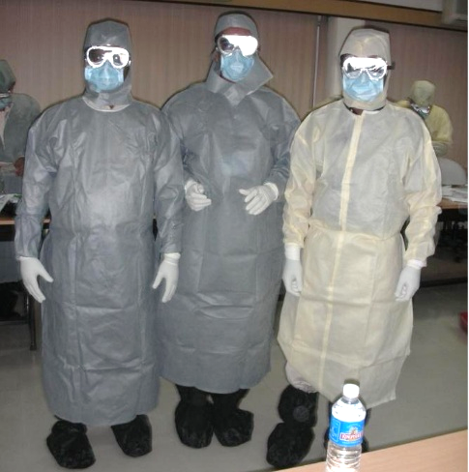
PPE
Separate areas
Buddy
Mirror
Chair in donning &
doffing area (cleanable)

Slide 28
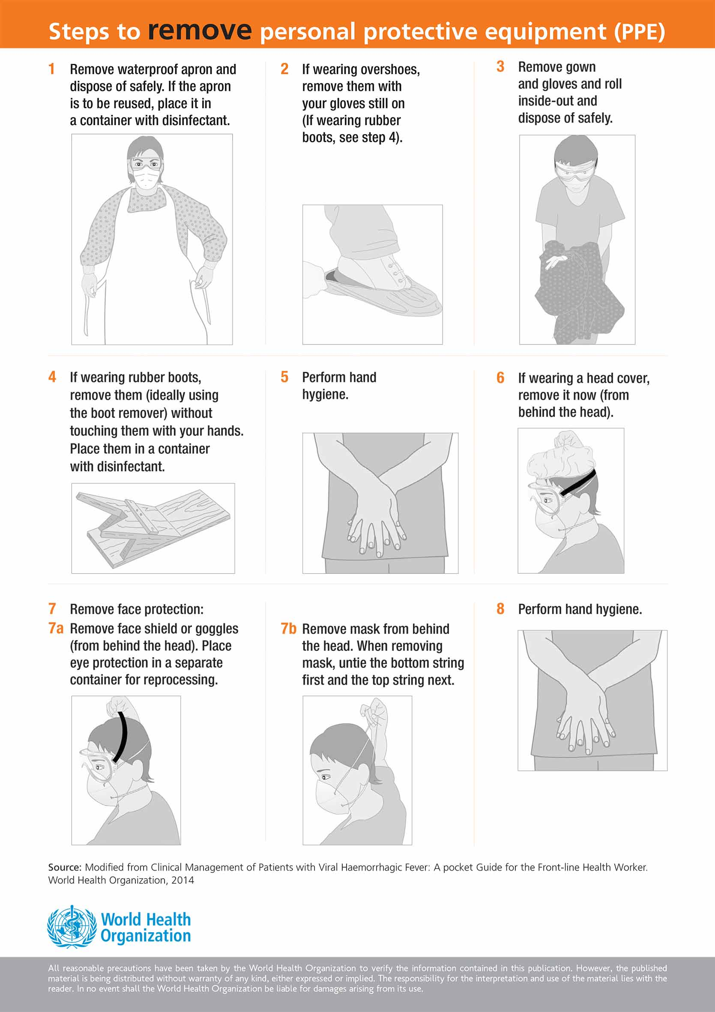
Train Yourself
When in doubt- ASK
Carefully Remove PPE for self protection

Slide 29
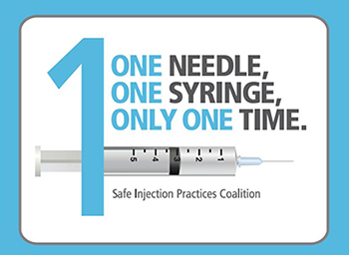
The seven steps to safe injections
Clean work space
Hand hygiene
Sterile safety-engineered syringe
Sterile vial of medication and diluent
Skin cleaning and antisepsis
Appropriate collection of sharps
Appropriate waste management
https://www.who.int/infection-prevention/tools/injections/training-education/en/
Notes:
There are 7 steps to giving a safe injection. It is important that anyone giving injections follow these steps, to protect your patient and yourself

Slide 30
Environment cleaning, disinfection and BMWM
It is important to ensure that environmental cleaning and disinfection procedures are followed consistently and correctly
Thorough cleaning environmental surfaces with water and detergent and applying commonly used hospital level disinfectants (sodium hypochlorite, 0.5%, or ethanol, 70%) are effective and sufficient procedures
Medical devices and equipment, laundry, food service utensils and medical waste should be managed in accordance with safe routine procedures

Slide 31
Additional Precautions

Slide 32
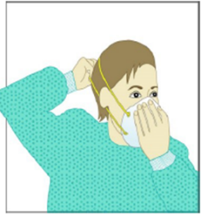
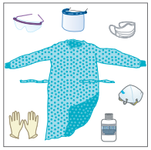

Patients suspected or confirmed COVID-19 (1)
Contact and droplet precautions for all patients with suspected or confirmed COVID-19
Airborne precautions are recommended only for aerosol generating procedures (i.e. open suctioning of respiratory tract, intubation, bronchoscopy, cardiopulmonary resuscitation)
Preferably patient should be in a single room:
  Natural ventilation with air flow of at least 160 L/s per patient or
  Negative pressure rooms with at least 12 air changes per hour and controlled direction of air flow when using mechanical ventilation
Cohort all patients with respiratory illness in a single room, or minimum 1m away from other patients when waiting for a room
Dedicated & trained HCW
HCW to wear PPE: a medical mask, goggles or face shield, gown, and gloves
Hand hygiene should be done any time the WHO “5 Moments” apply, and before PPE and after removing PPE

Slide 33
Patients suspected or confirmed COVID-19 (2)
Equipment should be single use when possible, dedicated to the patient and disinfected between uses
Portable machines in hospitals
Avoid transporting suspected or confirmed cases – if necessary, have patients wear masks; HCW should wear appropriate PPE. Define corridors in the hospital for patient transportation.
Routine cleaning of the environment is crucial
Limit the number of HCW, visitors, and family members who are in contact with the patient. If necessary, everyone must wear PPE
All persons entering patients’ room (including visitors) should be recorded (for contact tracing)
Precautions should continue until the patient is asymptomatic
Notes:
There are some additional steps we can take in the health care setting to protect our patients and ourselves. These include :
Encouraging our patients to clean their hands if they re coughing/sneezing
Provide a mask for a patients who has respiratory symptoms and patients who have a fever and a cough or sneezing should be kept at least 1m or more away from other patients.
Can you think if this is possible in your health care setting( are beds >1m apart? What about in the waiting room of a hospital emergency room or a health clinic? Where do you put patients who have a fever and are coughing?
Consider having tissues and masks available for patients in patient care areas. Finally, we an post signs reminding patients to cover their coughs and wash their hands.

Slide 34



Outpatient Care
The basic principles of IPC and standard precautions should be applied in all health care facilities, including outpatient care and primary care
  Triage and early recognition
  emphasis on hand hygiene, respiratory hygiene and medical masks to be used by patients with respiratory symptoms (consider having signage)
  if possible – place patients in separate rooms or away from other patients in the waiting rooms, and wear mask, gloves and gown if possible when seeing them in the clinic (as much of contact and droplet precautions as possible)
  when symptomatic patients are required to wait, ensure they have a separate waiting area (1m separation)
  prioritization of care of symptomatic patients
  educate patients and families about the early recognition of symptoms, basic precautions to be used and which health care facility they should refer to
Notes:
Source: Public Health Measures for Scaling up National Preparedness Middle East Respiratory Syndrome (MERS)
http://applications.emro.who.int/docs/EMROPub_2018_EN_16794.pdf?ua=1&ua=1

Slide 35
Additional Control Measures

Slide 36
Notes:
Source: https://www.cdc.gov/niosh/topics/hierarchy/default.html

Slide 37
Administrative Controls
Provision of adequate training for HCWs
Ensuring an adequate patient-to-staff ratio
Establishing a surveillance process for acute respiratory infections potentially caused by COVID-19 among HCWs
Ensuring that HCWs and the public understand the importance of promptly seeking medical care
Monitoring HCW compliance with standard precautions and providing mechanisms for improvement as needed

Slide 38
Use of masks
Use of mask – limit spread of certain respiratory diseases
Mask alone is insufficient to provide the adequate level of protection and other equally relevant measures should be adopted – hand hygiene
Wearing medical masks when not indicated may cause
  unnecessary cost
  procurement burden
  create a false sense of security that can lead to neglecting other essential measures such as hand hygiene practices
Using a mask incorrectly may hamper its effectiveness to reduce the risk of transmission

Slide 39
Use of masks: healthcare settings
Individuals with respiratory symptoms should:
Wear a medical mask while waiting in triage or waiting areas or during transportation within the facility
Wear a medical mask when staying in cohorting areas dedicated to suspected or confirmed cases
Do not wear a medical mask when isolated in single rooms but cover mouth and nose when coughing or sneezing with disposable paper tissues
Health care workers should:
Wear a medical mask while providing care to the patient
Use a particulate respirator N95 (NIOSH certified) , FFP2 (EU standard), or equivalent, when performing aerosol generating procedures (tracheal intubation, non-invasive ventilation, tracheotomy, cardiopulmonary resuscitation, manual ventilation before intubation, and bronchoscopy

Slide 40
Masks management
Place mask carefully to cover mouth and nose and tie securely to minimise any gaps between the face and the mask
While in use, avoid touching the mask
Remove the mask by using appropriate technique (i.e. do not touch the front but remove the lace from behind)
After removal or whenever you inadvertently touch a used mask, clean hands by using an alcohol-based hand rub or soap and water if visibly soiled
Replace masks with a new clean, dry mask as soon as they become damp/humid
Do not re-use single-use masks
Discard single-use masks after each use and dispose of them immediately upon removal

Slide 41
Risk = likelihood and consequences

Slide 42
Risk assessment
Risk assessment: risk of exposure and extent of contact anticipated with respiratory droplets, blood, body fluids, and/or open skin
  Select which PPE items to wear based on this assessment
  Perform hand hygiene according to the WHO “5 Moments”
  Should be done for each patient, each time
Make this routine!
Notes:
In health care risk assessment is also an evaluation of the interaction that is about to take place between the health care worker, the patient and the patient environment to assess and analyze the potential for exposure to to blood, body fluids ,respiratory droplets and /or open skin.
The health care worker should perform a risk assessment for each interaction with a patient and select the required PPE.
This needs to be part of the patient care routine

Slide 43
Early identification of Healthcare workers/patients with suspected infection due to COVID-19
Establish facility-based surveillance for healthcare-associated infections (HAIs) of all HCWs and admitted patients
For HCWs: self monitoring or preferably active monitoring (before every shift)
In case a HCW is exposed to infected patient/HCW, quickly do contact tracing
Contact person
  Symptomatic case - any person who has had contact with a COVID-19 case within a time frame ranging from 48 hrs before the onset of symptoms
  Asymptomatic cases - 48 hrs before the sample which led to confirmation was taken, to 14 days after the onset of symptoms or after the sample was taken.
If any contact is found to be symptomatic, immediately restrict from work until medical evaluation is completed

Slide 44
Risk assessment of contact HCWs
Asymptomatic HCW - determine risk category of exposure whether high risk or low risk
  High risk/close contacts-quarantined and actively monitor for symptoms
    In no symptoms develop, return to work after 14 days
    Should symptoms develop, self-isolate immediately and seek medical advice and test for COVID-19
        If test negative, return to work after 14 days
        If test positive, notify for further public health action
  Low risk contacts to continue to work and monitor for development of symptoms. In case symptoms develop, testing to be done:
        If test is negative, return to work once symptoms resolved
        If test is positive, HCW immediately restrict from work, notify case for further public health action
  HCW infected with COVID-19 may return to work once symptoms have resolved and two samples taken at interval of 24 hrs are negative

Slide 45
Additional precautions to be taken by HCWs
For maintaining continuity of operations, staffing plan in place including a contingency plan to handle situations where a HCW has a high risk exposure/develops symptoms and needs to be to be restricted from work
To prevent transmission of infection to family members
  Workplace
    avoid carrying accessories to workplace like wallets (driving licence and credit card may be carried in Ziploc bag)
    pens to be kept in lockers at workplace not to carry home, no lanyards etc.
    thoroughly wash hands, forearms and elbow at the end of the day before leaving workplace
  Reaching Home
    must change clothes and wash them
    minimize physical contact with family members
    wash hands frequently

Slide 46
Summary
IPC is key for containment
Based on key principles - hand hygiene, respiratory etiquette, safe distance
Hospital infection prevention & control - standard & additional precautions
  Protect yourself and the community
  Triage & admissions
  PPE
    Judicious and appropriate use
    Pay attention to donning and doffing
Home care precautions

Slide 47

Thank you

