Slide 1

Triage, Source Control and Additional Control Measures
IPC Webinar
Dr Purva Mathur MD
All India Institute of Medical Sciences
New Delhi
Strengthening Infection Prevention & Control for COVID-19 in Healthcare Facilities – focus on Private Sector | 4 May 2020

Slide 2
What is triage?
The sorting out and classification of patients or casualties to determine priority of need and proper place of treatment
During infectious disease outbreaks, triage is particularly important to separate patients likely to be infected with the pathogen of concern
https://www.cdc.gov/coronavirus/2019-ncov/hcp/non-us-settings/sop-triage-prevent-transmission.html

Slide 3
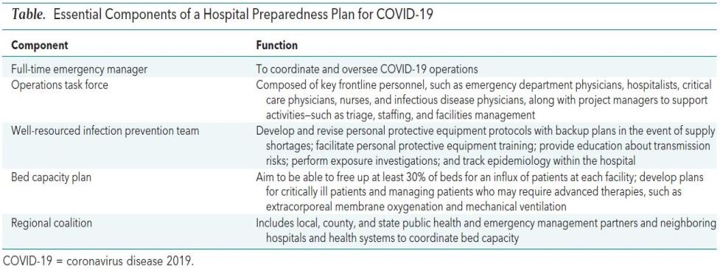
Hospital Preparedness Plan
How Should U.S. Hospitals Prepare for Coronavirus Disease 2019 (COVID-19)? Ann Intern Med. Published online March 11, 2020. doi:10.7326/M20-0907

Slide 4
Preparing for Triage
Post clear signs at healthcare facility entrance to direct patients to
  Telemedicine facility
  Those with fever and respiratory symptoms like cough or breathing difficulty – immediately proceed to triage or registration desk
Additional symptoms to consider
  Chills
  Repeated shaking with chills
  Muscle pain
  Headache
  Sore throat
  New loss of taste or smell
https://www.cdc.gov/coronavirus/2019-ncov/symptoms-testing/symptoms.html

Slide 5
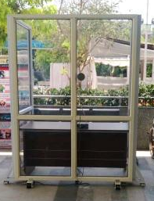
Protecting the healthcare staff
Install physical barriers (e.g. glass/plastic screens) at registration desk to limit close contact between triage staff and patients
Identify isolation rooms or separate well-ventilated rooms where suspected COVID-19 patients will be placed while waiting for examination
Provide masks/ face covers for all patients visiting the HCF

Slide 6
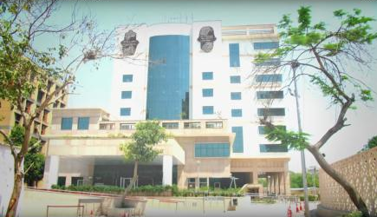
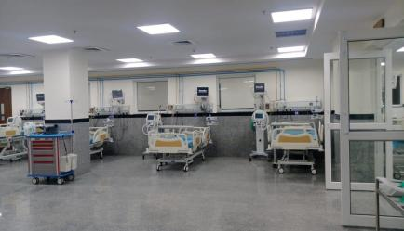
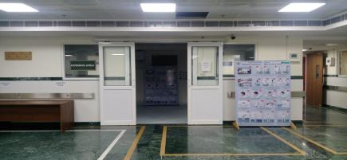
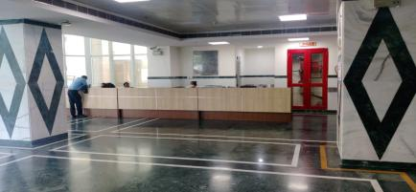
Screening & Isolation facility at AIIMS, New Delhi

Slide 7
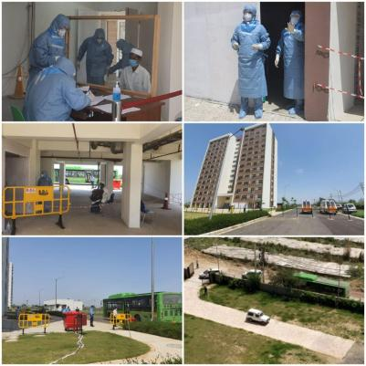
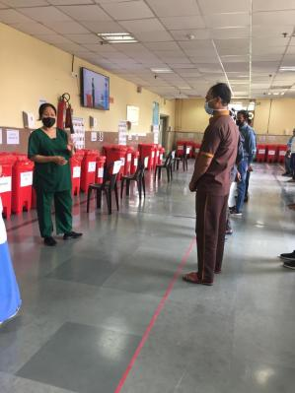
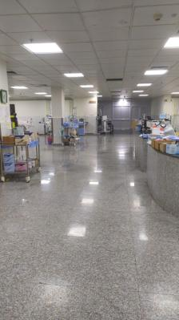
NCI Jhajjhar
JPNA Trauma Center Covid ICU

Slide 8
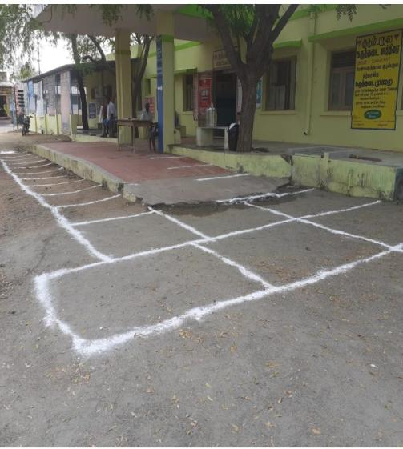
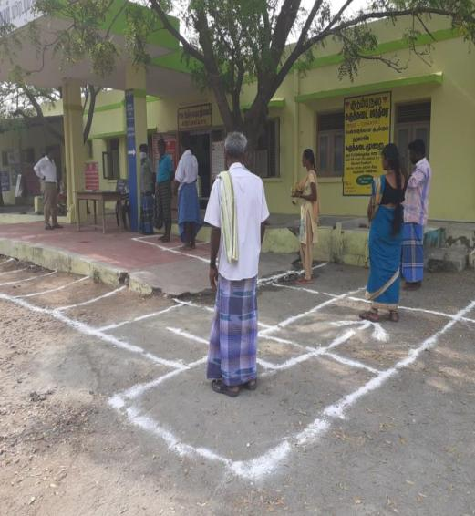
Social distancing -Triage outside the healthcare facility, PHC, Tamil Nadu
21

Slide 9
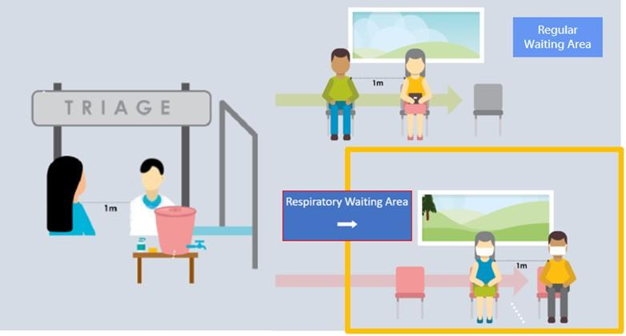
Setting up triage & waiting area
WPRO: The COVID-19 risk communication package for healthcare facilities

Slide 10
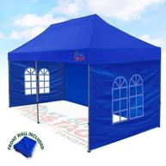




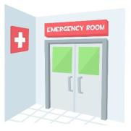


COVID-19 Triage area
One meter distance between all patients and given masks
Outside Triage area
– Signage directs
patients to different areas based on symptoms
This Photo by Unknown Author is licensed under CC BY-SA
Hospital Triage area
This Photo by Unknown Author is licensed under CC BY-SA

Slide 11
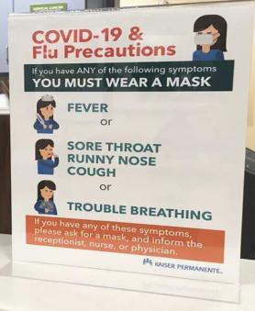
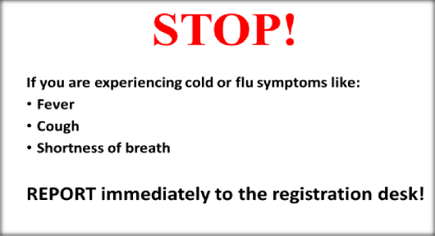
Sample visual alerts to post at facility entry

Slide 12
Protecting healthcare workers at triage
All HCWs performing triage activities should adhere to standard precautions at all times
  These HCWs should have convenient access to hand hygiene products
HCWs conducting preliminary screening that does not require direct patient contact should maintain at least 1 m distance
  These activities included interviewing patients about symptoms
  Exposures and/or taking temperatures with non-contact infrared thermometer
HCWs conducting physical examination of patients with respiratory symptoms should wear gowns, gloves, face mask, and eye protection (goggles/face shield)

Slide 13
Performing triage
Patients presenting for care should be screened for signs and symptoms of respiratory infection and potential COVID-19 exposures at the triage station
The questions asked during triage may vary depending on the COVID-19 epidemiological situation in the area
  If there is no or little transmission in the community, then patients should be asked about recent travel history or contact with a patient with COVID-19
  If there is widespread community transmission, questions about travel or contact with other COVID-19 patients are less relevant given the increased risk in the community
Triage should be conducted according to protocols from local public health authorities

Slide 14
Isolation of suspect COVID-19 cases
Patients who are identified as suspect COVID-19 cases through triage process must be
  Separated from other patients as soon as possible
  Given a face mask and ask them to put it on
  If face masks are not available, patients should cover their mouth with a cloth
  Place the patient in a single-person room with the door closed
If single-person rooms are not available, designate a separate, well-ventilated area for these patients and ensure they maintain 1 m separation from each other
Only essential HCWs designated to care for suspect COVID-19 patients should enter the isolation area wearing appropriate PPE
Ensure that HCWs caring for patients in the isolation area adhere to standard, contact, and droplet precautions and follow strict donning and doffing protocols

Slide 15
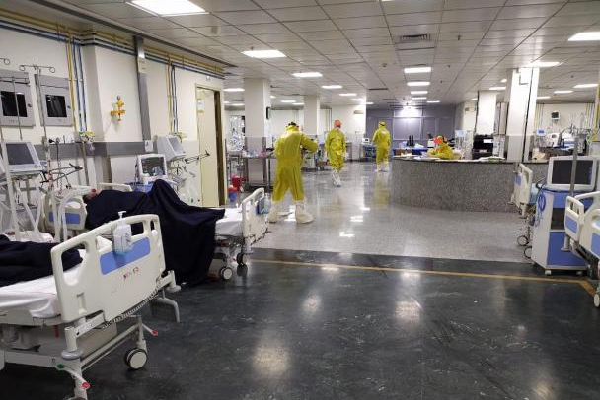
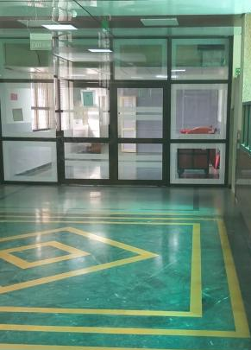
Isolation facility at AIIMS, New Delhi

Slide 16
Inpatient care strategies for COVID-19
Initial cases admitted in AIIR isolation rooms
You need to revisit your admission plan based on the case surge at your facility
Cohorting in isolation rooms/ wards
Cohorting in specific units
(may require adjustment of ventilation)
Units and floors converted to cohort units
Designated unit may be needed for non-infectious hospitalized patients

Slide 17
Emergency department – care strategies
Emergency departments often operate at or above capacity on a daily basis
In addition to above strategies for outpatient care, EDs should consider
  Diversion of non-critical possible COVID-19 cases at a triage point, prior to ED entry
  – “parking lot triage”
  Use of specific space (e.g. urgent care, pediatric, same-day surgery) for COVID-19 patients subject to appropriate isolation of that area from an air-handling and patient movement standpoint
  Use of discharge waiting areas (if not routinely used)
  Change in patient flow, placement and charting that can expedite non-emergency visits
  Coordination with EMS, including through telephone triage, to avoid ED visits that can safely be cared for as outpatients

Slide 18
IPC in Critical Care for COVID-19
Patients should wear simple flexible fabric masks to reduce droplet generation unless wearing an oxygen mask
Intermittent rather than continuous oximetry and cardiac monitoring may be instituted with separate for each patient
Use inhalers in lieu of nebulized medications to reduce droplet generation
Coordinate with critical care physicians regarding
  Threshold for intubation
  Use of bridging techniques (e.g. high flow cannula/BiPAP)
  Requirement of special area and augmented PPE for providers given the higher risk of aerosol generation

Slide 19
IPC in critical care
Use rapid sequence intubation (RSI) techniques to minimize aerosol generation
Aggressively control and suppress patient cough, as possible
Consider more aggressive sedation/paralysis strategies to reduce coughing
Reduce suctioning as possible
Use of High Efficiency Particulate Air (HEPA) filters on ventilators or at minimum in-line HME/HEPA filters on the endotracheal tube
Monitor MoHFW and latest literature to determine potential efficacy of antivirals and other therapies; currently there are no known effective medications and limited evidence for bacterial super-infection

Slide 20
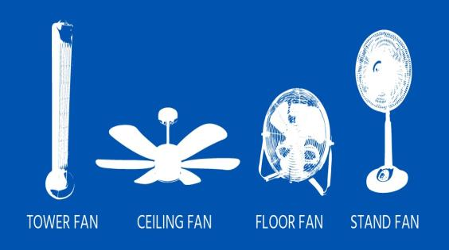
Airborne Infection Control: Ventilation

Slide 21
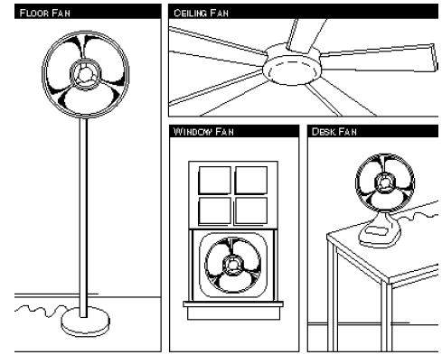
Fans in isolation wards – key factors
Choose the fan based on what you want the fan to do
Cool ambient temperature through dissipation of radiant heat
Provide directionality in order to improve ventilation
  Intake – suck air out of the room
  Out-take – blow air in the room
Cools and mixes the air
Directs the air
Exhausts the air
Directs the air

Slide 22



Using fans in isolation wards – key factors
Direction of fans should deflect air away from health care workers
  i.e. airflow should go from health care worker to patient
The use of either fans pictured would work

Slide 23
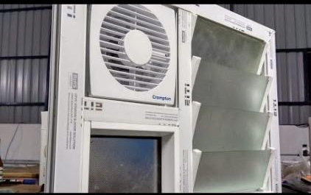
Can I use fans to direct airflow?
Yes, that is the best use of fans
The best placement for fans is
  in or near windows
  to help air exhaust out of room
Make sure fans aren’t exhausting air
into busy corridors
https://tbcindia.gov.in/index1.php?lang=1&level=1&sublinkid=4519&lid=3015

Slide 24
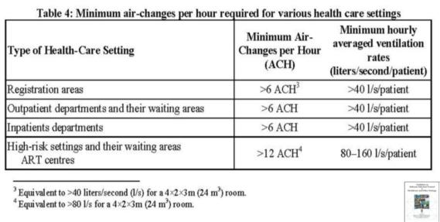
Air changes per hour (ACH) requirements
For isolation facility
  Old single rooms, ventilation with >6 ACH
  New/renovated negative pressure AIIR rooms >12 ACH
https://www.cdc.gov/coronavirus/2019-ncov/infection-control/infection-prevention-control-faq.html
https://tbcindia.gov.in/index1.php?lang=1&level=1&sublinkid=4519&lid=3015

Slide 25
How to calculate ventilation flow rate?
Wind-driven natural ventilation rate through a room with two opposite openings (e.g. a window and a door) can be calculated as follows:
ACH = 0.65 × wind speed (m/s) × smallest opening area (m²) × 3600 s/h
room volume (m³)
Ventilation rate (l/s) = 0.65 × wind speed (m/s) × smallest opening area (m2) × 1000 l/m³
https://www.who.int/water_sanitation_health/publications/natural_ventilation.pdf

Slide 26
How can opening windows and doors increase the number of air changes per hour in a ward?
Table below provides estimates of the ACH and ventilation rate due to wind alone, at a wind speed of 1 m/s
  assuming a ward of size 7 m (length) × 6 m (width) × 3 m (height)
  with a window of 1.5 × 2 m² and a door of 1 m² × 2 m² (smallest opening)
Estimated air changes per hour and ventilation rate for a 7 m × 6 m × 3 m ward
Openings | ACH | Ventilation rate (l/s)
Open window (100%) + open door | 37 | 1300
Open window (50%) + open door | 28 | 975
Open window (100%) + door closed | 4.2 | 150
https://www.who.int/water_sanitation_health/publications/natural_ventilation.pdf

Slide 27
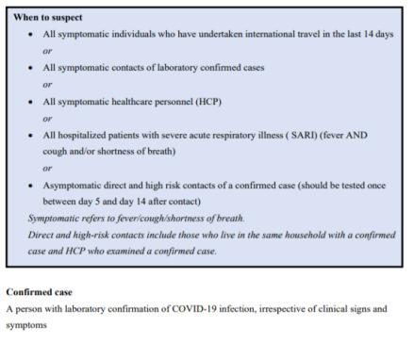
What are the guidelines for HCW who have contact with positive case?
Asymptomatic health care workers providing care to a confirmed case should be tested once between day 5 and day 14 of coming in contact
All symptomatic health care workers should be tested as per the Revised Strategy of COVID-19 testing in India (version 3; dated 20 March 2020)
The strategy changes with evidence of community transmission
Additional guidance available on ICMR and MoHFW websites
https://www.mohfw.gov.in/pdf/ICMRrevisedtestingstrategyforCOVID.pdf
D.0 Letter from MoHFW dated 20 April 2020 https://www.mohfw.gov.in/pdf/MeasuresUndertakenToEnsureSafetyOfHealthWorkersDraftedForCOVID19Services.pdf
https://www.mohfw.gov.in/pdf/RevisedNationalClinicalManagementGuidelineforCOVID1931032020.pdf

Slide 28
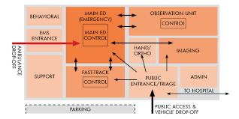
Protecting our employees' health? (1 of 3)
Three main ways to protect health care workers from getting COVID-19:
1. Limit infection entering your facility
  Cancel elective procedures
  Use telemedicine when possible
  Limit points of entry and manage visitors
  Screen patients for respiratory symptoms
  Encourage patient respiratory hygiene using alternatives to facemasks (e.g. tissues to cover cough)
https://www.cdc.gov/coronavirus/2019-ncov/infection-control/control-recommendations.html

Slide 29
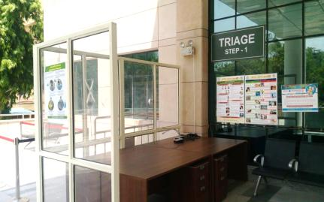
Protecting our employees' health? (2 of 3)
2. Isolate symptomatic patients as soon as possible
  Set up separate, well-ventilated triage areas
  Place patients with suspected or confirmed COVID-19 in private rooms with door closed and private bathroom (as possible)
  If available, prioritize AIIRs for patients undergoing aerosol-generating procedures
https://www.cdc.gov/coronavirus/2019-ncov/infection-control/control-recommendations.html

Slide 30
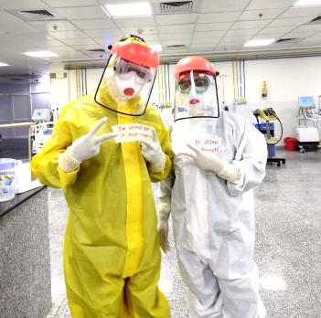
Protecting our employees' health (3 of 3)
3. Protect healthcare personnel
  Emphasize hand hygiene
  Install barriers to limit contact with patients at triage
  Cohort COVID-19 patients
  Limit the numbers of staff providing their care
  Cohort staff working in isolation wards
  Prioritize respirators and AIIRs for aerosol-generating procedures, and implement PPE optimization strategies to extend supplies
https://www.cdc.gov/coronavirus/2019-ncov/infection-control/control-recommendations.html

Slide 31
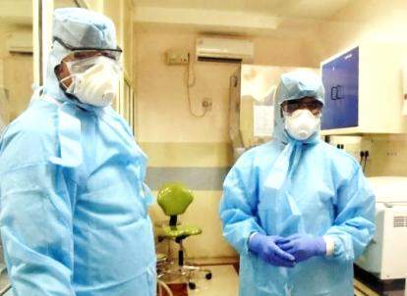
How to ensure surgeons / staff are safe when doing surgery?
Elective surgeries should be postponed
Standard infection control practices should be in place
Take precautions when performing Aerosol-Generating Procedures (AGPs)
Operating rooms should be allocated and signs posted on the doors to minimize staff exposure
If no general anesthesia:
  Patient should continue to wear the surgical mask
If general anesthesia used:
  Place a HEPA filter between the Y-piece of the breathing circuit and the patient's mask, endotracheal tube or laryngeal mask airway
  If available, use a closed suction system during airway suctioning
https://journals.lww.com/annalsofsurgery/Documents/Managing%20COVID%20in%20Surgical%20Systems%20v2.pdf
https://www.asahq.org/about-asa/governance-and-committees/asa-committees/committee-on-occupational-health/coronavirus
https://doi.org/10.1007/s12630-020-01617-4

Slide 32
Recommendations for planned surgeries
Postpone unless essential for patient outcome
Prepare OT for possible COVID-19 cases
  Educate the surgeons
  Develop preparedness plan for providing essential operations during the pandemic
  Decrease exposure of healthcare staff, particularly surgeons
  Develop dedicated COVID-19 OT
  Prepare for repurposing OT to support critical care patients
https://journals.lww.com/annalsofsurgery/Documents/Managing%20COVID%20in%20Surgical%20Systems%20v2.pdf
https://doi.org/10.1007/s12630-020-01617-4

Slide 33
Do all patients with confirmed or suspected COVID-19 need to be placed in airborne infection isolation rooms?
No
Updated CDC Interim IPC recommends placing patients in a regular examination room with the door closed
Airborne infection isolation rooms should be reserved for patients undergoing aerosol generating procedures or for diagnoses such as active tuberculosis
Patients with known or suspected COVID-19 should be cared for in a single-person room with the door closed or cohorted in well ventilated wards with beds at least one meter apart
1. https://www.cdc.gov/coronavirus/2019-ncov/infection-control/infection-prevention-control-faq.
2. htmlhttps://www.cdc.gov/coronavirus/2019-ncov/infection-control/infection-prevention-control-faq.html

